Slide 1
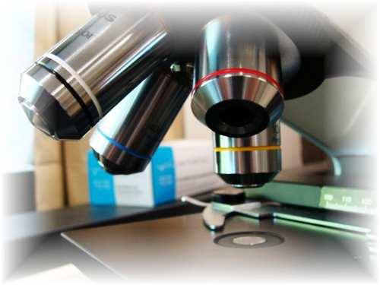
About Science Prof Online
PowerPoint Resources
Science Prof Online (SPO) is a free science education website that provides fully-developed Virtual Science Classrooms, science-related PowerPoints, articles and images. The site is designed to be a helpful resource for students, educators, and anyone interested in learning about science.
The SPO Virtual Classrooms offer many educational resources, including practice test questions, review questions, lecture PowerPoints, video tutorials, sample assignments and course syllabi. New materials are continually being developed, so check back frequently, or follow us on Facebook (Science Prof Online) or Twitter (ScienceProfSPO) for updates.
Many SPO PowerPoints are available in a variety of formats, such as fully editable PowerPoint files, as well as uneditable versions in smaller file sizes, such as PowerPoint Shows and Portable Document Format (.pdf), for ease of printing.
Images used on this resource, and on the SPO website are, wherever possible, credited and linked to their source. Any words underlined and appearing in blue are links that can be clicked on for more information. PowerPoints must be viewed in slide show mode to use the hyperlinks directly.
Several helpful links to fun and interactive learning tools are included throughout the PPT and on the Smart Links slide, near the end of each presentation. You must be in slide show mode to utilize hyperlinks and animations.
This digital resource is licensed under Creative Commons Attribution-ShareAlike 3.0 : http://creativecommons.org/licenses/by-sa/3.0/
Alicia Cepaitis, MS
Chief Creative Nerd
Science Prof Online
Online Education Resources, LLC
alicia@scienceprofonline.com
Tami Port, MS
Creator of Science Prof Online
Chief Executive Nerd
Science Prof Online
Online Education Resources, LLC
info@scienceprofonline.com
From the Virtual Biology Classroom on ScienceProfOnline.com
Image: Compound microscope objectives, T. Port
Notes:
Welcome to Science Prof Online PowerPoint Resources!
This PowerPoint Presentation comes from the Virtual Cell Biology Classroom of Science Prof Online, and, as such, is licensed under Creative Commons Attribution-ShareAlike 3.0.; meaning you can download, share and alter any of this presentation, but you can’t sell it or repackage and sell any part of it. Please credit Science Prof Online as the source of this presentation. Please abide by credited image copyrights. Thank you for using this resource.

Slide 2
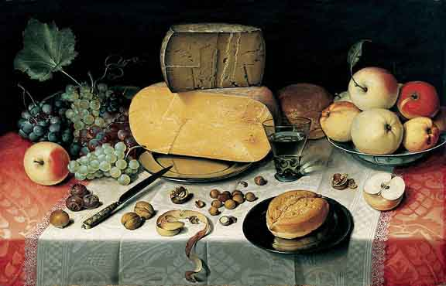
Metabolism:
Diet &
Nutrition
Stuff We Need
______nutrients:
Carbohydrates
Proteins
Lipids
______nutrients:
Vitamins
Minerals
…and, of course, Water
From the Virtual Biology Classroom on ScienceProfOnline.com
Image: Stilleben, painting dated 1613, oil on canvas, by Floris van Dyck
Notes:
Macro
Micro

Slide 3
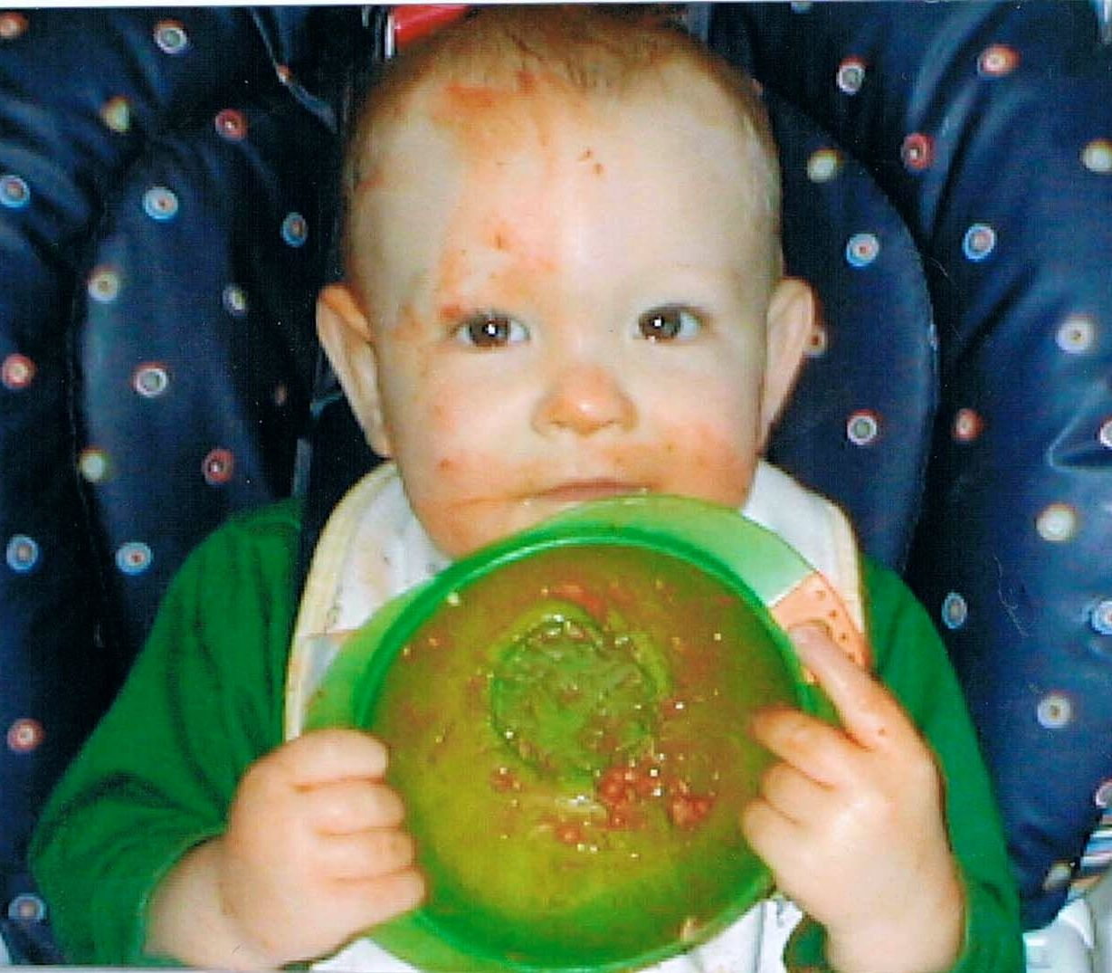
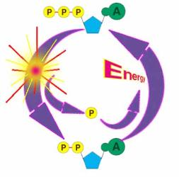
The Chemistry of Food ☺ ^{(yummy!)}
Macronutrients: Three of the four types of major organic macromolecules we recognize as part of our diet: Carbs, protein & lipids (fats).
Provide energy to fuel body’s activities.
And raw materials to build body’s own molecules.
From the Virtual Biology Classroom on ScienceProfOnline.com
Image: Leo after pouring baby food on his head ☺, T. Port

Slide 4

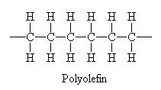
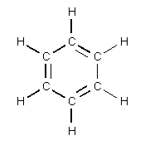
Carbon
Little Atom, Big Deal
The chemical basis of life. Abundant in all known life forms.
Essential to complex organic macromolecules, because each carbon atom can form ___ bonds (usually involving hydrogen , oxygen and/or nitrogen).
Able to form polymers (big organic molecules).
The atoms can bond with each other to form long chains.
Sometimes the ends of these chains join together to form a ring.
Double bonds form when atoms share two pairs electrons (two covalent bonds). Triple bonds = 3 shared pair of electrons.
From the Virtual Biology Classroom on ScienceProfOnline.com
Images: Carbon, Universe Today Website
Notes:
4

Slide 5
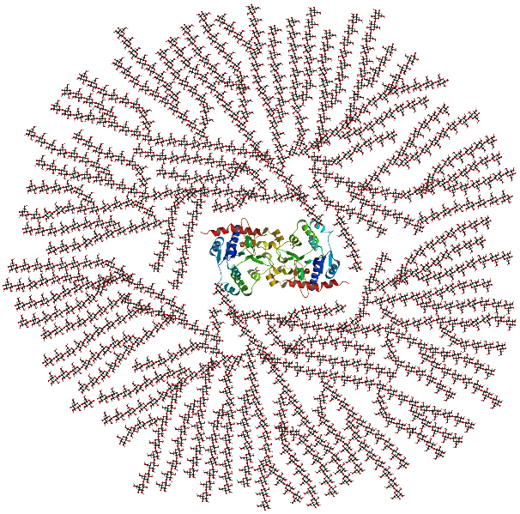
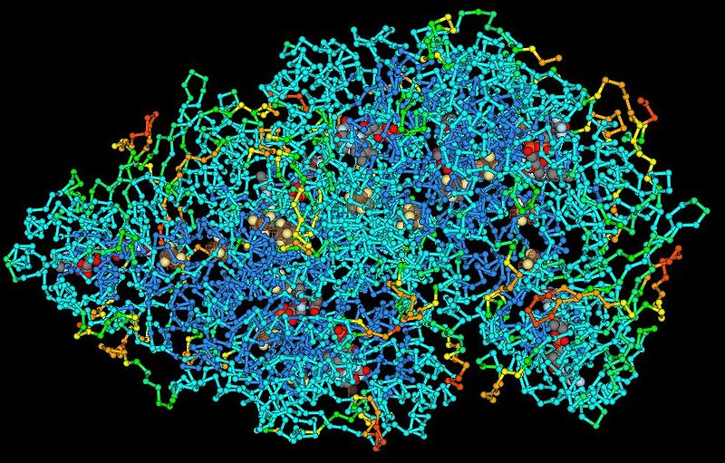
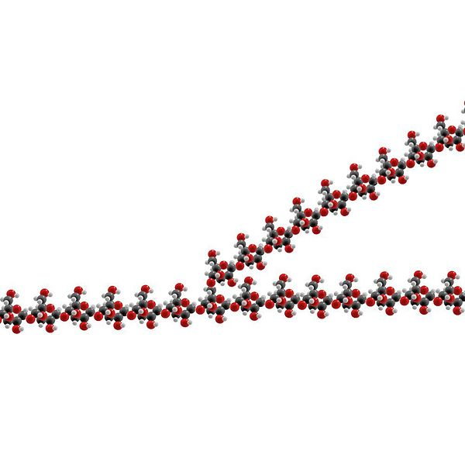
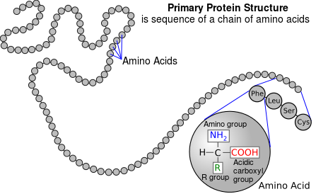
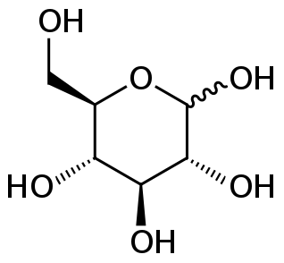
Polymers
Big molecules that are made of many similar units (monomers).
Images: Part of a Glycogen Molecule, Wiki; Glycogen diagram, Wiki; Glucose chemical structure, Wiki; Protein Molecule, Wiki; Primary structure of protein, Wiki
From the Virtual Biology Classroom on ScienceProfOnline.com

Slide 6
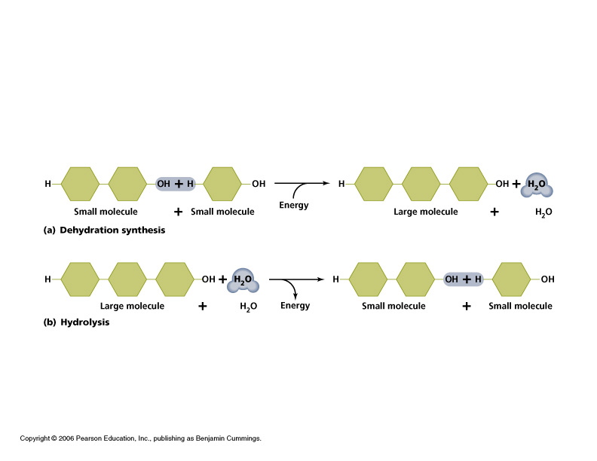
Polymers Can be Built and Broken Down Through
Dehydration and Hydrolysis Reactions
Dehydration reaction: Building the polymer.
- Polymer = long chain of subunits called monomers.
- Reconnect monomers by covalent bonds
- a.k.a. Condensation reaction
- Energy input required.
- Aided by enzymes.
Hydrolysis: Breaking the polymer.
- Covalent bond is broken between subunits. - Releases energy
- Aided by enzymes

Slide 7
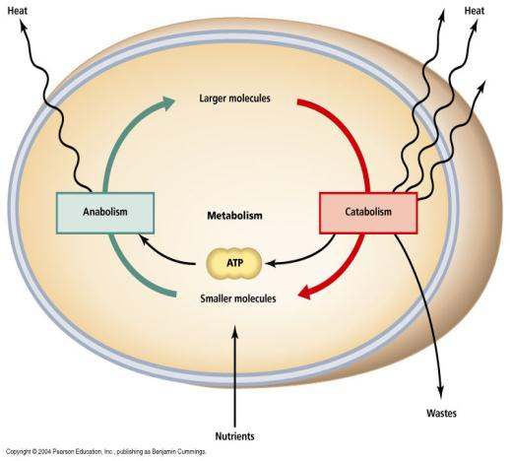
Building and Breaking Down Molecules
Anabolic Reaction
(anabolism)
The phase of metabolism in which simple substances are synthesized into the complex materials of living tissue.
Catabolic Reaction
(catabolism)
The metabolic break down of complex molecules into simpler ones, often resulting in release of energy.
From the Virtual Biology Classroom on ScienceProfOnline.com

Slide 8
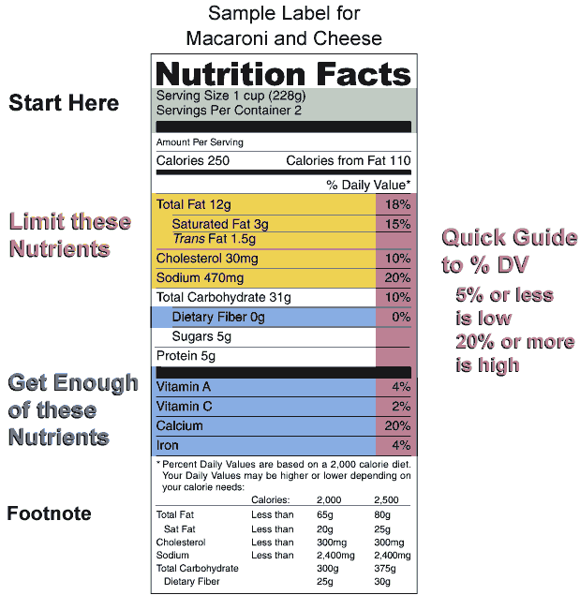
3 of the 4 macromolecules commonly occur on Nutrition Labels, and are the major components in our diet.
Q: Which organic macromolecule that is part of our diet is not present on food labels?
From the Virtual Biology Classroom on ScienceProfOnline.com
Images: Nutrition Label, Wiki

Slide 9
Study Table of Organic Macromolecules
(We will fill this in as we go through the rest of the lecture.)
Macromolecule (polymer) | Made of what type of monomer? | Is there another name for this polymer? | What are the main elements in this macromolecule? | Examples
1.
2.
3.
4.
From the Virtual Biology Classroom on ScienceProfOnline.com

Slide 10
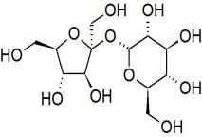
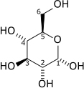
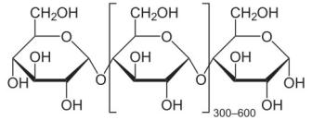
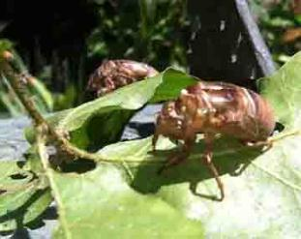
Organic Molecules - Carbohydrates
Monosaccharides
single sugars (one molecule)
simplest
*glucose, fructose
Disaccharides
double sugars
combination of two monosaccharides
* sucrose = glucose + fructose
* lactose = glucose + galactose
Polysaccharides
macromolecules; polymers composed of several sugars
can be same monomer (many of same monosaccharide) or mixture of monomers
food storage carbohydrates: glycogen (animals) starch (plants)
structural carbs: chitin (animals), cellulose (plants)
From the Virtual Biology Classroom on ScienceProfOnline.com

Slide 11
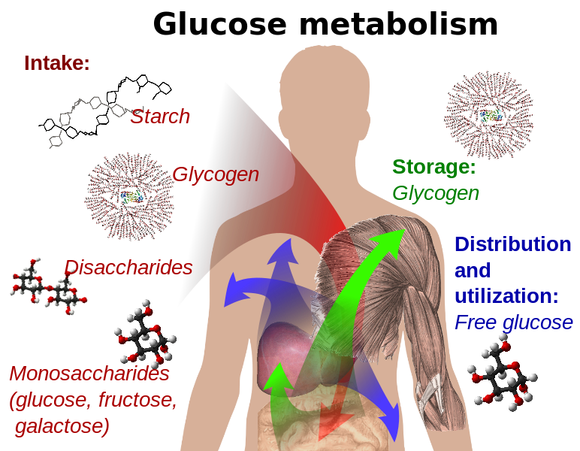
Glycogen
Carbohydrate polymer that we use to store sugar energy.
- Subunits are glucose monosaccharides
- Humans and other vertebrates store glucose as glycogen in the liver and muscles
Images: Part of a Glycogen Molecule, Wiki; Glycogen diagram, Wiki; Glucose chemical structure, Wiki; Glucose metabolism, Wiki
From the Virtual Biology Classroom on ScienceProfOnline.com

Slide 12
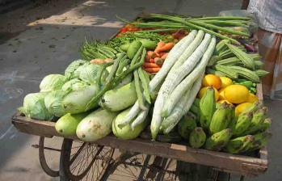
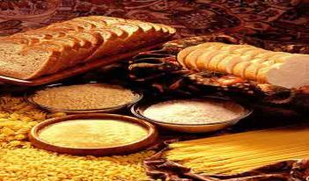
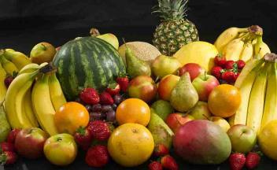
Carbohydrates - Nutrition
Present in fruits, vegetables and grains… essentially in plant matter…and low amounts in dairy.
_______ carbs are not bad for you. They should be the type of food you eat the most of (45 – 65% of your daily food intake).
Complex carbs more nutrient-rich and harder for your body to break down. They enter blood stream more slowly, and include fiber.
Highly processed, refined carbs (such as sucrose) are like “pre-chewed” food, so are very easily digested. They quickly enter blood stream, and can cause levels of the hormone _______ to spike.
Consuming too many refined carbs can increase your risk of Type 2 diabetes.
From the Virtual Biology Classroom on ScienceProfOnline.com
Image: Vegetables, Gpics, Wiki; Grains, USDA; Fruits, Bill Ebbesen
Notes:
Complex
insulin

Slide 13
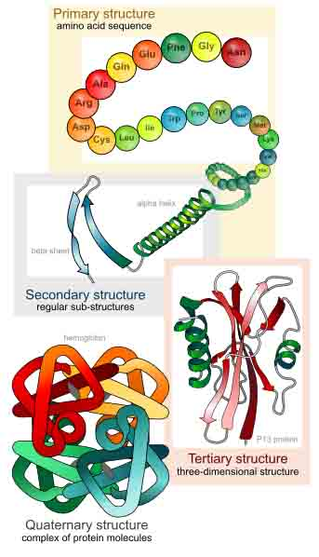
Protein Structure
From the Virtual Biology Classroom on ScienceProfOnline.com
Image: Levels of protein structure, M Ruiz

Slide 14

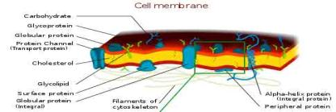
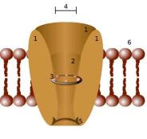
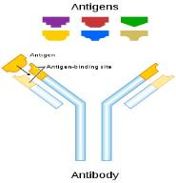
Organic Molecules - Proteins
Complex organic macromolecules fundamental to living cells.
Composed of one or more chains of amino acids.
Proteins perform many functions in cells, including:
1. Structural
• Components in cell walls, membranes,
and within cells themselves.
2. Enzymes
• Chemicals that speed up a chemical reaction.
• The catalysts in cells are called enzymes.
3. Regulation
• Some regulate cell function by stimulating or hindering either the action of other proteins or the expression of genes.
4. Transportation
• Some act as channels and “pumps” that move substances into or out of cells.
5. Defense
• Antibodies = proteins that defend your body against microorganisms
• Some bacteria produce proteins (bacteriocins) that kill other bacteria.
Images : Cell Membrane, Wiki; Channel Protein, Wiki; Antibody, Wiki
From the Virtual Biology Classroom on ScienceProfOnline.com

Slide 15
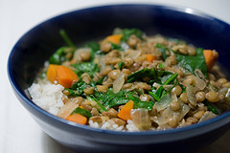

Proteins - Dietary
__________ Proteins = contain all essential amino acids necessary for good health
__________ Proteins = are missing some of the essential amino acids necessary for good health
Essential Amino Acids = can’t be synthesized by the human body
Percentage of daily food intake that should be protein: 10 – 35%.
The amount of protein that a person actually requires on a daily basis is quite small, approximately 0.8 gram per pound of body weight, depending on level of physical activity. (That means, for example, that 150# person needs about 120 grams or 4.25 oz of protein daily.) – USDA
Images: Lentils, a vegetable protein, Paul Goyette; Roasted chicken, Viperx, Wiki
From the Virtual Biology Classroom on ScienceProfOnline.com
Image: Chicken parts, Wiki
Notes:
Complete
Incomplete

Slide 16
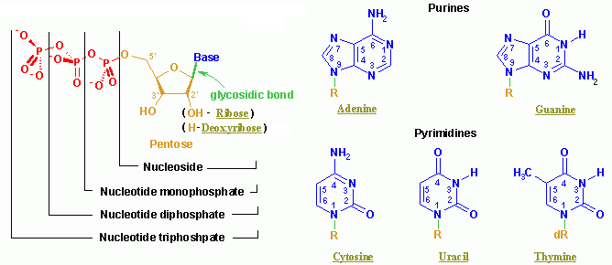
Organic Molecules – Nucleic Acids
Nucleic acids (both RNA and DNA) are macromolecules; polymers made up of monomers called nucleotides.
Nucleic acids deoxyribonucleic acid (DNA) and ribonucleic acid (RNA) = genetic material of cells.
Names derived from type of sugar contained within molecules = ribose
Nucleotides
Each monomer of nucleic acid is a nucleotide and consists of 3 portions:
- a sugar
- one or more phosphate
- one of five cyclic nitrogenous bases
+adenine, guanine (double-ringed purines)
+ cytosine, thiamine or uracil (single-ringed pyrimidines)
From the Virtual Biology Classroom on ScienceProfOnline.com
Image: Nucleotide Structure, Wikipedia

Slide 17
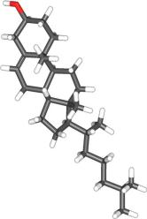
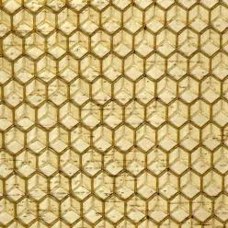
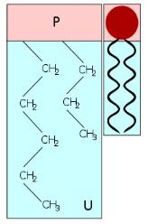
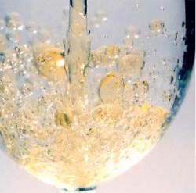
Organic Molecules – Lipids
(Fats, Phospholipids, Waxes & Steroids)
Hydrophobic macromolecules…insoluble in water.
Not attracted to water because …
non-polar covalent bonds linking carbon & hydrogen aren’t attracted to the polar bonds of water.
From the Virtual Biology Classroom on ScienceProfOnline.com
Images: Cholesterol, Wiki; Phospholipid Structure, Bryan Derksen. Wiki Honeycomb, Wikii; Oil & Water, Kidipede

Slide 18
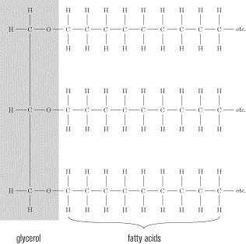
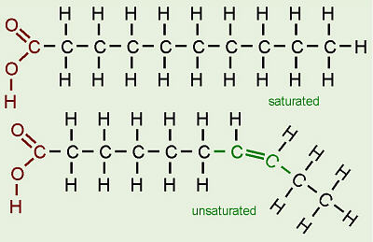
Lipids - Dietary Fats
Saturated fats
• Mostly from animal sources.
• Single bonds between the carbons in their fatty acid tails (all carbons are bonded to max number of hydrogens possible).
• Hydrocarbon chains fairly straight and packed closely together … so ______at room temperature.
Unsaturated fats (oils)
• Mostly from plant sources.
• Have double bonds between some carbons in the hydrocarbon tail, causing bends or “kinks” in shape.
• Kinks in hydrocarbon tails, so unsaturated fats can’t pack closely together … ________ at room temp.
From the Virtual Biology Classroom on ScienceProfOnline.com
Notes:
solid
liquid

Slide 19
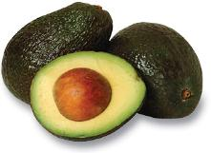
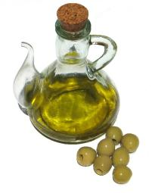
Lipids – Dietary Fats
We typically refer to them all as “Fats”, but remember, fats are only one of several molecules known as lipids.
Phospholipids, steroids and true fats play an important role in human nutrition, should get no more than 30% of calories from fats. The type of fat consumed is very important!
_____________ fatty acids (EFAs) are fats that the body can’t make, but needs to take in from outside sources.
There are two families of EFAs: omega-3 and omega-6. Fats from each of these families are essential, as the body can convert one omega-3 to another omega-3, for example, but cannot create an omega-3 from scratch.
When the EFAs were discovered in 1923, they were designated Vitamin F. In 1930, further research showed that the two EFAs are better classified with the fats than with the vitamins.
Olive oil has both omega 3 and omega 6 EFAs
From the Virtual Biology Classroom on ScienceProfOnline.com
Notes:
Essential

Slide 20
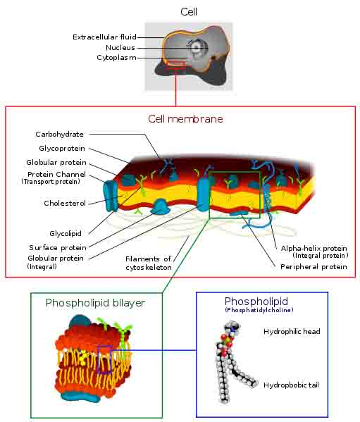
Organic Molecules – Lipids
(Fats, Phospholipids, Waxes & Steroids)
Phospholipids
• Phospholipids are a major component of all cell membranes.
Most phospholipids contain a diglyceride as the tail, and a phosphate group for head.
Hydrocarbon tails are hydrophobic, but phosphate heads are hydrophilic.
• So phospholipids are soluble in both water and oil.
• Tails from both layers facing inward and the heads facing outward = phospholipid bilayer.
From the Virtual Biology Classroom on ScienceProfOnline.com
Image: Cell Membrane, Wiki;

Slide 21
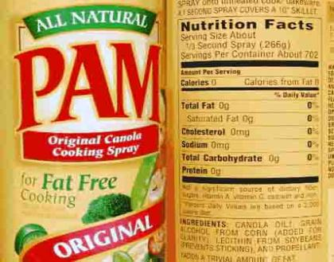
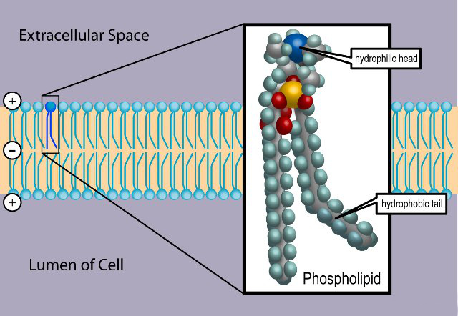
Phospholipids - Dietary
• Because they are polar (hyprophobic and hydrophilic parts) phospholipids can act as an emulsifier in foods, enabling oils to dissolve in water.
_______, which is made of phospoholipid, is used in cooking sprays and as a food emulsifier.
For example, lecithin keeps the cocoa and cocoa butter in a candy bar from separating.
Originally discovered in egg yolk, and today commercially extracted from soybeans, but widely present in animal and plant tissues.
Remember, if we are eating cells, we are eating phospholipids.
From the Virtual Biology Classroom on ScienceProfOnline.com
Image: Phospholipid, Wikipedia
Notes:
Lecithin (less-a-thin)

Slide 22
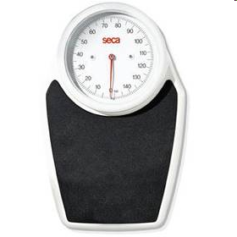
Calories (really Kilocalories)
Q: What is a calorie?
Carbohydrates have ____ calories per gram.
Fiber, a type of less-digestible carb has ____ calories per gram.
Proteins have _____ calories per gram.
Fats have ___ calories per gram.
From the Virtual Biology Classroom on ScienceProfOnline.com
Notes:
Calorie = the amount of energy needed to raise one kilogram of water one degree Celsius.
4
2
4
9

Slide 23
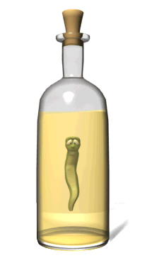
How many calories are in alcohol?
7 calories per gram.
But different drinks have different strengths of alcohol.
So you can calculate the calories in any alcoholic drink that you consume with the following calculation:
1.6 x alcohol % x oz in a glass
To learn more about alcohol and your health, see the “Rethinking Drinking” website by the NIAAA (National Institute on Alcohol Abuse and Alcoholism).
From the Virtual Biology Classroom on ScienceProfOnline.com

Slide 24
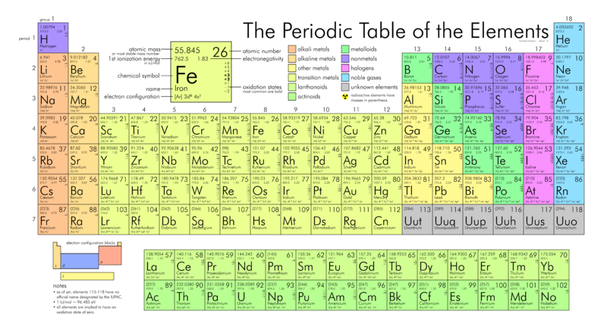
The Chemistry of Food ☺ ^{(yummy!)}
Micronutrients: Our diet must also include essential nutrients that our bodies cannot manufacture but are needed for biological function, such as:
  Vitamins
  Minerals
From the Virtual Biology Classroom on ScienceProfOnline.com
Image: Periodic Table of Elements, Wiki

Slide 25
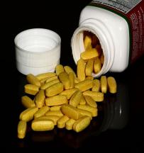
VITAMINS - Micronurteints
________ ________ usually not produced by the body, but essential in minute amounts for metabolism.
Do not serve as a source of energy, but some help facilitate many metabolic reactions as _________.
Example: B vitamins
- Eight water-soluble vitamins that play important roles in cell metabolism.
-Once thought to be a single vitamin, referred to as Vitamin B (much like how people refer to Vitamin C or Vitamin D).
- Later research showed that they are chemically distinct vitamins that often coexist in the same foods.
- Supplements containing all eight B vitamins are generally referred to as a vitamin B complex. Individual B vitamin supplements are referred to by the specific name of each vitamin (e.g. B1, B2, B3).
From the Virtual Biology Classroom on ScienceProfOnline.com
Images: B vitamin caplets, Ragesoss
Notes:
Organic molecules
enzymes

Slide 26
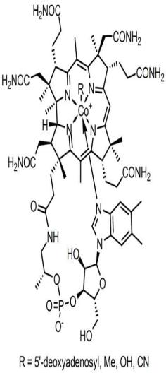
VITAMIN - B₁₂
Largest and most complex of all the vitamins.
Sources of B₁₂: Only bacteria can synthesize. Present in animal products such as meat, poultry, fish (including shellfish), and to a lesser extent, dairy. Vegans need to take supplements.
Involved in many aspects of our health. Required for proper red blood cell formation, neurological function, and DNA synthesis.
10-15% of people are believed to be deficient in this vitamin.
B₁₂ and Depression
Observational studies have found as many as 30% of patients hospitalized for depression to be deficient in vitamin B₁₂.
A recent cross-sectional study of 700 community-living, physically disabled women over the age of 65 found that vitamin B₁₂ deficient women were twice as likely to be severely depressed as non-deficient women.
The reasons for the relationship between vitamin B₁₂ deficiency and depression are not clear.
Learn more about Vitamin B12 from the website of the Office of Dietary Supplements, National Institutes of Health.
From the Virtual Biology Classroom on ScienceProfOnline.com
Image: Molecular structure of Vitamin B12, Wiki

Slide 27
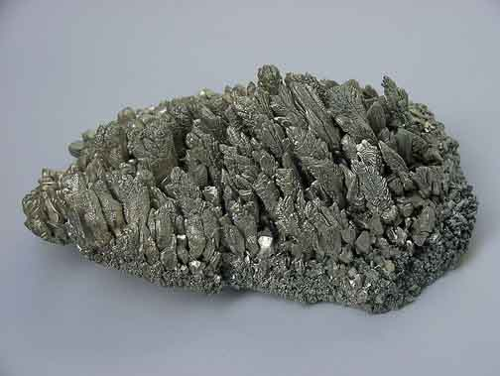
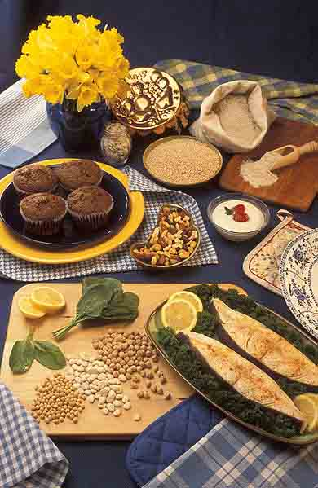
MINERALS - Micronutrients
Mg
12
24.305
Minerals are chemical elements present in our diet.
EXAMPLE: Magnesium
Magnesium plays an important role in the production and transport of ENERGY.
It is also important for:
  the contraction and relaxation of muscles.
  the synthesis of protein.
  assisting certain enzymes in the body.
Over 300 enzymes require magnesium ions for action, including all enzymes using or synthesizing ATP, or those that use other nucleotides to synthesize DNA and RNA.
Human magnesium deficiency is common (~32% of those in US meet RDA).
Magnesium supplements can help you poop!
Magnesium
From the Virtual Biology Classroom on ScienceProfOnline.com
Images: Magnesium crystals, Warut Roonguthai; Food sources of Magnesium, Peggy Greb

Slide 28

WATER
Chemical reactions of living things take place in water.
Many types of metabolic wastes can only be eliminated from body when dissolved in water.
The break down of many materials requires
water.
You may be able to survive weeks without
food, but wouldn’t last more than a few days
without water.
Human body ~ 65% water (even dense tissue
like bone is 33% water).
Food provides ~ 20% of total water intake.
Remaining 80% from water and other beverages.
Institute of Medicine advises men consume
roughly 3.0 liters (~ 13 cups) total beverages
daily & women consume 2.2 liters (~ 9 cups).
From the Virtual Biology Classroom on ScienceProfOnline.com

Slide 29
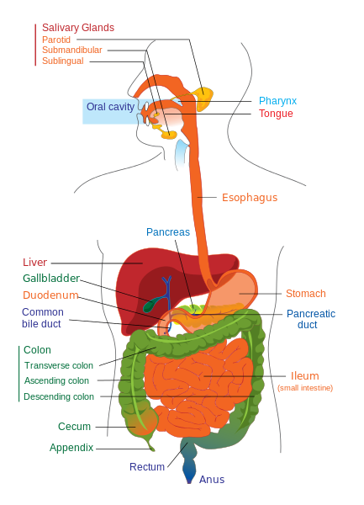
Digestion
Compartmentalized breakdown of foods
  Enzymes
  Stomach acid
How we get nutrients from the outside to the inside.
Smaller units are absorbed and carried by the bloodstream to the cells of our body.
From the Virtual Biology Classroom on ScienceProfOnline.com
Image: Digestive system diagram, Wiki

Slide 30
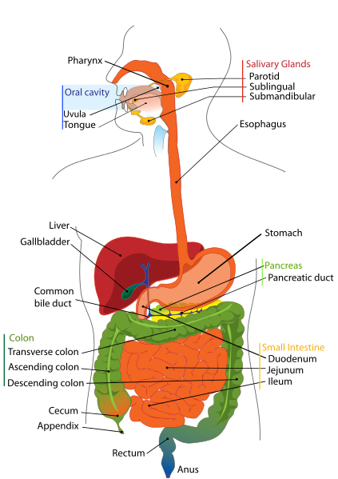
Digestive System (a.k.a. gastrointestinal tract & GI tract)
Digestion involves the breakdown of food into smaller components that can be absorbed by the body.
Process of digestion has many stages::
Oral cavity: Secretion of saliva (which contains digestive enzyme amaylase) helps produce a soft, moist bolus of food that can pass down the esophagus.
Esophagus: Passageway from oral cavity to stomach.
Stomach: Gastric juice and enzymes help break down food.
Small Intestine: Most digestion takes place in the small intestine where nutrients are absorbed.
  Gallbladder: Where bile (a fluid produced by the liver) is stored before release into small intestine to emulsify fats.
  Pancreas: Both an endocrine (hormone secreting) and a digestive organ. Secretes pancreatic juice with enzymes that help with digestion and absorption of nutrients in small intestine.
Large Intestine/Colon: Water and some minerals are reabsorbed back into the blood. Colon is where most of the bacteria in the GI tract live.
Rectum & Anus: Waste products of digestion are defecated
From the Virtual Biology Classroom on ScienceProfOnline.com
Image: Digestive System, Wiki

Slide 31
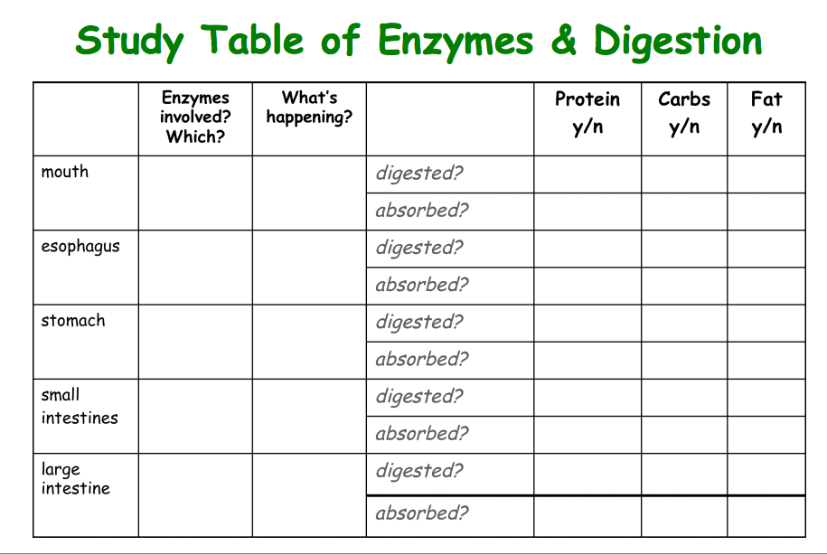
From the Virtual Biology Classroom on ScienceProfOnline.com

Slide 32
Digestive System (a.k.a. gastrointestinal tract & GI tract)
WATCH THIS!
Digestive Enzymes
Food Moving Through Digestive System
Digestive System: Part 1 & Part 2
from Crash Course Biology
From the Virtual Biology Classroom on ScienceProfOnline.com
Image: Digestive System, Wiki

Slide 33
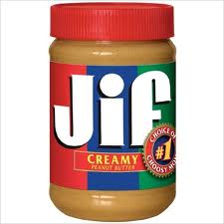





Confused about what to eat?
Eat more fresh food!
Eat local food when you can!
Complex carbs, balanced
wit protein and healthy fats.
Reduce animal fats and refined sugar.
From the Virtual Biology Classroom on ScienceProfOnline.com
Image: Edamame, Tammy Green

Slide 34
Confused?
Here are links to fun resources that further explain nutrition:
“The Body Machine” music video by School House Rock.
Food Molecules video from HowStuffWorks, a Discovery company.
NuVal: A simple number that give you a “snapshot” of the nutritional Value of various food items.
“Alphabutt” song by Kimya Dawson
(You must be in PPT slideshow view
to click on links.)
Smart Links
From the Virtual Biology Classroom on ScienceProfOnline.com

Slide 35


Are you feeling blinded by science?
Do yourself a favor. Use the…
Virtual Biology Classroom (VBC) !
The VBC is full of resources to help you succeed, including:
practice test questions
review questions
study guides and learning objectives
PowerPoints on other topics
You can access the VBC by going to the Science Prof Online website www.ScienceProfOnline.com
Images: Blinded With Science album, Thomas Dolby; Endomembrane system, Mariana Ruiz, Wiki

