Slide 1
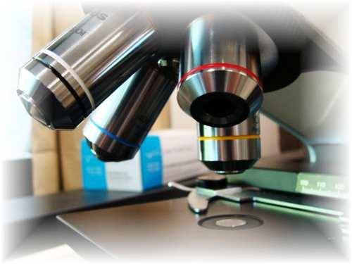
About Science Prof Online
PowerPoint Resources
Science Prof Online (SPO) is a free science education website that provides fully-developed Virtual Science Classrooms, science-related PowerPoints, articles and images. The site is designed to be a helpful resource for students, educators, and anyone interested in learning about science.
The SPO Virtual Classrooms offer many educational resources, including practice test questions, review questions, lecture PowerPoints, video tutorials, sample assignments and course syllabi. New materials are continually being developed, so check back frequently, or follow us on Facebook (Science Prof Online) or Twitter (ScienceProfSPO) for updates.
Many SPO PowerPoints are available in a variety of formats, such as fully editable PowerPoint files, as well as uneditable versions in smaller file sizes, such as PowerPoint Shows and Portable Document Format (.pdf), for ease of printing.
Images used on this resource, and on the SPO website are, wherever possible, credited and linked to their source. Any words underlined and appearing in blue are links that can be clicked on for more information. PowerPoints must be viewed in slide show mode to use the hyperlinks directly.
Several helpful links to fun and interactive learning tools are included throughout the PPT and on the Smart Links slide, near the end of each presentation. You must be in slide show mode to utilize hyperlinks and animations.
This digital resource is licensed under Creative Commons Attribution-ShareAlike 3.0 : http://creativecommons.org/licenses/by-sa/3.0/
Alicia Cepaitis, MS
Chief Creative Nerd
Science Prof Online
Online Education Resources, LLC
alicia@scienceprofonline.com
Tami Port, MS
Creator of Science Prof Online
Chief Executive Nerd
Science Prof Online
Online Education Resources, LLC
info@scienceprofonline.com
From the Virtual Cell Biology Classroom on ScienceProfOnline.com
Image: Compound microscope objectives, T. Port
Notes:
Welcome to Science Prof Online PowerPoint Resources!
This PowerPoint Presentation comes from the Virtual Cell Biology Classroom of Science Prof Online, and, as such, is licensed under Creative Commons Attribution-ShareAlike 3.0.; meaning you can download, share and alter any of this presentation, but you can’t sell it or repackage and sell any part of it. Please credit Science Prof Online as the source of this presentation. Please abide by credited image copyrights. Thank you for using this resource.

Slide 2

Metabolism
Anaerobic Cellular Respiration
&
Fermentation
From the Virtual Cell Biology Classroom on ScienceProfOnline.com

Slide 3

Everyday Biology
What causes smelly farts?
Most people pass gas at least 10 – 25x a day.
Farts are mostly a byproduct microbial anaerobic respiration & fermentation in the colon (large intestine).
Over 99% of fart volume is non-smelly gases, including oxygen, nitrogen, carbon dioxide, hydrogen and methane.
Smelly farts are caused by microbes that generate volatile sulfur compounds and/or by feces in the rectum.
Diets high in healthy sulfur containing veggies (ex. broccoli, cabbage,
brussel sprouts) and protein with sulfur-containing amino acids
significantly increase the smell of farts.
From the Virtual Cell Biology Classroom on ScienceProfOnline.com

Slide 4
Aerobic Cellular Respiration →
Utilizes glycolysis, synthesis of acetyl-CoA, Krebs cycle, and electron transport chain; results in complete breakdown of _________ to carbon dioxide, water and
The ultimate objective is to make molecules to do cellular work.
Q: How many total ATP can be obtained from one glucose using aerobic cellular respiration?
ATP
ATP
From the Virtual Cell Biology Classroom on ScienceProfOnline.com
Notes:
glucose

Slide 5
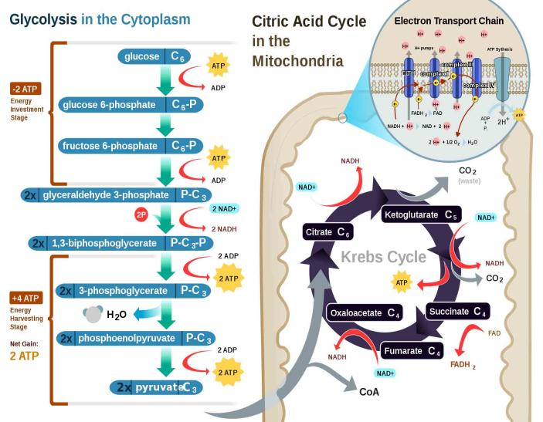
Aerobic Cellular Respiration
Q: What is the role of O² in aerobic cellular respiration?
From the Virtual Cell Biology Classroom on ScienceProfOnline.com
Images: Cellular Respiration, Regis Frey

Slide 6
Using oxygen (1/2 O₂) in metabolism creates toxic waste.
Cells that are able to use aerobic respiration produce special molecules that detoxify oxygen:
Q: What kind of molecules are catalase and SOD?
Cells that don’t make one or both of these cannot
exist in the presence of oxygen.
(catalase)
Catalase: H₂O₂ -------→ H₂0 and 0₂
(SOD)
Superoxide dismutase (SOD): oxygen radical -------→ H20 and O₂
From the Virtual Cell Biology Classroom on ScienceProfOnline.com
Notes:
enzymes

Slide 7
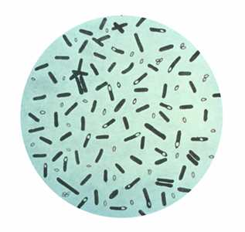
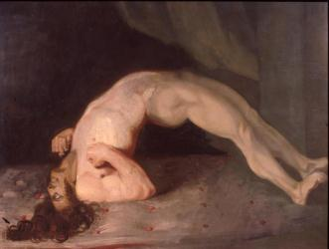
Bacterial Genus: Clostridium
GRAM-POSITIVE
Obligate anaerobe, bacillus-shaped
All species form endospores.
All have a strictly fermentative
mode of metabolism (Don’t’ use oxygen).
Vegetative cells are killed by exposure to O², but their endospores are able to survive long periods of exposure to air.
Known to produce a variety of toxins, some of which are fatal.
Clostridium tetani = agent of tetanus
C. botulinum = agent of botulism
C. perfringens = one of the agents of gas gangrene
C. difficile = part of natural intestinal flora, but resistant strains can overpopulate and cause pseudomembranous colitis.
Clostridium botulinum
Images:Clostridium botulinum: stained with Gentian violet. CDC Public Health Image Library. (PHIL #2107), 1979; Charles Bell 1809 painting.
From the Virtual Cell Biology Classroom on ScienceProfOnline.com

Slide 8
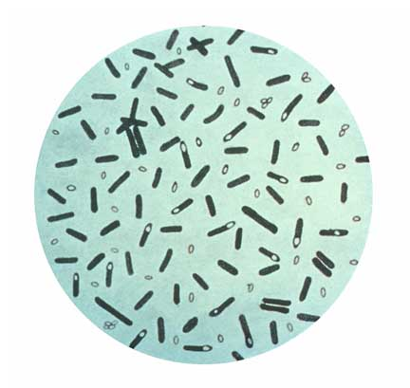

If oxygen is required for aerobic cellular respiration…
how do cells
get energy if
there is no
O₂,
or if they
can’t use oxygen?
Images: Clostridium botulinum, CDC; Calvin holding breath, Bill Watterson
From the Virtual Cell Biology Classroom on ScienceProfOnline.com

Slide 9
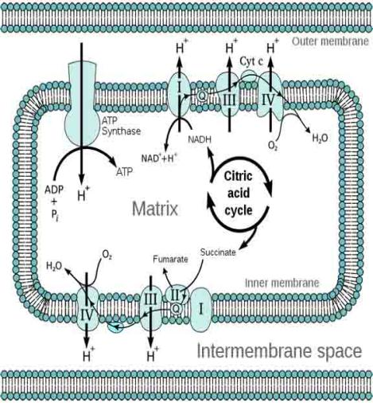
Anaerobic Cellular Respiration
Many anaerobic bacteria, and muscle cells that run out of O², can make ATP by using something other than oxygen as an electron acceptor (nitrate, sulfate & carbon dioxide).
In anaerobic respiration, not all the ETC is used, so less ATP is produced.
From the Virtual Cell Biology Classroom on ScienceProfOnline.com
Image: Electron transport chain, Tim Vickers

Slide 10
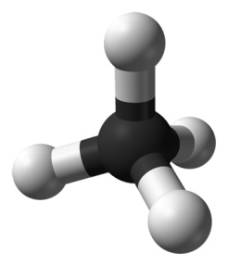

More Fun With Farts
When CO₂ is used as an electron acceptor in anaerobic respiration, the product is either methane or acetic acid (depending on the organism).
Methane produced in our gut (and released as farts) results from this process.
New study of people with GI symptoms, found that those with high levels of hydrogen (H) and methane (CH₄) gases in their breath also had higher body mass index (BMI) and % body fat.
Having both CH₄ and H in breath indicates presence of Methanobrevibacter smithii, a key methane-producing microbe (Archaea) in the human gut.
In addition to making methane, M. smithii scavenges hydrogen from other microbes, and these 2 actions appear to increase nutrient absorption and promote weight gain.
Image: Methane 3D, Ben MillsMethane=producing Gut Organisms May Promote Weight Gain” Medscape.
From the Virtual Cell Biology Classroom on ScienceProfOnline.com

Slide 11
Aerobic vs Anaerobic Respiration
Q: What is the key difference between aerobic and anaerobic respiration?
Q: How does this difference impact the amount of energy that anaerobes can harvest from their food?
REVIEW!
Interactive animated lesson and comparing Anaerobic vs Aerobic Respiration
From the Virtual Cell Biology Classroom on ScienceProfOnline.com
Image: Electron transport chain, Tim Vickers

Slide 12
Fermentation
When there is no final electron acceptor for the ETC, then electron transport can’t happen.
Fermentation is an alternative system that allows glycolysis to continue without the other steps of cellular respiration.
Not as energetically efficient as respiration.
Produces only 2 ATP.
ATP
ATP
From the Virtual Cell Biology Classroom on ScienceProfOnline.com

Slide 13
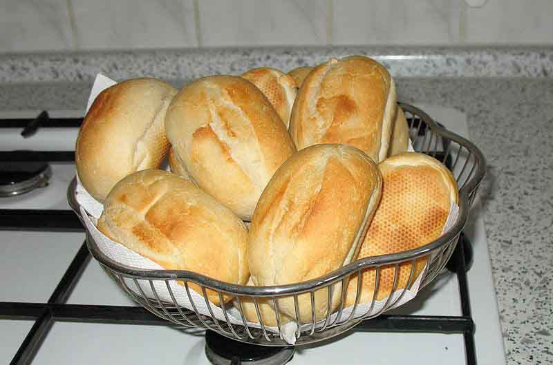

Fermentation
Two different fermentation pathways:
Yeasts and some bacteria are able to get their ATP from glycolysis by using alcoholic fermentation. Converts pyruvate into ethanol and carbon dioxide.
Animal cells and some bacteria through the process of lactic acid fermentation. Here pyruvate results in end product of lactic acid.
The formation of carbon dioxide, a byproduct of ethanol fermentation, causes bread to rise.
When muscles need energy produced faster than the body can deliver oxygen, such as when lifting heavy weights, the working muscles generate energy anaerobically, through lactic acid fermentation.
From the Virtual Cell Biology Classroom on ScienceProfOnline.com
Images: Bread Rolls, Bangin; Dexter Jackson, Local Fitness

Slide 14
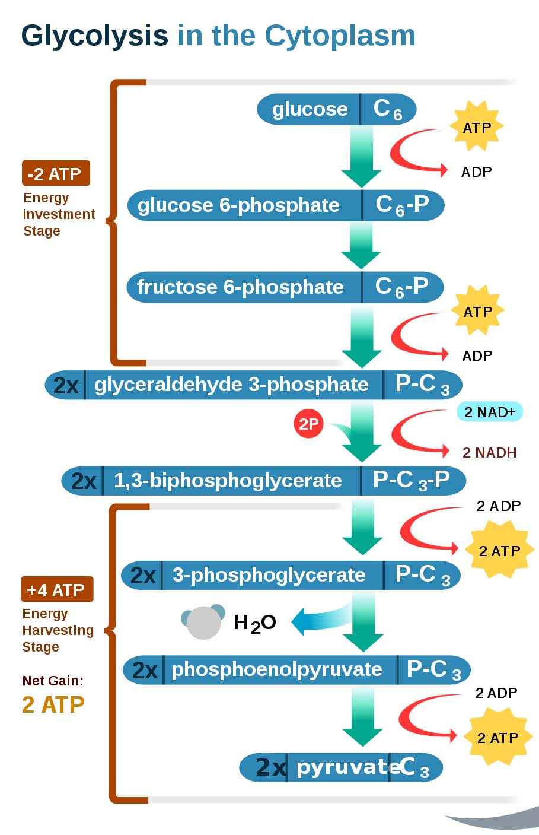
From the Virtual Cell Biology Classroom on ScienceProfOnline.com
Image: Glycolysis, Regis Frey

Slide 15
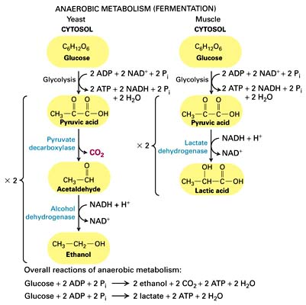
Fermentation
REVIEW!
Interactive animated lesson comparing Alcoholic
vs
Lactic Acid Fermentation
From the Virtual Cell Biology Classroom on ScienceProfOnline.com

Slide 16
Why does fermentation require extra steps after glycolysis?
In fermentation, after glycolysis, there are additional steps to oxidize NADH (into NAD⁺).
Electrons and hydrogen ions from the NADH that was produced by glycolysis are donated to another organic molecule.
No more ATP is created through these additional steps.
So essentially…
FERMENTATION =
glycolysis + recycling of NAD⁺
From the Virtual Cell Biology Classroom on ScienceProfOnline.com
Image: Glycolysis, Regis Frey

Slide 17
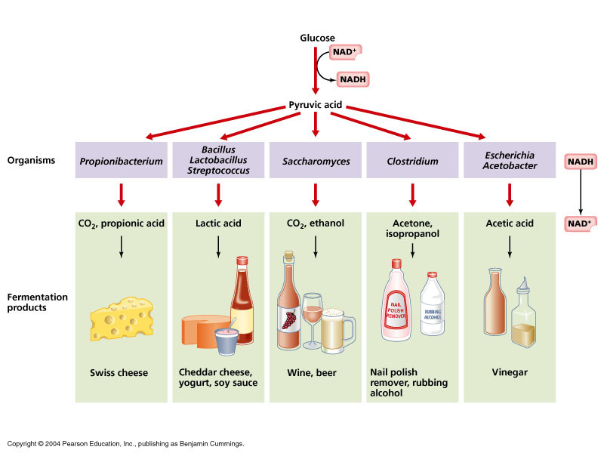
Fermentation
Most of the potential energy remains in the bonds of fermentation products.
Fermentation products are wastes to cells that make them, many are useful to humans (ethanol, acetic acid, and lactic acid).
From the Virtual Cell Biology Classroom on ScienceProfOnline.com

Slide 18

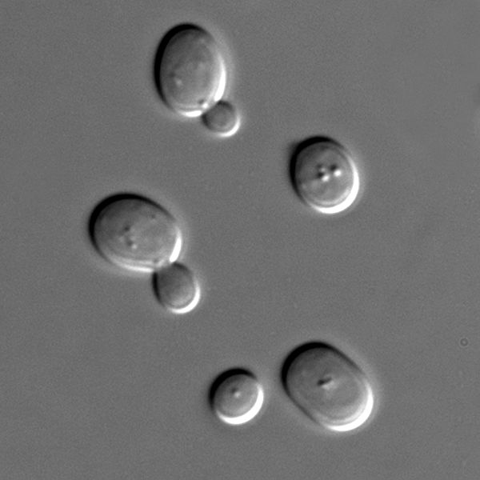
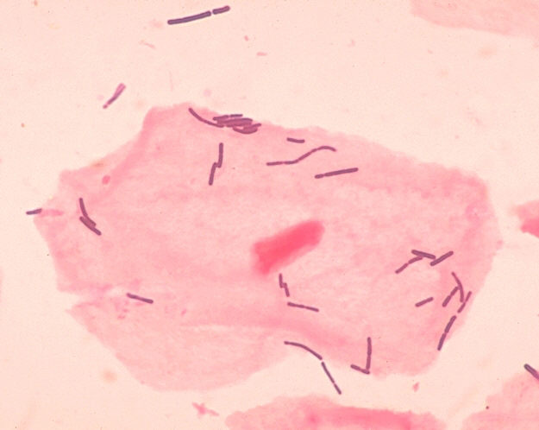
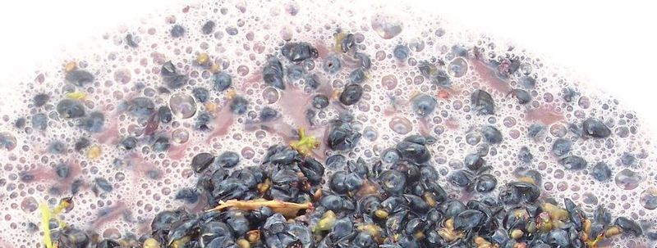
Alcohol Fermentation in Wine
Louis Pasteur & Industrial Microbiology
Pasteur’s
Observations:
Blobs were alive because
they divide and make more of themselves.
2. Put grape juice + yeast in open and in air-tight containers. Fermentation occurred in both. This means that yeast are facultative anaerobes.
3. Took two flasks of sterile grape juice and introduced bacteria into one and yeast into another.
- Q: What is fermentation?
- What causes fermentation?
Some scientists thought that air caused fermentation
Others thought that microbes caused fermentation.
- Q: What is pasteurization?
Are these non-living blobs or living microbes?
< yeast + grapes = yummy wine ☺ (ethanol)
bacteria + grapes = spoiled wine ☹ (lactic acid) >
Image: Louis Pasteur, Pierre Lamy Petit, circa 1866; Grapes fermenting; Sachromyces yeast; Lactobacillus, Public health Image Library #1048
From the Virtual Cell Biology Classroom on ScienceProfOnline.com
Notes:
Fermentation = breakdown of sugar, resulting in either the waste product of ethanol or lactic acid
Pasteurization is the process of heating a food, usually a liquid, to a specific temperature for a certain amount of time, and then immediately cooling it. Slows spoilage due to microbial growth.

Slide 19
Muscles & Lactic Acid Fermentation
Slow and Fast Twitch Muscle
• Muscle contains both slow twitch fibers and fast twitch fibers.
Slow twitch fibers have many mitochondria and use aerobic respiration to generate ATP. These fibers contract and fatigue more slowly.
Slow twitch also contains an oxygen-storing protein, myoglobin, which helps provide the oxygen that sustains aerobic respiration.
Fast twitch fibers use lactate fermentation to make most of their ATP, so can provide only short bursts of energy.
Most of us have about 50% slow twitch fibers and 50% fast twitch fibers.
Long-distance runners often have more slow twitch fibers while sprinters or bodybuilders often have more fast twitch fibers.
From the Virtual Cell Biology Classroom on ScienceProfOnline.com

Slide 20
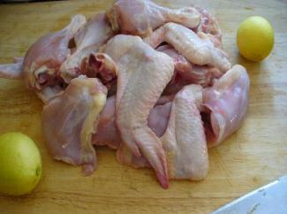
Slow and Fast Twitch Muscle
Poultry: White Meat & Dark Meat
White meat = fast twitch
Dark meat = slow twitch
Slow twitch is dark because it contains the oxygen-storing protein
myoglobin.
In poultry slow twitch muscles tend to be prominent in leg muscles where long term endurance is required.
Fast twitch muscles are predominant in the wing and breast where quick response, rather than endurance, is needed.
Wild game birds tend to have more slow twitch muscle than their domestic counterparts. Q: Why?
From the Virtual Cell Biology Classroom on ScienceProfOnline.com
Image: Chicken parts, Wiki

Slide 21
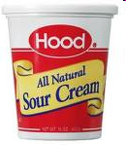
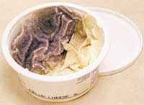
Souring & Spoilage
Different Results of Anaerobic Metabolism
Souring: Fermentation of carbohydrates generates organic acids.
Sour cream, cheese, and yogurt are produced by the action of bacteria doing fermentation.
Lactic-acid bacteria of the genus Lactobacillus are one type of microbe used in the fermentation process.
These bacteria convert lactose to lactic acid, which causes milk to change from liquid to solid curd and produces a sour flavor.
Spoilage: When microbes use anaerobic respiration to break down proteins, releasing nitrogen and sulfur-containing organic compounds.
Also known as putrification.
Anaerobic respiration of protein often produces foul smelling chemicals such as putrescine, cadaverine & hydrogen sulfide.
From the Virtual Cell Biology Classroom on ScienceProfOnline.com

Slide 22

Metabolic Processes … Bottom Line
Metabolism transforms food energy into energy that our cells can use.
Q: What carbohydrate molecule is the basic component of your food energy?
Q: What is different about how cells use anaerobic respiration extract energy from their food (compared to those that use aerobic respiration)?
Q:What molecule, the product of metabolism, is used to do cellular work?
From the Virtual Cell Biology Classroom on ScienceProfOnline.com
Image: Jumping rope, Meagan E. Klein

Slide 23
Confused?
Here are links to fun resources that further explain cellular respiration:
Anaerobic Cellular Respiration Main Page on the Virtual Cell Biology Classroom of Science Prof Online.
Anaerobic Respiration Page by Timothy Paustain, University of Wisconsin, Madison.
“Alphabutt” song by Kimya Dawson
How NAD+ Works animation and quiz from McGraw-Hill.
Glycolysis animation and quiz from McGraw-Hill.
Krebs Cycle Animation & Quiz 1 from McGraw-Hill.
Krebs Cycle Animation & Quiz 2 from McGraw-Hill.
Electron Transport Chain animation from Molecular & Cellular Biology Learning Center.
Food Molecules video from HowStuffWorks, a Discovery company.
“Tiny Bubbles” song by Don Ho.
(You must be in PPT slideshow view to click on links.)
Smart Links
From the Virtual Cell Biology Classroom on ScienceProfOnline.com

Slide 24

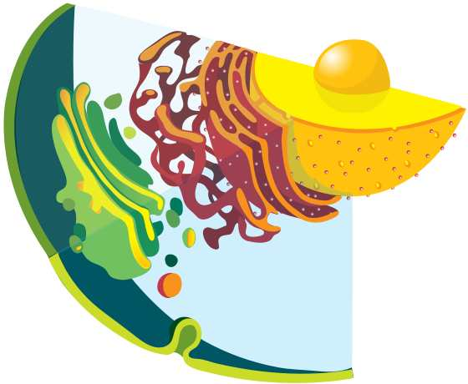
Are you feeling blinded by science?
Do yourself a favor. Use the…
Virtual Cell Biology Classroom (VCBC) !
The VCBC is full of resources to help you succeed, including:
practice test questions
review questions
study guides and learning objectives
PowerPoints on other topics
You can access the VCBC by going to the Science Prof Online website www.ScienceProfOnline.com
Images: Blinded With Science album, Thomas Dolby; Endomembrane system, Mariana Ruiz, Wiki

