Slide 1
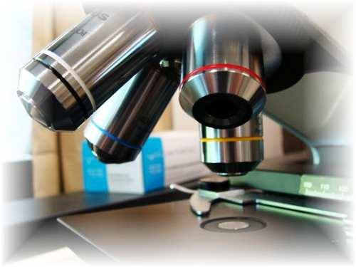
About Science Prof Online
PowerPoint Resources
Science Prof Online (SPO) is a free science education website that provides fully-developed Virtual Science Classrooms, science-related PowerPoints, articles and images. The site is designed to be a helpful resource for students, educators, and anyone interested in learning about science.
The SPO Virtual Classrooms offer many educational resources, including practice test questions, review questions, lecture PowerPoints, video tutorials, sample assignments and course syllabi. New materials are continually being developed, so check back frequently, or follow us on Facebook (Science Prof Online) or Twitter (ScienceProfSPO) for updates.
Many SPO PowerPoints are available in a variety of formats, such as fully editable PowerPoint files, as well as uneditable versions in smaller file sizes, such as PowerPoint Shows and Portable Document Format (.pdf), for ease of printing.
Images used on this resource, and on the SPO website are, wherever possible, credited and linked to their source. Any words underlined and appearing in blue are links that can be clicked on for more information. PowerPoints must be viewed in slide show mode to use the hyperlinks directly.
Several helpful links to fun and interactive learning tools are included throughout the PPT and on the Smart Links slide, near the end of each presentation. You must be in slide show mode to utilize hyperlinks and animations.
This digital resource is licensed under Creative Commons Attribution-ShareAlike 3.0:
http://creativecommons.org/licenses/by-sa/3.0/
Alicia Cepaitis, MS
Chief Creative Nerd
Science Prof Online
Online Education Resources, LLC
alicia@scienceprofonline.com
Tami Port, MS
Creator of Science Prof Online
Chief Executive Nerd
Science Prof Online
Online Education Resources, LLC
info@scienceprofonline.com
From the Virtual Cell Biology Classroom on ScienceProfOnline.com
Image: Compound microscope objectives, T. Port
Notes:
Welcome to Science Prof Online PowerPoint Resources!
This PowerPoint Presentation comes from the Virtual Cell Biology Classroom of Science Prof Online, and, as such, is licensed under Creative Commons Attribution-ShareAlike 3.0.; meaning you can download, share and alter any of this presentation, but you can’t sell it or repackage and sell any part of it. Please credit Science Prof Online as the source of this presentation. Please abide by credited image copyrights. Thank you for using this resource.

Slide 2
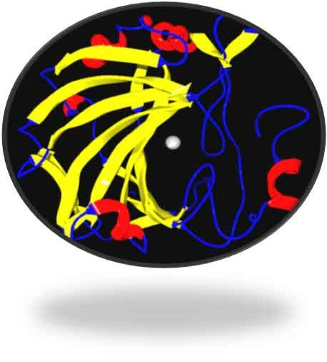
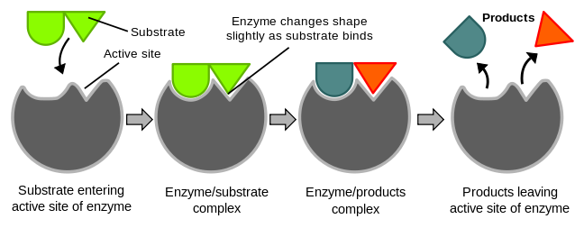
Enzymes
Images: Ribbon diagram of
enzyme with cofactor; Enzymatic reaction, Wiki
From the Virtual Cell Biology Classroom on ScienceProfOnline.com

Slide 3
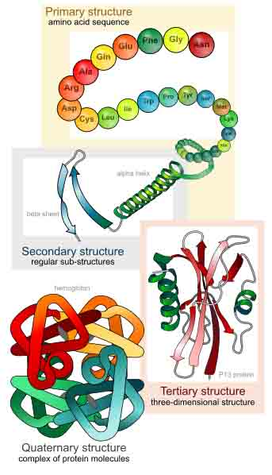
What are enzymes?
Enzymes
are
proteins.
Tertiary an d
quaternary
structure.
Q: What cellular organelle makes proteins?
From the Virtual Cell Biology Classroom on ScienceProfOnline.com
Image: Levels of protein structure, M Ruiz

Slide 4
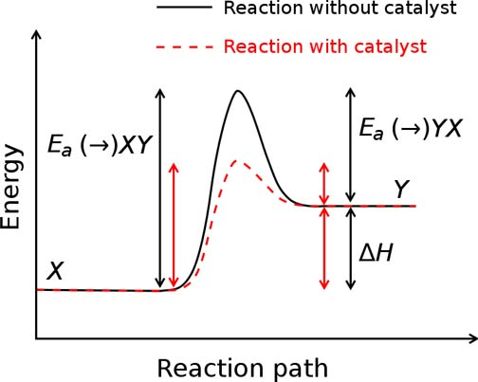
What do enzymes do?
Enzymes act as catalysts in cellular reactions.
Q: What does a catalyst do?
From the Virtual Cell Biology Classroom on ScienceProfOnline.com
Images: Activation energy graph, Wiki
Notes:
catalysts

Slide 5
How do enzymes work?
Enzymes catalyze reactions by weakening chemical bonds, which lowers activation energy.
Video:
Activation Energy
From the Virtual Cell Biology Classroom on ScienceProfOnline.com
Image: Activation energy graph, Wiki

Slide 6
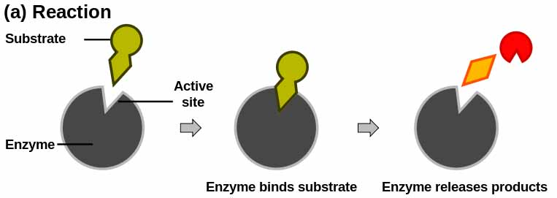
How do enzymes work?
Each enzyme has a unique 3-D shape, including a surface groove called an active site.
The enzyme works by binding a specific chemical reactant (substrate) to its active site, causing the substrate to become unstable and react.
The resulting product(s) is then released from the active site.
  Video: How Enzymes Work
From the Virtual Cell Biology Classroom on ScienceProfOnline.com
Image: Enzymatic reaction, Jerry Crimson Manni

Slide 7
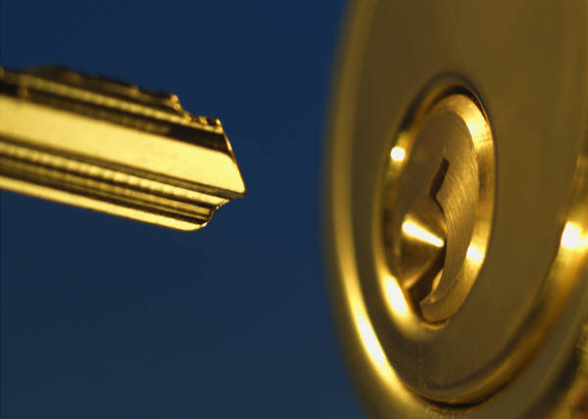
Enzymes…
are specific for what they will catalyze.
fit with substrate like a key and lock.
From the Virtual Cell Biology Classroom on ScienceProfOnline.com

Slide 8
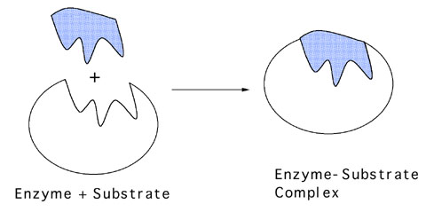
When an enzyme is interacting with it’s substrate, during the chemical reaction, together they are referred to as the …
From the Virtual Cell Biology Classroom on ScienceProfOnline.com
Image: Enzyme –substrate complex, UC Davis

Slide 9
…are reusable.
They are not consumed (used up) in the reactions they catalyze.
May perform thousands of reactions per second.
Enzymes…
Video: Enzyme Hydrolysis of Sucrose
From the Virtual Cell Biology Classroom on ScienceProfOnline.com

Slide 10

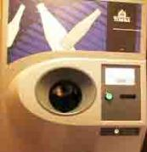
The more cans (substrate), the more $ (product).
The more recycling machines (enzymes), the faster the cans turn into $.
Enzymes are like tiny machines that catalyze reactions within living things.
$
$
$
$
$
$
$
From the Virtual Cell Biology Classroom on ScienceProfOnline.com

Slide 11
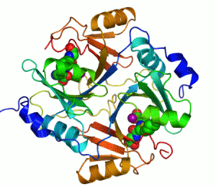
Enzymes…
Have names that usually end in -ase.
- Sucrase
- Lactase
- Maltase
From the Virtual Cell Biology Classroom on ScienceProfOnline.com
Image: Animation of Enzyme, Wiki
Notes:
- ase

Slide 12
Formats for writing an enzymatic reaction.
( ________ )
_______ + ________ -----------> _________
( ________ )
__________ -----------> ________ ________
From the Virtual Cell Biology Classroom on ScienceProfOnline.com
Notes:
Reactant, reactant, (enzyme) > product
Reactant, (enzyme) > product, product
One or more of the reactants in an enzymatic reaction is the substrate, the reactant(s) that specifically interacts with the enzyme.

Slide 13
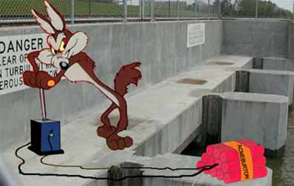
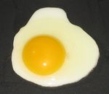

Q: How do you sabotage an enzyme?
• Denature it!
Alteration of a protein shape through some form of external stress
• Example, by applying heat, acidic or
alkaline environment
• Denatured enzyme can’t carry out its
cellular function .
Irreversible egg protein denaturation caused by high temperature (while cooking it).
Video: Denaturation in Food
From the Virtual Cell Biology Classroom on ScienceProfOnline.com

Slide 14
Factors That Influence Enzyme Activity
Temperature
pH
Cofactors & Coenzymes
Inhibitors
From the Virtual Cell Biology Classroom on ScienceProfOnline.com
Image: Animation of Enzyme, Wiki

Slide 15
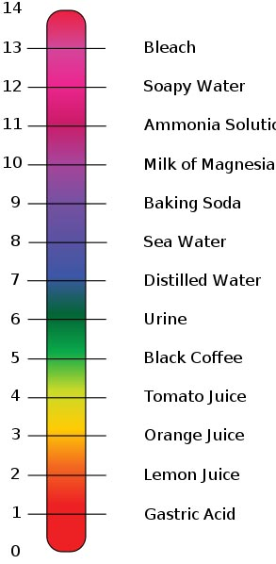
Temperature & pH
Think about what kind of cell or organism an enzyme may work in…
Temperatures far above the normal range denature enzymes. (This is why very high fevers are so dangerous. They can cook the body’s proteins.)
Most enzymes work best near neutral pH (6 to 8).
From the Virtual Cell Biology Classroom on ScienceProfOnline.com
Images: pH scale, Edward Stevens, Wiki

Slide 16
Factors That Influence Enzyme Activity
Temperature
pH
Cofactors & Coenzymes
Inhibitors
From the Virtual Cell Biology Classroom on ScienceProfOnline.com
Image: Animation of Enzyme, Wiki

Slide 17
Cofactors / Coenzymes
Non-protein portion of the enzyme (ex. zinc, iron, copper, vitamins) that is need for proper enzymatic activity.
Image: Enzyme with Cofactor, Wiki. Ribbon-diagram showing carbonic anhydrase II. The grey sphere is the zinc cofactor in the active site.
From the Virtual Cell Biology Classroom on ScienceProfOnline.com

Slide 18
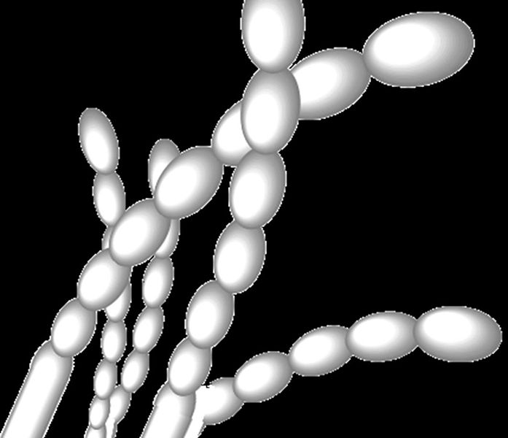
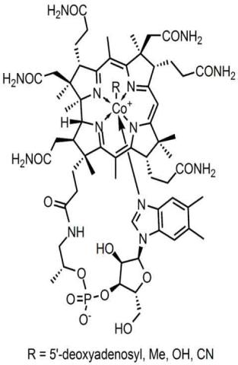
Coenzyme: Vitamin B12
Most vitamins are coenzymes essential in helping move atoms between molecules in the formation of carbohydrates, fats, and proteins.
Exclusively synthesized by bacteria.
Dietary sources include meat, eggs, dairy products and supplements.
Images: Streptomyces spores, Wiki; Vitamin B12 chemical structure, Wiki
From the Virtual Cell Biology Classroom on ScienceProfOnline.com

Slide 19
Factors That Influence Enzyme Activity
Temperature
pH
Cofactors & Coenzymes
Inhibitors
From the Virtual Cell Biology Classroom on ScienceProfOnline.com
Image: Animation of Enzyme, Wiki

Slide 20
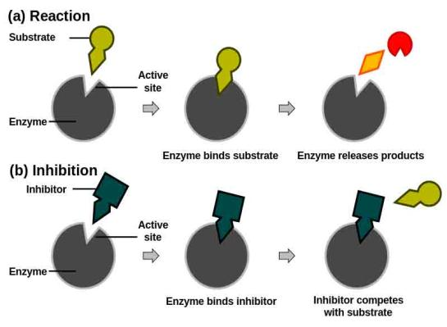

Two Types of Enzyme Inhibitors
1. Competitive
inhibitor
Chemicals that resemble an enzyme’s normal substrate and compete with it for the active site.
Reversible depending on concentration of inhibitor and substrate.
EXAMPLE: The drug Antabuse is used to help alcoholics quit drinking. Antabuse inhibits aldehyde oxidase, resulting in the accumulation of acetaldehyde (say a-si-’tell-de-hide) during the metabolism of alcohol. Elevated acetaldehyde levels cause symptoms of nausea and vomiting.
From the Virtual Cell Biology Classroom on ScienceProfOnline.com
Image: Competitive inhibition of enzyme, Jerry Crimson Mann

Slide 21
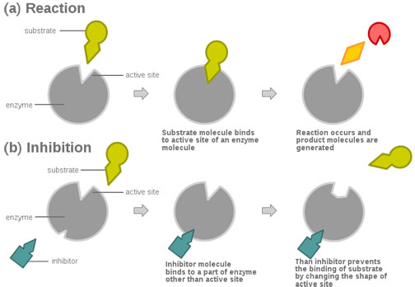

Two Types of Enzyme Inhibitors
2. Non-competitive inhibitor
Do not enter active site, but bind to another part of the enzyme, causing the enzyme & active site to change shape.
Usually reversible, depending on concentration of inhibitor & substrate.
Video
Feedback Inhibition of a Metabolic Pathway
EXAMPLE: You may know that compounds containing heavy metals such as lead, mercury, copper or silver are poisonous. This is because ions of these metals are non-competitive inhibitors for several enzymes.
From the Virtual Cell Biology Classroom on ScienceProfOnline.com
Image: Pouring liquid mercury, Bionerd

Slide 22

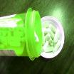

Enzyme Inhibitors
Blocking an enzyme's activity can kill a pathogen or correct a metabolic imbalance.
Many medications are
enzyme inhibitors.
Enzyme inhibitors are also used as herbicides and pesticides.
EXAMPLE:
Another example of competitive inhibition is protease inhibitors.
They are a class of anti-retroviral drugs used to treat HIV.
The structure of the drug ritonavir (say ri-TAHN-a-veer) resembles the substrate of HIV protease, an enzyme required for HIV to be made.
From the Virtual Cell Biology Classroom on ScienceProfOnline.com
Images: Prescription bottle, T. Port; Dead cockroach, Wiki

Slide 23
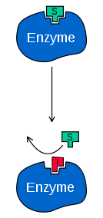
REVIEW!
Enzyme Inhibition:
1. Enzyme Inhibition I
2. Enzyme Inhibition II
3. Feedback Inhibition
of a Metabolic Pathway
Q: What type of inhibition is this?
Image: Enzyme Inhibitor, Wiki
From the Virtual Cell Biology Classroom on ScienceProfOnline.com

Slide 24
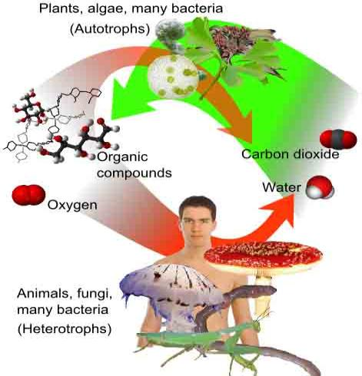
Metabolism
The Transformation of Energy
Sum of all chemical reactions in a cell or organism.
Cells either get their energy either by photosynthesis or by eating stuff.
From the Virtual Cell Biology Classroom on ScienceProfOnline.com
Image: Autotrophs & Heterotrophs, Mikael Häggström

Slide 25
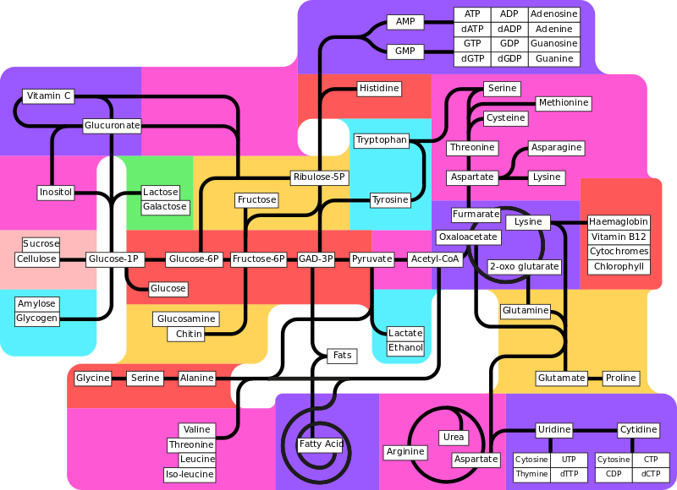
Metabolic Pathways
Series of chemical reactions that regulate the concentration of substances within the organism.
Has order, like an assembly line.
Molecules are altered in a series of steps.
Use many smaller
steps rather than
one big step.
Enzymes are workers that control each station along the pathway.
May be turned on and off as needed.
  Video:
  Biochemical Pathways
From the Virtual Cell Biology Classroom on ScienceProfOnline.com
Image: Metabolism Pathways, Wiki

Slide 26
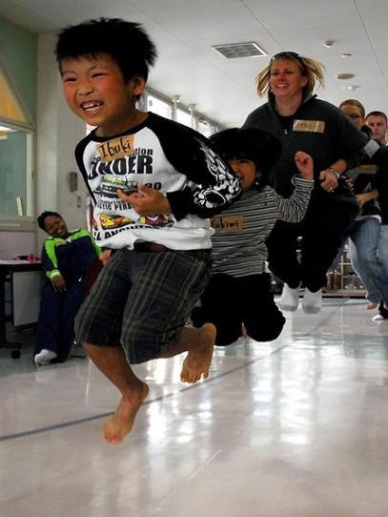
Why Are Enzymes So Important?
Why are we devoting one whole lecture topic to a protein molecule?
Nearly all chemical reactions in biological cells need enzymes to make the reaction occur fast enough to support life.
From the Virtual Cell Biology Classroom on ScienceProfOnline.com
Image: Jumping rope, Meagan E. Klein

Slide 27
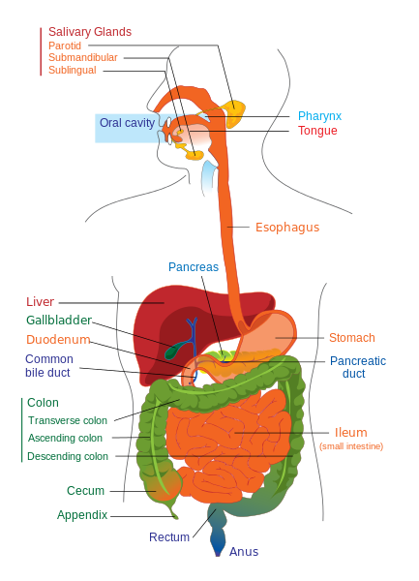
Digestion & Enzymes
Digesting one meal could take years without enzymes!
Examples of digestive enzymes: sucrase, lipase, amylase.
Videos:
1. Digestion of Molecules Animation
2. A Look At Digestive Enzymes In Our Body
3. Role of Enzymes in Digestion of Food
4. The Digestive System: Follow the Food!
From the Virtual Cell Biology Classroom on ScienceProfOnline.com
Image: Digestive system diagram, Wiki

Slide 28
Study Table of Enzymes & Digestion
(We will fill this in as we go through lecture & lab.)
 | Enzymes involved? Which? | What’s happening? |  | Protein y/n | Carbs y/n | Fat y/n
mouth |  |  | digested?
 |  |  | absorbed?
esophagus |  |  | digested?
 |  |  | absorbed?
stomach |  |  | digested?
 |  |  | absorbed?
small intestines |  |  | digested?
 |  |  | absorbed?
large intestine |  |  | digested?
 |  |  | absorbed?
From the Virtual Biology Classroom on ScienceProfOnline.com

Slide 29
Confused?
Here are some links to fun resources that further explain enzymes:
Enzymes Main Page on the Virtual Cell Biology Classroom of Science Prof Online.
“How Enzymes Work” an animation from McGraw-Hill.
“The Role Enzymes Play in the Body” from Enzymedica. These guys are selling supplements. I don’t endorse the supplement, but their video is very instructive regarding enzymes and digestion.
Enzyme Substrate Interactions from Pearson Education.
“Enzymes and Digestion” from About.com.
“Bio Rad GTCA Song” musical advertisement for SsoFast™.
(You must be in PPT slideshow view to click on links.)
Smart Links
From the Virtual Cell Biology Classroom on ScienceProfOnline.com

Slide 30
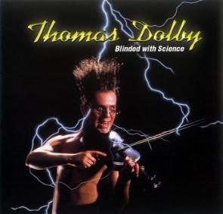

Are you feeling blinded by science?
Do yourself a favor. Use the…
Virtual Cell Biology Classroom (VCBC) !
The VCBC is full of resources to help you succeed, including:
practice test questions
review questions
study guides and learning objectives
PowerPoints on other topics
You can access the VCBC by going to the Science Prof Online website www.ScienceProfOnline.com
Images: Blinded With Science album, Thomas Dolby; Endomembrane system, Mariana Ruiz, Wiki

