Slide 1

About Science Prof Online
PowerPoint Resources
Science Prof Online (SPO) is a free science education website that provides fully-developed Virtual Science Classrooms, science-related PowerPoints, articles and images. The site is designed to be a helpful resource for students, educators, and anyone interested in learning about science.
The SPO Virtual Classrooms offer many educational resources, including practice test questions, review questions, lecture PowerPoints, video tutorials, sample assignments and course syllabi. New materials are continually being developed, so check back frequently, or follow us on Facebook (Science Prof Online) or Twitter (ScienceProfSPO) for updates.
Many SPO PowerPoints are available in a variety of formats, such as fully editable PowerPoint files, as well as uneditable versions in smaller file sizes, such as PowerPoint Shows and Portable Document Format (.pdf), for ease of printing.
Images used on this resource, and on the SPO website are, wherever possible, credited and linked to their source. Any words underlined and appearing in blue are links that can be clicked on for more information. PowerPoints must be viewed in slide show mode to use the hyperlinks directly.
Several helpful links to fun and interactive learning tools are included throughout the PPT and on the Smart Links slide, near the end of each presentation. You must be in slide show mode to utilize hyperlinks and animations.
This digital resource is licensed under Creative Commons Attribution-ShareAlike 3.0:
http://creativecommons.org/licenses/by-sa/3.0/
Alicia Cepaitis, MS
Chief Creative Nerd
Science Prof Online
Online Education Resources, LLC
alicia@scienceprofonline.com
Tami Port, MS
Creator of Science Prof Online
Chief Executive Nerd
Science Prof Online
Online Education Resources, LLC
info@scienceprofonline.com
From the Virtual Cell Biology Classroom on ScienceProfOnline.com
Image: Compound microscope objectives, T. Port
Notes:
Welcome to Science Prof Online PowerPoint Resources!
This PowerPoint Presentation comes from the Virtual Cell Biology Classroom of Science Prof Online, and, as such, is licensed under Creative Commons Attribution-ShareAlike 3.0.; meaning you can download, share and alter any of this presentation, but you can’t sell it or repackage and sell any part of it. Please credit Science Prof Online as the source of this presentation. Please abide by credited image copyrights. Thank you for using this resource.

Slide 2
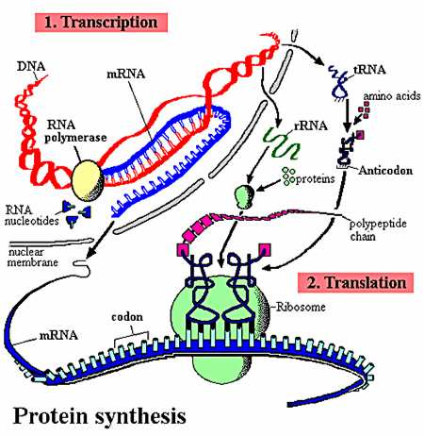
Gene Expression
Transcription
&
Translation
(Making Proteins)
From the Virtual Cell Biology Classroom on ScienceProfOnline.com

Slide 3
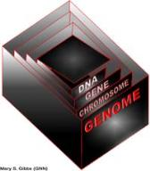
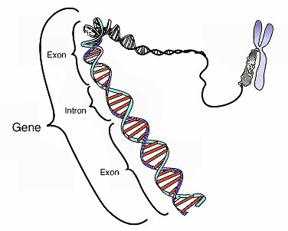
Chromosomes & Genes
Genome - Complete complement of an organism’s DNA.
Cellular DNA is organized in chromosomes.
Genes have specific places on chromosomes.
Image: Chromosome & gene, Graham Colm, National Human Genome Research Institute
From the Virtual Cell Biology Classroom on ScienceProfOnline.com

Slide 4
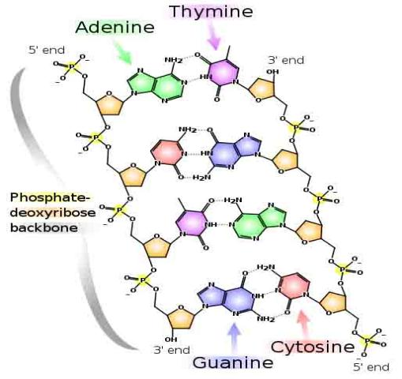
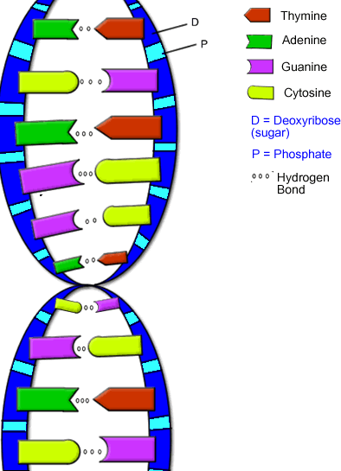
Nucleic Acid: DNA Structure
From the Virtual Cell Biology Classroom on ScienceProfOnline.com
Image: DNA Detail Diagram: Madprime; DNA Molecule, Biology Corner

Slide 5
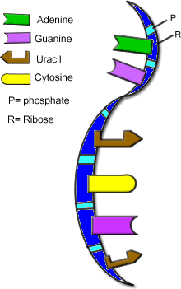
Nucleic Acids: RNA Structure
RNA is typically a single-stranded molecule.
Purine Bases (double ring)
Adenine & Guanine
Pyrimidine Bases (single ring)
Cytosine & _______
From the Virtual Cell Biology Classroom on ScienceProfOnline.com
Image: RNA, Biology Corner
Notes:
Uracil

Slide 6

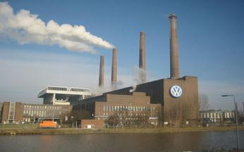
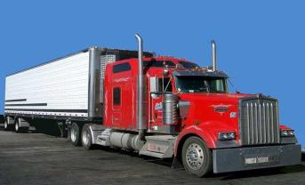
Types of RNA
Genetic information copied from DNA is transferred to 3 types of RNA:
messenger (mRNA) is like a
Copy of information in DNA that is brought to
the ribosome where the information is
translated into a protein.
ribosomal (rRNA) is like a
The protein factories of the cells.
transfer (tRNA) are like a
Brings the amino acid to the ribosome.
From the Virtual Cell Biology Classroom on ScienceProfOnline.com
Images: Blueprint, clipart; Factory, Andreas Praefcke; Truck, PRA; Ribosome translating protein, Xvazquez.
Notes:
blueprint
factory
truck

Slide 7
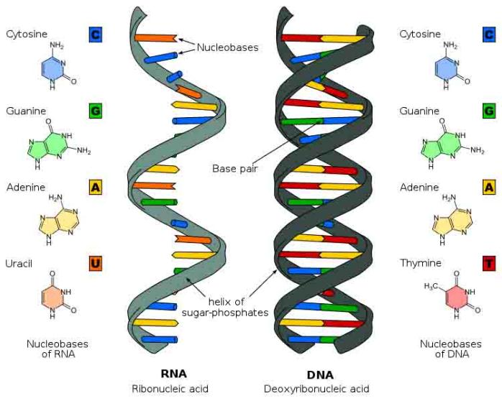
Nucleic Acid Structure
See SPO Class Notes article on Nucleotides & Nucleic Acids.
From the Virtual Cell Biology Classroom on ScienceProfOnline.com
Image: Comparison of DNA & RNA, Wiki Commons
Notes:
Uracil

Slide 8
Nucleic Acid Function
Transcription
&
Translation
From the Virtual Cell Biology Classroom on ScienceProfOnline.com

Slide 9
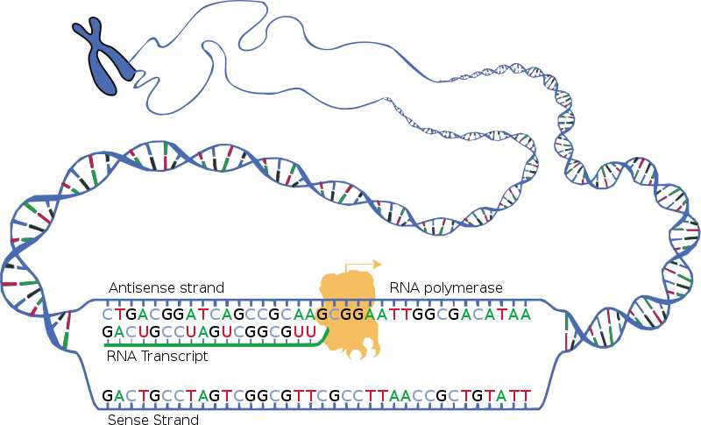
Transcription
Process by which a DNA sequence is copied to produce a complementary mRNA strand.
In other words, it is the transfer of genetic information from DNA into RNA.
Like replication, but making RNA.
Beginning of the process that ultimately leads to the translation of the genetic code (via mRNA) into a protein.
REVIEW
Transcription Animations
mRNA Synthesis from McGraw-Hill
2. Transcription from WH Freeman
From the Virtual Cell Biology Classroom on ScienceProfOnline.com
Image: Transcription, National Human Genome Research Institute.

Slide 10
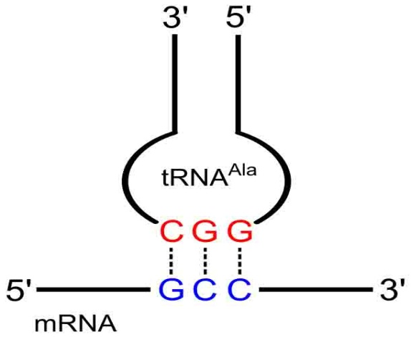
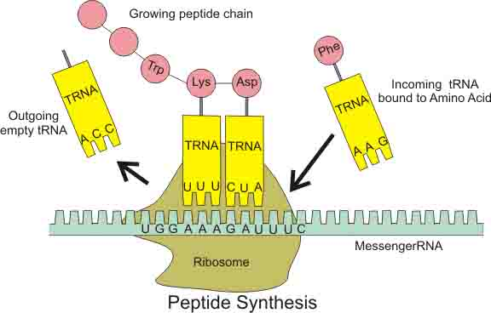
Translation
Ribosomes (which contain rRNA) make proteins from the messages encoded in mRNA.
The genetic instructions for a polypeptide chain are ‘written’ in the DNA as a series of
3-nucleotide ‘words.’
______ on mRNA
___________ on tRNA
‘U’ (uracil) replaces ‘T’ in RNA
This is the genetic code.
Q: Where does translation occur in prokaryotes?
Q: Eukaryotes?
Anti-codon
Codon
From the Virtual Cell Biology Classroom on ScienceProfOnline.com
Image: Codon-Anticodon pairing, Yikrazuul, Wiki; Peptide Synthesis Diagram: Boumphreyfr, Wiki.
Notes:
Genetic Code
Ribosomes
Codon
Anti-codon

Slide 11
Translation
REVIEW
Translation Animations
How Translation Works from McGraw-Hill
Ribosome Building
a Protein
from Wikipedia
From the Virtual Cell Biology Classroom on ScienceProfOnline.com
Image: Peptide Synthesis Diagram: Boumphreyfr, Wiki

Slide 12
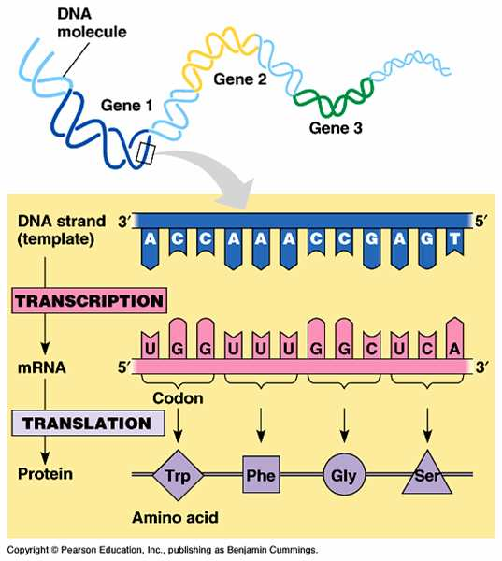
Transcription & Translation Overview
REVIEW
Interactive animation that allows you to transcribe and translate
a gene!
See SPO Class Notes article on DNA Function: Transcription & Translation.
From the Virtual Cell Biology Classroom on ScienceProfOnline.com

Slide 13
Transcription + Translation = Gene Expression
Section of DNA (a gene) being transcribed & translated to produce a protein.
Genes can be turned on and off.
DISCUSSION: How do the Radiolab “Inheritance” Podcast segments on rat maternal behavior (time 16:00 – 25:00) and starving boys from Overkalix, Sweden (time 28:30 - 40:00) relate to gene expression?
From the Virtual Cell Biology Classroom on ScienceProfOnline.com

Slide 14
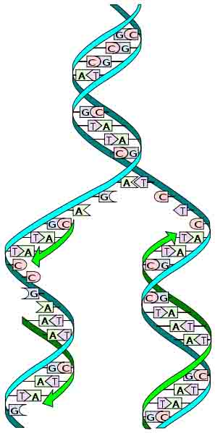
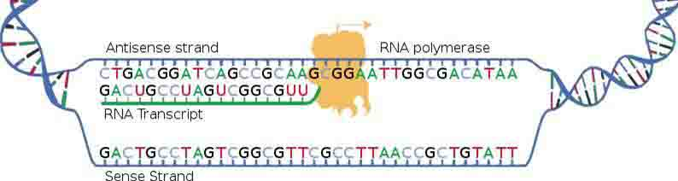
Replication, Transcription, Translation
  MAKING DNA
  Making a copy of the genetic material = Replication
  When you think “replication” think “duplication”
  Q: Where does replication occur in prokaryotes? Eukaryotes?
  MAKING RNA
  Transferring genetic code (DNA) to RNA = Transcription
  Think of a medical transcriptionist copying the physicians words into another format.
  Q: Where does transcription occur in prokaryotes? Eukaryotes?
  MAKING PROTEINS
  Making proteins = Translation
  Think of how translation relates to languages.
  The translation of biology translates DNA information into proteins.
  Q: Where does translation occur in prokaryotes? Eukaryotes?
From the Virtual Cell Biology Classroom on ScienceProfOnline.com
Images: Replication Diagram: Madprime; Peptide Synthesis Diagram: Boumphreyfr, Wiki
Notes:
Translation

Slide 15
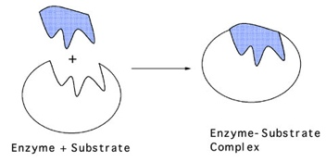
Let’s put it all together!
The order of nucleotide bases in the DNA, in three base groupings (codons), is the genetic code; the “blueprints” of an organism.
Mutations result when there is a mistake copying the DNA (replication).
DNA is instructions for building proteins (from amino acids).
Mutations in the DNA code can result in the wrong amino acid being added to a protein.
A different amino acid can change the shape of that protein, and if a protein’s shape is changed, it can’t do its job.
Image: Peptide Synthesis Diagram: Boumphreyfr, Wiki; Replication Diagram: Madprime, Wiki
From the Virtual Cell Biology Classroom on ScienceProfOnline.com

Slide 16
Hereditary Diseases are due to DNA mutations
All inherited diseases arise from a mistake in the genetic code passed down from a person’s parents, which leads to a defective protein.
Image: Peptide Synthesis Diagram: Boumphreyfr, Wiki; Replication Diagram: Madprime, Wiki
From the Virtual Cell Biology Classroom on ScienceProfOnline.com

Slide 17
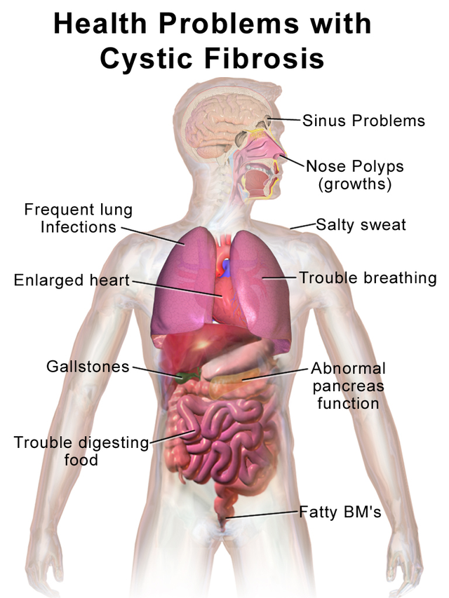
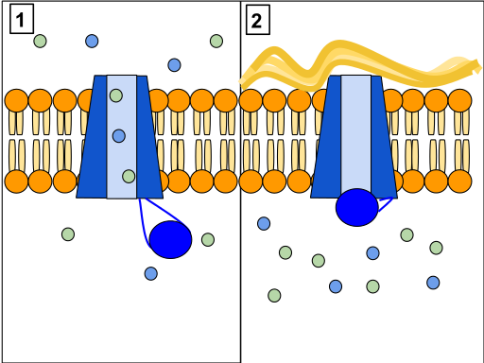
Cystic fibrosis (CF) is the most common, fatal genetic disease in the US.
Causes the body to produce thick mucus that clogs the lungs, leads to infection, and blocks the pancreas from delivering digestive enzymes to the intestine.
Results from mutations in a single gene:
Cystic Fibrosis Transmembrane Regulator (CFTR) gene.
In normal cells, the CFTR channel protein allows cells to release chloride and other ions.
In people with CF, this protein is defective and the cells are not able to release the chloride, resulting in an improper salt balance in the cells and thick, sticky mucus.
Medical research is focusing on ways to cure CF by correcting the defective gene, or correcting the defective protein.
Genetic Disease: Cystic Fibrosis (CF)
CFTR channel protein controls flow of H2O and Cl- inside the lungs. When this protein is working correctly (Panel 1) ions can flow in and out of the cells. But, when the CFTR protein is blocked (Panel 2) these ions cannot flow out of the cell due.
Images: Health Problems of Cystic Fibrosis, Bruce Blaus Wiki, CFTR, Protein Channel, Wiki
From the Virtual Cell Biology Classroom on ScienceProfOnline.com

Slide 18
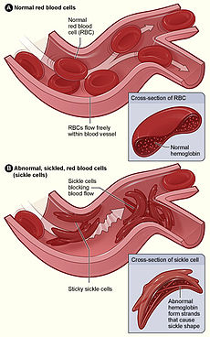
Most common inherited blood disorder in the United States.
In the US, sickle cell disease is most prevalent among African Americans.
Caused by a mutation in the hemoglobin-Beta gene found on chromosome 11.
Hemoglobin transports oxygen from the lungs to other parts of the body.
Red blood cells with normal hemoglobin (hemoglobin-A) are smooth and round and easily flow through blood vessels.
People with this disease have abnormal hemoglobin molecules that stick to one another and cause red blood cells to become sickle shaped and pile up, rather than flow, causing blockages and damaging vital organs and tissue.
People who only carry the sickle cell trait typically don't get the disease, but can pass the defective gene on to their children.
Genetic Disease: Sickle Cell Disease
From the Virtual Cell Biology Classroom on ScienceProfOnline.com
Image: Sickle Cell Diagram. Wiki

Slide 19
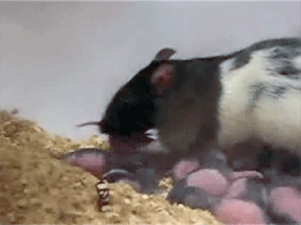
What is Epigenetics?
Heritable changes in gene expression that do not involve changes to the DNA sequence
A change in phenotype without a change in genotype.
Epigenetic change can be influenced by several factors including age, environment, lifestyle, and disease.
From the Virtual Cell Biology Classroom on ScienceProfOnline.com
Image: Rat Mother Licking Babies, by Dr. Frances Champagne

Slide 20
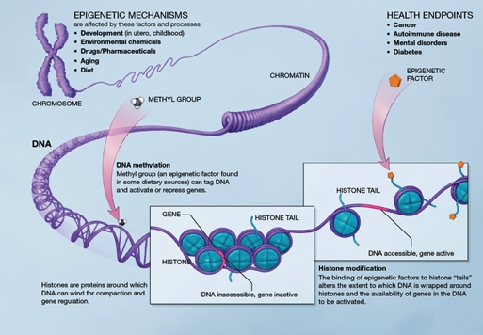
What is Epigenetics?
From the Virtual Cell Biology Classroom on ScienceProfOnline.com
Image: Epigenetics Mechanisms, Wiki

Slide 21
Confused?
Here are links to fun resources that further explain genetic transcription & translation:
Molecular Genetics: Replication Main Page on the Virtual Cell Biology Classroom of Science Prof Online.
“That Spells DNA” song by Jonathan Coulton.
DNA Structure Cell Biology Animation from John Kyrk.
Build a DNA Molecule from University of Utah.
DNA Replication animation and review questions.
DNA Replication Process animated video by FreeScienceLectures.com.
DNA Replication step-through animation by John Kyrk.
Transcription & Translation Main Page on the Virtual Cell Biology Classroom of Science Prof Online.
DNA Transcription step-through animation by John Kyrk.
Transcribe & Translate a Gene, from University of Utah.
DNA Transcription and Protein Assembly animated movie by RedAndBrownPaperBag.
Transcription and Translation animated movie from PBS production “DNA: The Secret of Life.
(You must be in PPT slideshow view to click on links.)
Smart Links
From the Virtual Cell Biology Classroom on ScienceProfOnline.com

Slide 22
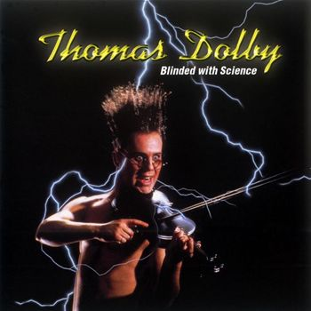
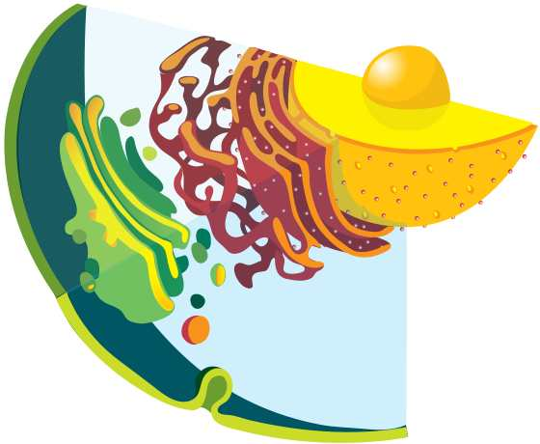
Are you feeling blinded by science?
Do yourself a favor. Use the…
Virtual Cell Biology Classroom (VCBC) !
The VCBC is full of resources to help you succeed, including:
practice test questions
review questions
study guides and learning objectives
PowerPoints on other topics
Access the Virtual Cell Biology Classroom (VCBC) on the Science Prof Online website www.ScienceProfOnline.com
Images: Blinded With Science album, Thomas Dolby; Endomembrane system, Mariana Ruiz, Wiki

