Slide 1

About Science Prof Online
PowerPoint Resources
Science Prof Online (SPO) is a free science education website that provides fully-developed Virtual Science Classrooms, science-related PowerPoints, articles and images. The site is designed to be a helpful resource for students, educators, and anyone interested in learning about science.
The SPO Virtual Classrooms offer many educational resources, including practice test questions, review questions, lecture PowerPoints, video tutorials, sample assignments and course syllabi. New materials are continually being developed, so check back frequently, or follow us on Facebook (Science Prof Online) or Twitter (ScienceProfSPO) for updates.
Many SPO PowerPoints are available in a variety of formats, such as fully editable PowerPoint files, as well as uneditable versions in smaller file sizes, such as PowerPoint Shows and Portable Document Format (.pdf), for ease of printing.
Images used on this resource, and on the SPO website are, wherever possible, credited and linked to their source. Any words underlined and appearing in blue are links that can be clicked on for more information. PowerPoints must be viewed in slide show mode to use the hyperlinks directly.
Several helpful links to fun and interactive learning tools are included throughout the PPT and on the Smart Links slide, near the end of each presentation. You must be in slide show mode to utilize hyperlinks and animations.
This digital resource is licensed under Creative Commons Attribution-ShareAlike 3.0:
http://creativecommons.org/licenses/by-sa/3.0/
Alicia Cepaitis, MS
Chief Creative Nerd
Science Prof Online
Online Education Resources, LLC
alicia@scienceprofonline.com
Tami Port, MS
Creator of Science Prof Online
Chief Executive Nerd
Science Prof Online
Online Education Resources, LLC
info@scienceprofonline.com
From the Virtual Biology Classroom on ScienceProfOnline.com
Image: Compound microscope objectives, T. Port
Notes:
Welcome to Science Prof Online PowerPoint Resources!
This PowerPoint Presentation comes from the Virtual Cell Biology Classroom of Science Prof Online, and, as such, is licensed under Creative Commons Attribution-ShareAlike 3.0.; meaning you can download, share and alter any of this presentation, but you can’t sell it or repackage and sell any part of it. Please credit Science Prof Online as the source of this presentation. Please abide by credited image copyrights. Thank you for using this resource.

Slide 2
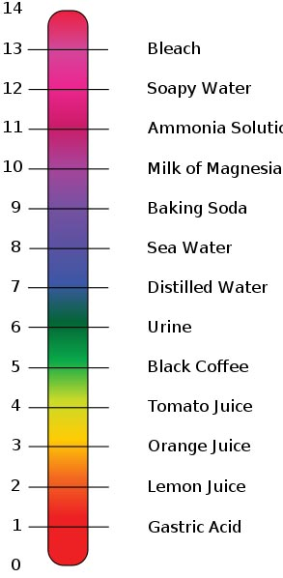
Acids, Bases & Buffers
Importance of
The pH Scale
in Biology
Images: pH scale, Edward Stevens, Wiki
From the Virtual Biology Classroom on ScienceProfOnline.com

Slide 3
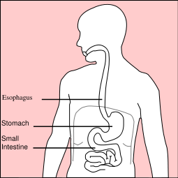
Everyday Science
Q: Where is the most acidic area of your body?
Q: What would be the purpose of having acidic gastric juices in the stomach?
WATCH THIS! Ever wonder how corrosive human stomach acid is?
Images: Human digestive system, Wiki
From the Virtual Biology Classroom on ScienceProfOnline.com

Slide 4
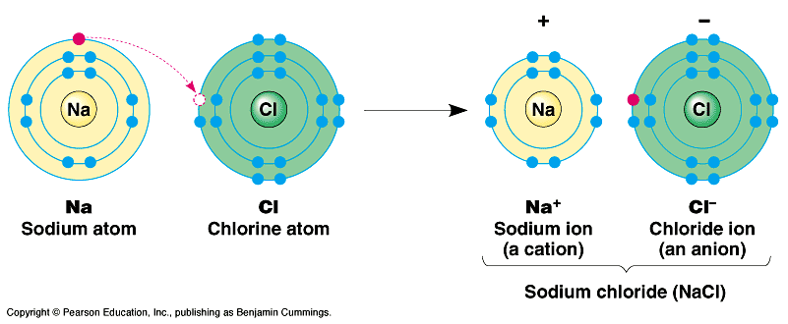
Ionic Bonds
Involves transfer of electrons between two atoms.
Found mainly … inorganic compounds.
Ion = an atom or group of atoms which have lost or gained one or more electrons, making them negatively or positively charged.
Q: What are positively charged ions (+) called?
Q: What are negatively charged ions (-) called?
Images: Sodium Chloride, University of Winnepeg
From the Virtual Cell Biology Classroom on ScienceProfOnline.com

Slide 5
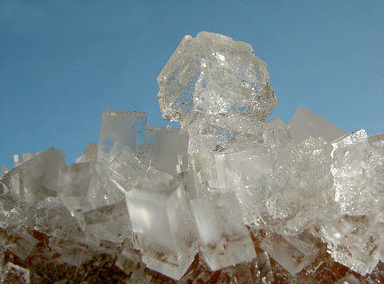
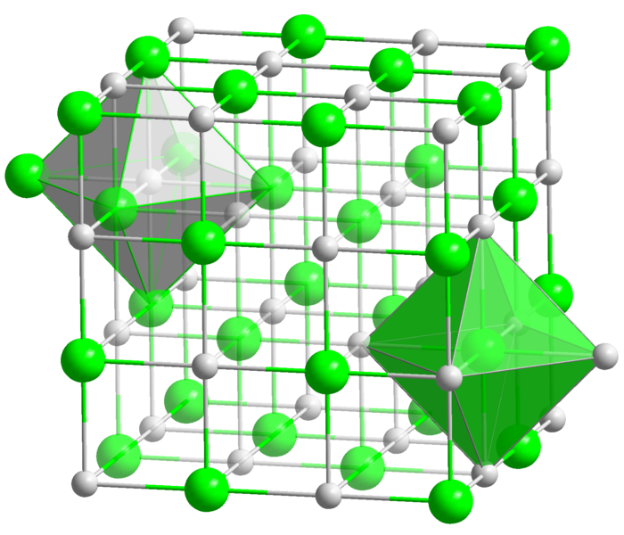
Ionic compounds are made of oppositely charged ions
Ionic Bonds are atoms held together by attraction between
a (+) and a (–) ion
Compound is neutral overall, but still charged on the inside.
Makes solid crystals.
Images: Halit crystal, Crystal structure of NaCl, Wiki
From the Virtual Cell Biology Classroom on ScienceProfOnline.com

Slide 6
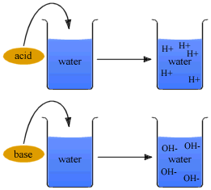
Ions: Acids & Bases
An acid is any ionic compound that releases hydrogen _____ (H⁺) in solution.
A base is any ionic compound that releases hydroxide _____ (⁻OH) in solution.
From the Virtual Biology Classroom on ScienceProfOnline.com
Notes:
cations
anions

Slide 7
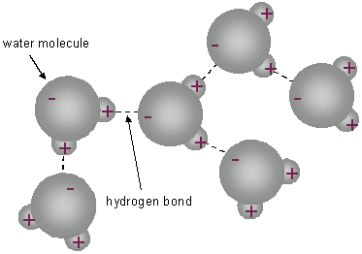
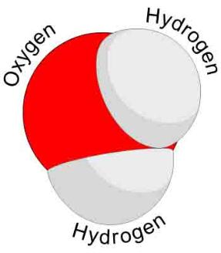
Another important characteristic of water…
Water can form acids and bases
Image: Periodic Table of Elements; Water Molecule, Wiki
From the Virtual Biology Classroom on ScienceProfOnline.com

Slide 8


Dissociation of Water
Hydronium ion +
Hydroxyl ion -
Neutral water has equal amounts of H⁺ and OH ⁻
Acids: Excess of H⁺ in aqueous solution
Bases: Excess of OH⁻ in aqueous solution
Acids & bases neutralize each other.
Images: Dissociation of water, Wiki
From the Virtual Biology Classroom on ScienceProfOnline.com

Slide 9
Measurements of Acidity & Alkalinity (pH)
Acidity of a solution > measured by concentration of hydrogen ions (H+) vs. hydroxyl ions (OH-).
pH ranges: 0 (very acidic) to 14 (very basic).
pH scale is logarithmic.
Change in just one unit of scale = tenfold change in H+ concentration.
If concentration of H+ = OH - … neutral.
Images: pH scale, Edward Stevens, Wiki
From the Virtual Biology Classroom on ScienceProfOnline.com

Slide 10
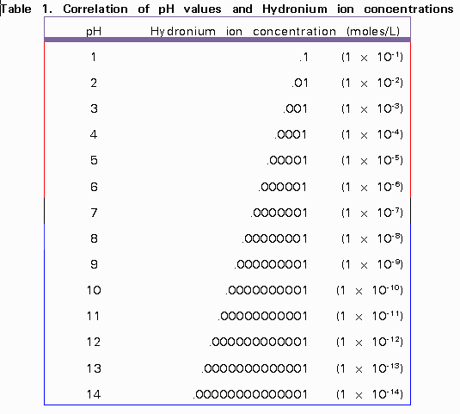
pH scale is logarithmic
Change in just one unit of scale
= tenfold change in H+ concentration.
Image: pH & hydronium ion concentration, UBC Wiki
From the Virtual Biology Classroom on ScienceProfOnline.com

Slide 11
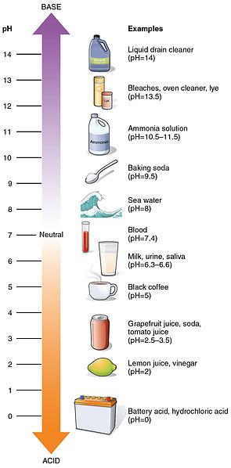
More Examples of pH from Daily Life
Images: pH scale, Wiki
From the Virtual Biology Classroom on ScienceProfOnline.com

Slide 12
Ions & Acids
An acid is any ionic compound that releases hydrogen ions (H+) in solution.
Weak acids have a sour taste.
Strong acids are highly corrosive (So don’t go around taste-testing acids.)
Examples:
Ascorbic acid (C₆H₈O₆, Vitamin C)
Citric acid (C₆H₈O₇, a weak organic acid in citrus fruits)
Phosphoric acid (H₃PO₄, in pop…this stuff is also used to remove rust…hmmm)
Images: pH scale, Edward Stevens, Wiki
From the Virtual Biology Classroom on ScienceProfOnline.com

Slide 13
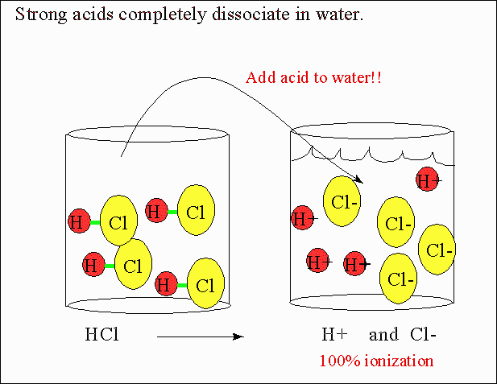
Images: Strong Acids, Department of Chemistry, CSU
From the Virtual Biology Classroom on ScienceProfOnline.com

Slide 14
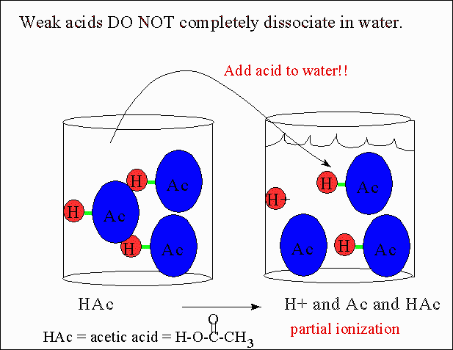
From the Virtual Biology Classroom on ScienceProfOnline.com

Slide 15
Ions & Bases
A base is an ionic compound that releases hydroxyl ions (OH-) in solution.
Bases are also called alkaline substances.
Some general properties of bases include:
Taste: Bitter taste (opposed to sour taste of acids and sweetness of aldehydes and ketones).
Touch: Slimy or soapy feel on fingers.
Reactivity: Strong bases are caustic on organic matter, react violently with acidic substances.
Examples:
Sodium hydroxide, NaOH, of lye or caustic soda used in oven cleaners.
Magnesium hydroxide, Mg(OH)², also known as milk of magnesia, a weak base used in antacids and laxatives.
Images: pH scale, Edward Stevens, Wiki
From the Virtual Biology Classroom on ScienceProfOnline.com

Slide 16
Acid/Base Balance in Biology
pH balance is important to homeostasis of organisms.
Homeostasis = tendency of the body to maintain a balanced internal environment, even when faced with external changes. Such as the body's ability to maintain an internal temperature around 98.6 degrees F, whatever the temperature outside.
Examples:
Digestion needs acidic environment (pH 2-3)
Urine is slightly acidic
Blood must stay in neutral range near 7.35 to 7.45
Acids, Bases & You, and in-depth YouTube video.
Images: pH scale, Edward Stevens, Wiki
From the Virtual Biology Classroom on ScienceProfOnline.com

Slide 17
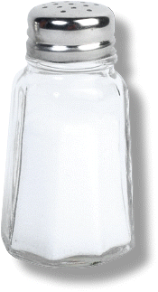
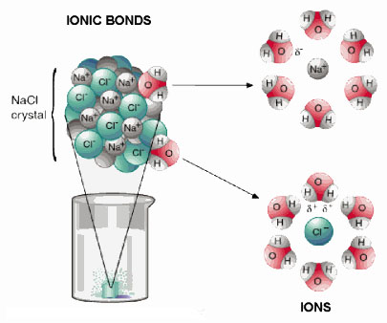
Ions & Salts
Compounds that dissociate in water and produce cations other than H+ and anions other than OH- are called salts.
The most familiar salt is sodium chloride, the principal component of common table salt.
Other examples of salts:
Baking soda (NaHCO3)
Epsom Salts (MgSO4)
From the Virtual Biology Classroom on ScienceProfOnline.com

Slide 18
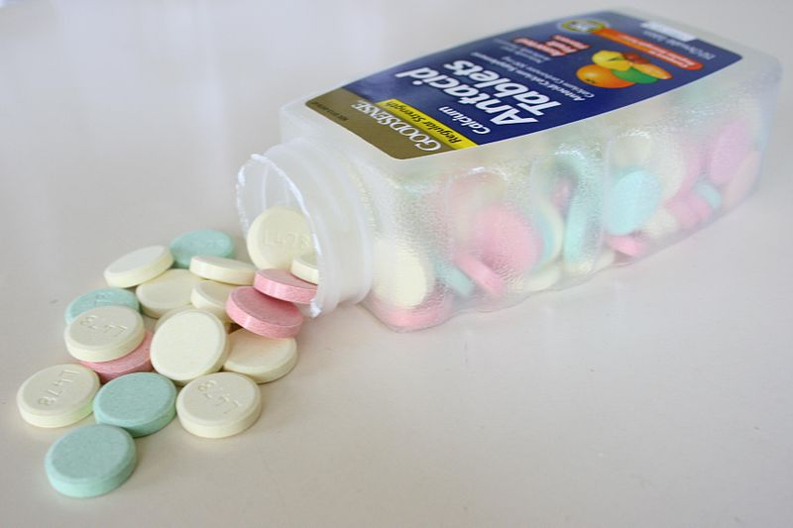
Salts: The Role of Buffers
Certain salts, called buffers, can
combine with excess hydrogen (H+) or
hydroxide (OH-) ions.
Produce substances less acidic or alkaline.
Act like a chemical sponge to soak up excess acid or base, keep pH constant.
- Buffers can be “used up”. Once used up, no longer help regulate pH.
- Buffers are vital to maintaining pH in organisms.
Example:
Antacids are buffers made of the salt calcium carbonate (CaCo3).
Images: Antacid Tablets, Wiki
From the Virtual Biology Classroom on ScienceProfOnline.com

Slide 19
Bicarbonate Buffer system is important in maintaining proper blood pH
Videos:
Bicarbonate Buffer System & pH imbalances
Bicarbonate Buffer System from John Wiley
Images: Bicarbonate Buffer System, Wiki
From the Virtual Biology Classroom on ScienceProfOnline.com

Slide 20
REVIEW!
Interactive animated lessons on
pH: Acids & Bases
and
Buffers
Image: Methane Covalent Bonds, Dynablast; Formation of ionic sodium fluoride,
From the Virtual Biology Classroom on ScienceProfOnline.com

Slide 21
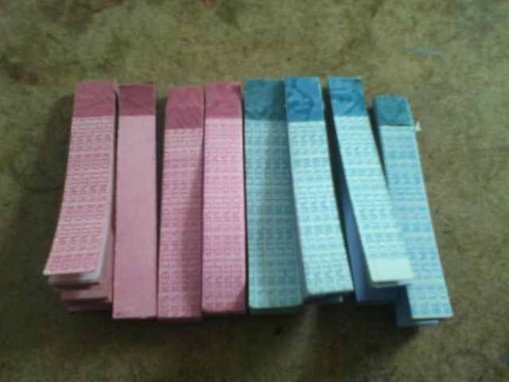
Tools that can be used to measure pH:
Litmus Paper
Litmus paper comes in two colors, red or blue.
Acidic substances turn blue litmus paper red.
Basic (alkaline) substances turn red litmus paper blue.
From the Virtual Biology Classroom on ScienceProfOnline.com
Image: Blue and Red Litmus Paper, Wiki

Slide 22
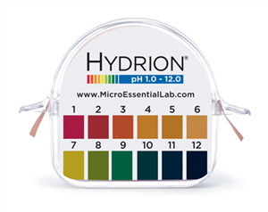
Tools that can be used to measure pH:
Hydrion Paper
Hydrion paper is used to to measure pH to the nearest whole number.
These “dip sticks” have colored squares (indicators) that change color in the presence of specific pH ranges.
You can determine the pH value to the nearest whole number by matching the colors on the key to the hydrion paper after you dip it into a substance and wait a few seconds.
From the Virtual Biology Classroom on ScienceProfOnline.com

Slide 23
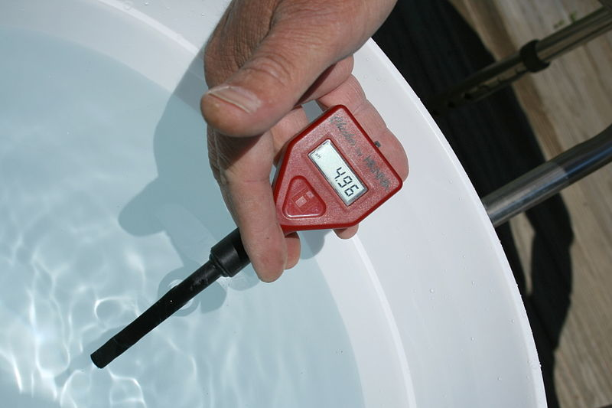
Tools that can be used to measure pH: pH Meter
A pH meter can be used to measure pH to the nearest tenth (0.1) or hundredth (0.01) depending on the insstrument.
pH meters must be calibrated in pH 7 buffer solution before you can use them to measure pH.
The meter should be rinsed in water after each use and kept in water when not in use.
Q: Which of the three pH measuring tools do you think is most accurate?
From the Virtual Biology Classroom on ScienceProfOnline.com
Image: pH meter, Wiki

Slide 24
Confused?
Here are some links to fun resources that further explain Chemistry:
Acids & Bases Are Everywhere from Chem4Kids website by Rader.
Acid & Bases, an Introduction by Vision Learning
Acids, Bases & You, and in-depth YouTube video.
Buffer System YouTube video.
Bicarbonate Buffer System & pH imbalances YouTube video.
(You must be in PPT slideshow view to click on links.)
Smart Links
From the Virtual Biology Classroom on ScienceProfOnline.com

