Slide 1
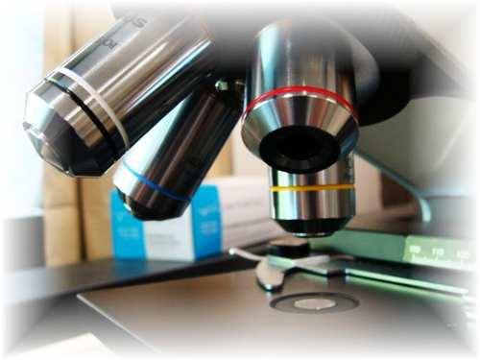
About Science Prof Online
PowerPoint Resources
Science Prof Online (SPO) is a free science education website that provides fully-developed Virtual Science Classrooms, science-related PowerPoints, articles and images. The site is designed to be a helpful resource for students, educators, and anyone interested in learning about science.
The SPO Virtual Classrooms offer many educational resources, including practice test questions, review questions, lecture PowerPoints, video tutorials, sample assignments and course syllabi. New materials are continually being developed, so check back frequently, or follow us on Facebook (Science Prof Online) or Twitter (ScienceProfSPO) for updates.
Many SPO PowerPoints are available in a variety of formats, such as fully editable PowerPoint files, as well as uneditable versions in smaller file sizes, such as PowerPoint Shows and Portable Document Format (.pdf), for ease of printing.
Images used on this resource, and on the SPO website are, wherever possible, credited and linked to their source. Any words underlined and appearing in blue are links that can be clicked on for more information. PowerPoints must be viewed in slide show mode to use the hyperlinks directly.
Several helpful links to fun and interactive learning tools are included throughout the PPT and on the Smart Links slide, near the end of each presentation. You must be in slide show mode to utilize hyperlinks and animations.
This digital resource is licensed under Creative Commons
Attribution-ShareAlike 3.0:http://creativecommons.org/licenses/by-sa/3.0/
Tami Port, MS
Creator of Science Prof Online
Chief Executive Nerd
Science Prof Online
Online Education Resources, LLC
info@scienceprofonline.com
Alicia Cepaitis, MS
Chief Creative Nerd
Science Prof Online
Online Education Resources, LLC
alicia@scienceprofonline.com
Image: Compound microscope objectives, T. Port
From the Virtual Cell Biology Classroom on ScienceProfOnline.com
Notes:
Welcome to Science Prof Online PowerPoint Resources!
This PowerPoint Presentation comes from the Virtual Cell Biology Classroom of Science Prof Online, and, as such, is licensed under Creative Commons Attribution-ShareAlike 3.0.; meaning you can download, share and alter any of this presentation, but you can’t sell it or repackage and sell any part of it. Please credit Science Prof Online as the source of this presentation. Please abide by credited image copyrights. Thank you for using this resource.

Slide 2
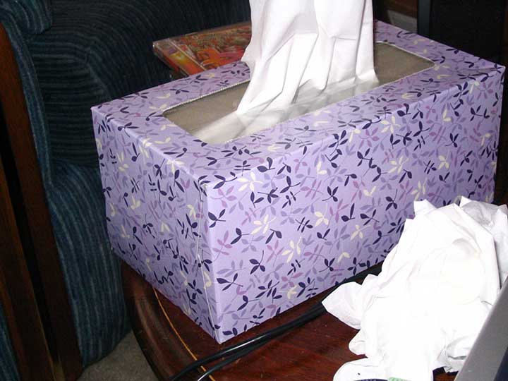
Human Body Tissues
From the Virtual Anatomy and Physiology Classroom on ScienceProfOnline.com

Slide 3
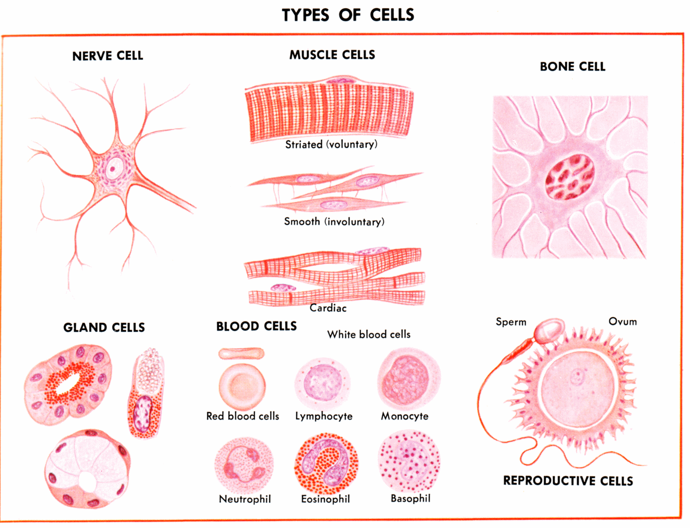
Cells
Cell are the building blocks of the human body.
There are ~ 100 trillion cells in an adult body.
Our cells can be categorized into over 200 different types.
Cells are joined together as different types of tissues that make up functional units of the human body.
A cell all by itself rare in the human body even though cells are commonly shown as individuals in many images.

Slide 4
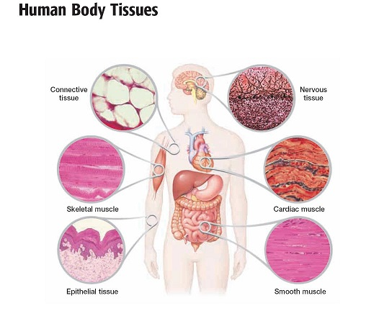
Tissue Definition
Tissue = a group of cells that have similar structure and that function together as a unit.
Each tissue type has a very specific set of functions.
A nonliving material, called the intercellular matrix, fills the spaces between the cells.
1.
4.
2.
5.
3.
6.
1. Connective, 2. Muscle (skeletal), 3. Epithelial, 4. Nervous, 5. Muscle (cardiac), 6. Muscle (smooth).

Slide 5
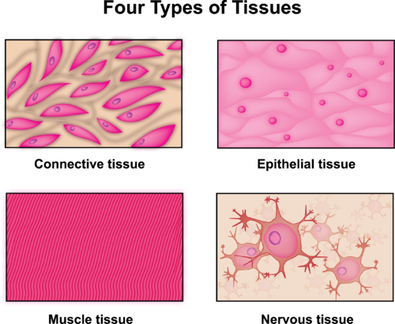
Four Human Tissue Types
Image credit: http://www.ck12.org/

Slide 6
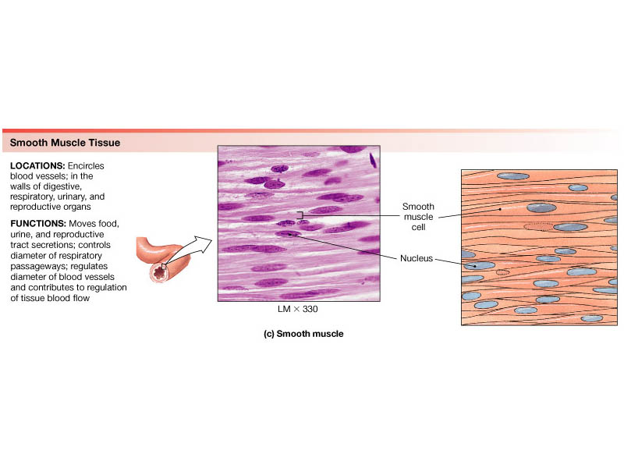
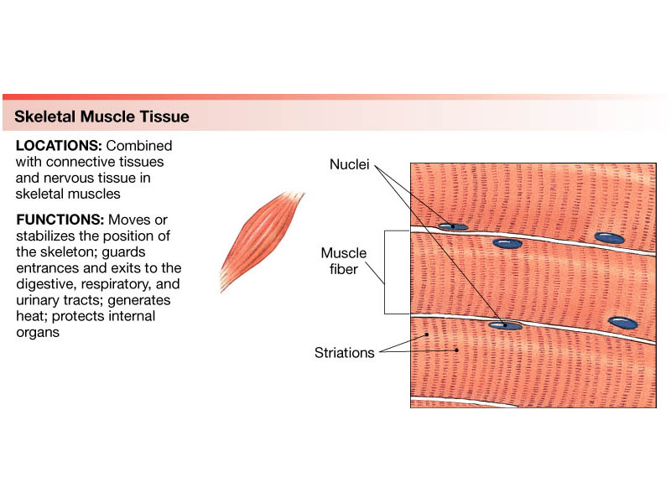
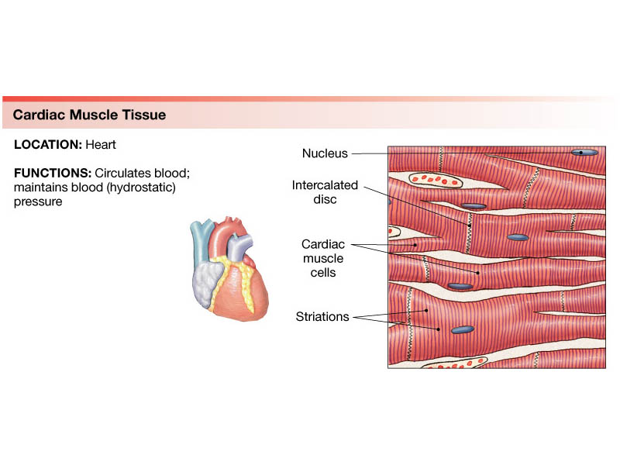
1. Muscle Tissue: Smooth, Skeletal, Cardiac
1a. Smooth muscle:
non-striated (no stripes)
used for long, sustained contractions
Example: digestive tract, uterus
1b. Skeletal muscle tissue:
striated (stripes), long cylindrical cells
that contract voluntarily
1c. Cardiac muscle tissue:
striated, like skeletal muscle, but branched
connections between cardiac muscle cells allow coordination of the heart beat

Slide 7
Muscle Tissue: 1a. Smooth
Smooth muscle:
non-striated
used for long, sustained contractions
Example: digestive tract, uterus

Slide 8
Muscle Tissue: 1b. Skeletal
Skeletal muscle tissue:
striated, long cylindrical cells
can contract voluntarily (you consciously make the contraction happen)

Slide 9
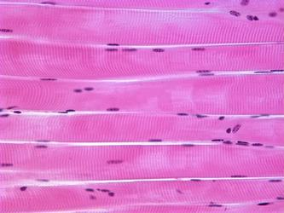
Muscle Tissue: 1b. Skeletal
Nuclei
Muscle fiber
Striations: See the vertical stripes in each muscle fiber?
Protein fibers of skeletal muscle gives this tissue stripes or "striations" when viewed under a microscope.
Image: Skeletal muscle

Slide 10
Muscle Tissue: 1c. Cardiac
Cardiac muscle tissue:
striated, branched cells
contraction is involuntary (You don’t consciously control.)
connections between cardiac muscle cells allow coordination of the heart beat.
Fibrillation is a deadly condition where heart cells are not beating in sync.

Slide 11
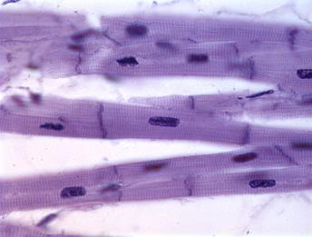
Muscle Tissue: 1c. Cardiac
Nuclei
Muscle fiber
(See how it branches for communication!)
Image: Cardiacl muscle

Slide 12
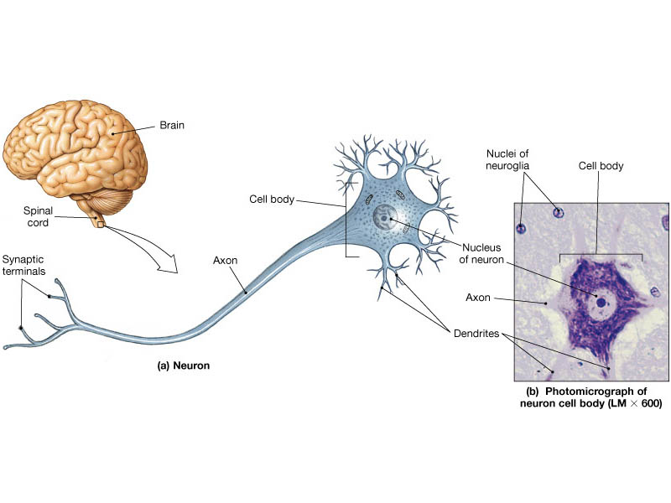
2. Nervous Tissue
used for communication throughout the body
nerve cells are called neurons
nerve cells vary in shape, depending on their functions in the nervous system.

Slide 13
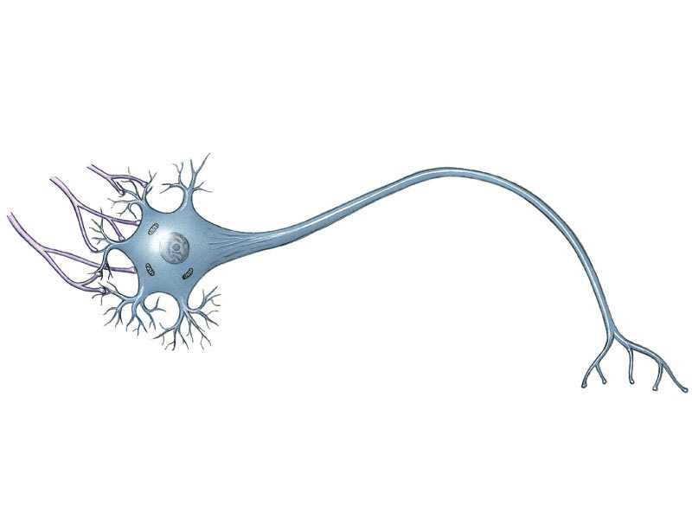
A nerve cell has four major parts,
each specialized for a specific function.
Dendrites receive signals from other neurons.
The axon carries electrical signals to other cells.
Nucleus
Synaptic terminals on the axon transmit the signal to other cells.
The cell body maintains the cell’s integrity.
WATCH THIS: Schoolhouse Rock! Telegraph line
Notes:
Figure: 19-09
Title:
A nerve cell.
Caption:
A nerve cell has four major parts, each specialized for a specific function. Nerve cells vary tremendously in shape, depending on their functions in the nervous system.

Slide 14
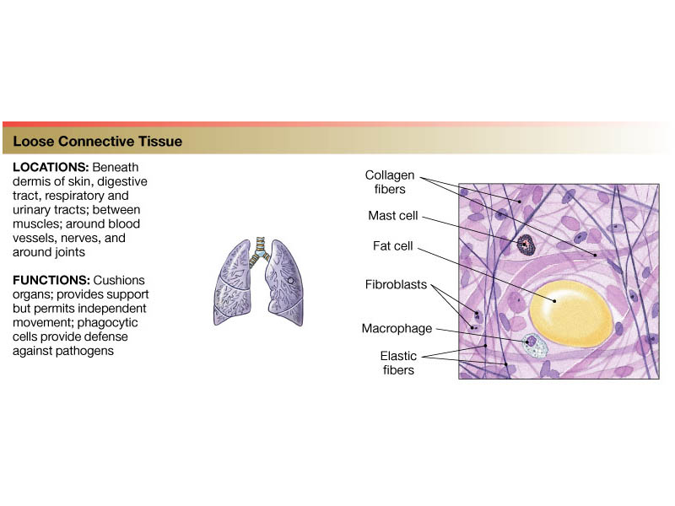
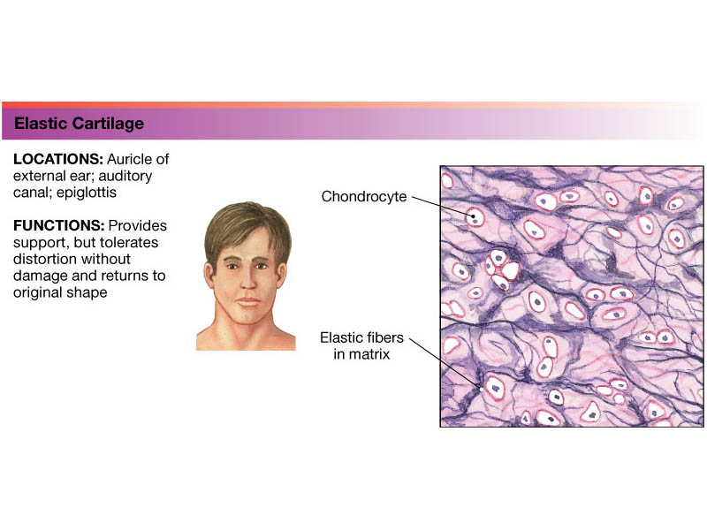
3. Connective Tissue
Cushions and Protects Body Parts
Main Components of Connective Tissues:
loosely associated cells (fibroblasts).
surrounded by an extracellular/ intercellular matrix of ground substance and protein fibers
Fibrous Connective Tissue:
i. Loose and ii.Dense
b. Specialized Connective Tissue:
i. Bone, ii. Cartilage and iii. Blood

Slide 15
3ai. Loose Fibrous Connective Tissue
Loose array of cells in a matrix of ground substance and randomly placed protein fibers.

Slide 16
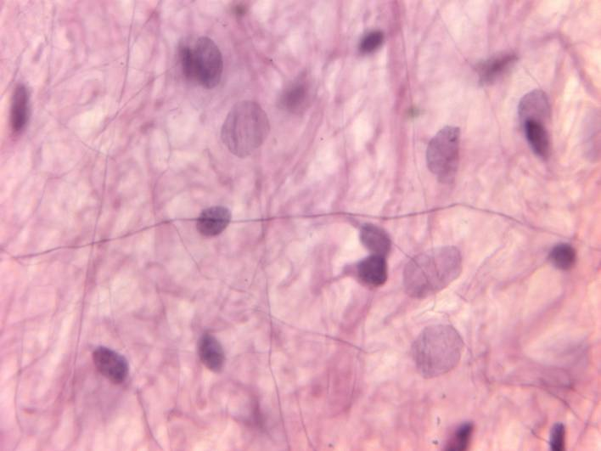
3ai. Loose Fibrous Connective Tissue: Areolar
Areolar tissue is found in many locations in the body.
Areolar tissue is found in skin; both the dermis and sub-cutaneous layers, where it binds the outer layers of the skin to the muscles beneath.
Areolar tissue is also found in or around mucous membranes, and around blood vessels, nerves, and the organs of the body.
collagen
elastin
cells

Slide 17
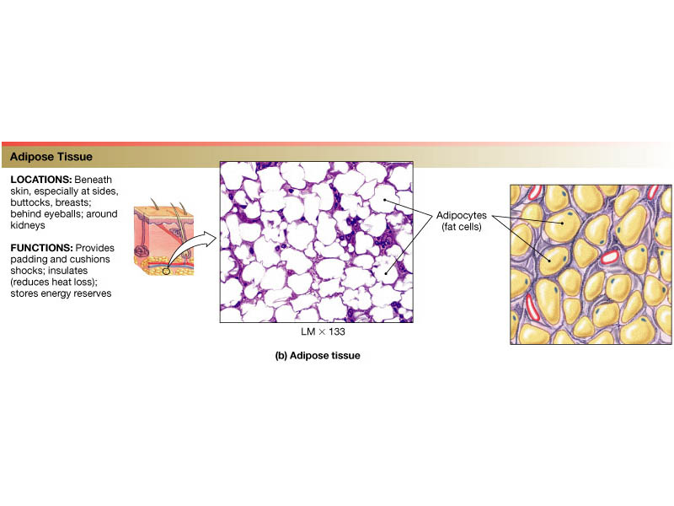
3ai. Loose Fibrous Connective Tissue: Adipose (Fat)
Adipocytes, bulging with fat droplets made of triglyceride molecules, have little space between them.
Image: Formed elements of blood, Wiki

Slide 18
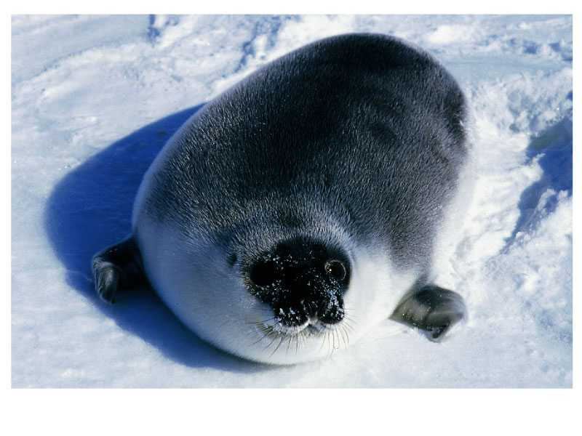
Fat is important
for insulation,
cushioning and
energy reserves.
A hooded seal at 4 days of age. At 100 pounds, she is almost too fat to move. Fat from her mother’s milk will feed and insulate the pup as she dives into icy water to learn to hunt and feed.
Notes:
Biology 99
Overview - Tissues & Organ Systems
18
Figure: 19-06b
Title:
Adipose tissue.
Caption:
(b) A hooded seal at 4 days of age has doubled her birth weight by drinking mother’s milk that consists of 61% fat. At 100 pounds, she is almost too fat to move. The fat will feed and insulate the pup as the ice floes break up and she dives into icy water to learn to hunt and feed on her own.

Slide 19
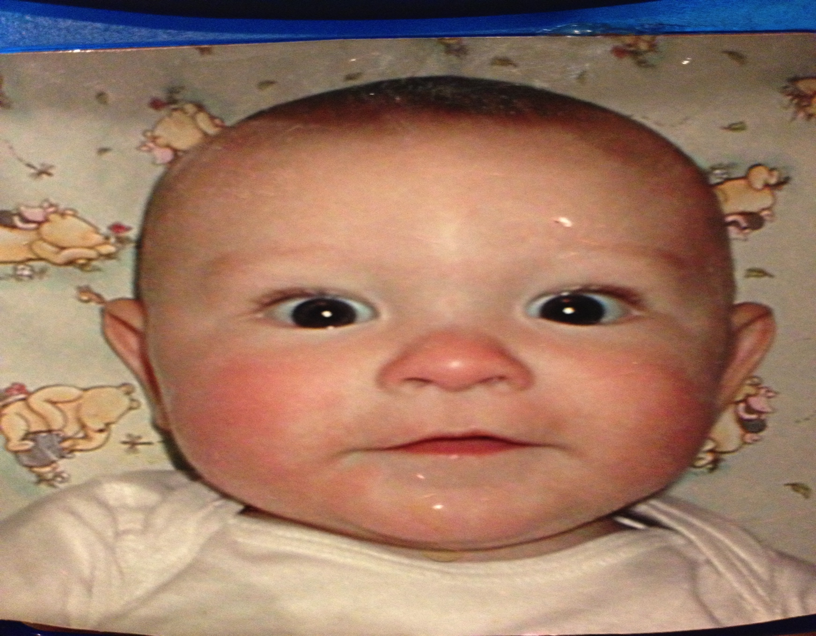
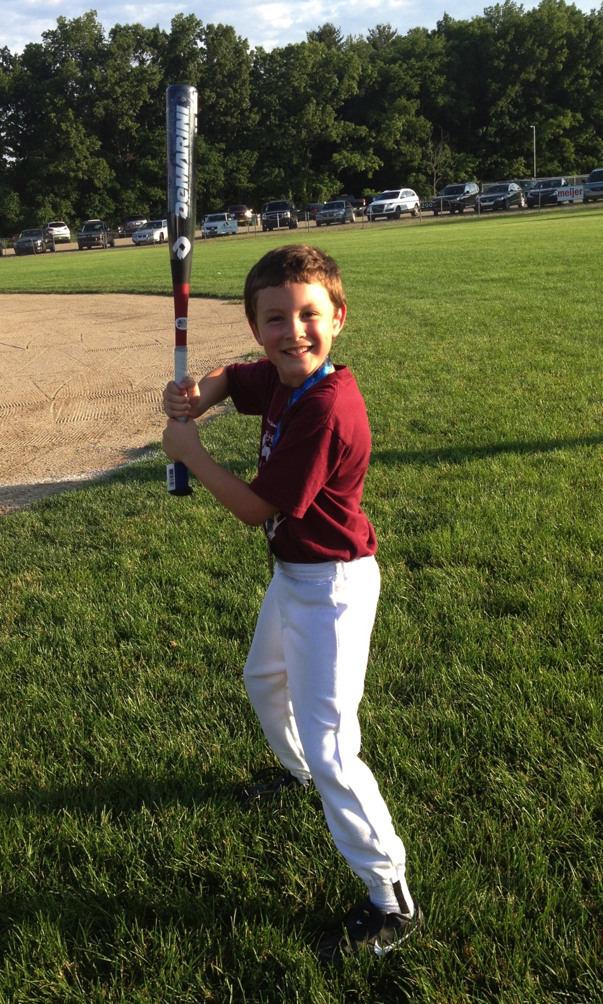
MY SON:
Lots of adipose tissue as a chubby li’l baby. He needed it for energy reserves to grow into a skinny young man!
Notes:
Biology 99
Overview - Tissues & Organ Systems
19
Figure: 19-06b
Title:
Adipose tissue.
Caption:
(b) A hooded seal at 4 days of age has doubled her birth weight by drinking mother’s milk that consists of 61% fat. At 100 pounds, she is almost too fat to move. The fat will feed and insulate the pup as the ice floes break up and she dives into icy water to learn to hunt and feed on her own.

Slide 20
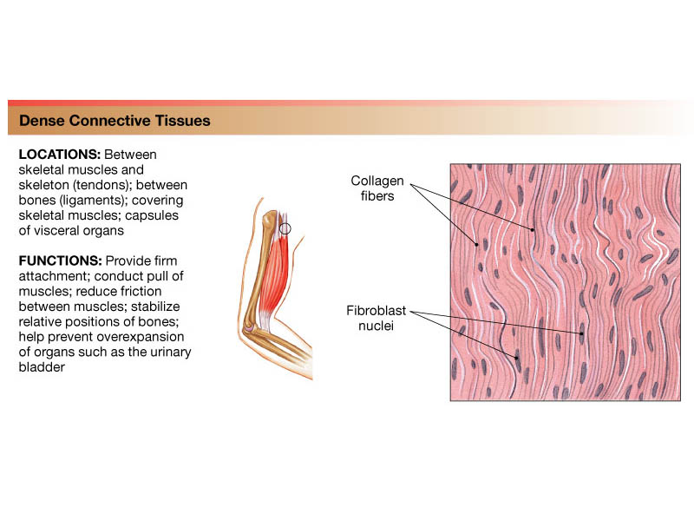
3aii. Dense Fibrous Connective Tissue:
Cells in a matrix with densely packed protein fibers
May be irregular fibers (dermis)
or regular arrayed fibers (tendons, ligaments)
Image: Formed elements of blood, Wiki

Slide 21
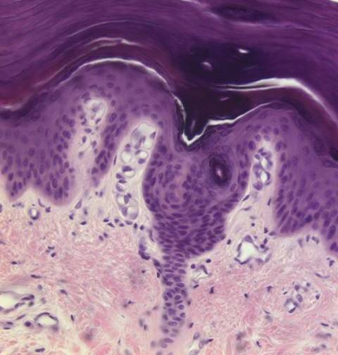
Compare Loose to Dense CT in the Dermis
Loose
CT
Dense
CT

Slide 22
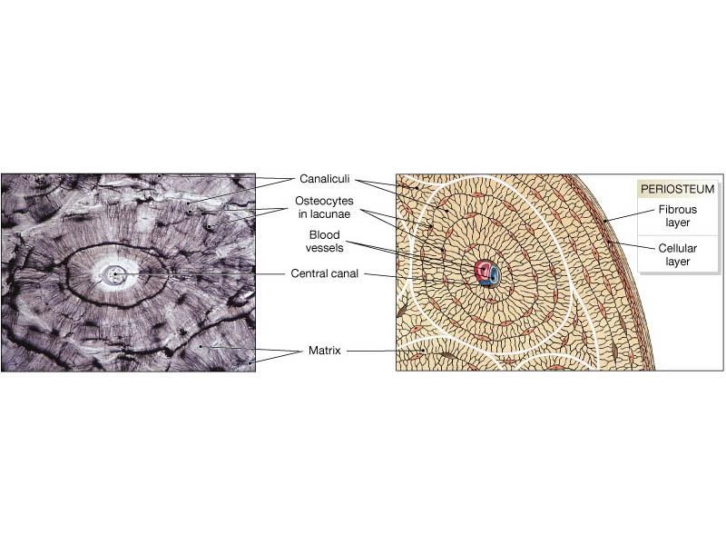
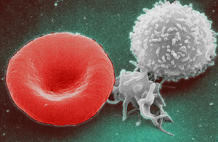
3b. Specialized Connective Tissue: Bone, Cartilage, Blood
i. Bone
iii. Blood
ii.Cartilage
Image: Formed elements of blood, Wiki

Slide 23
Specialized Connective Tissue: 3bi. Bone
Cross Section of Bone Tissue
Bone cells (osteocytes) are trapped in a mineralized matrix of
calcium phosphate Ca₃(PO₄)₂.
Bone cells appear as dark spots in small chambers (lacunae) within the hard matrix that the cells themselves have secreted.

Slide 24
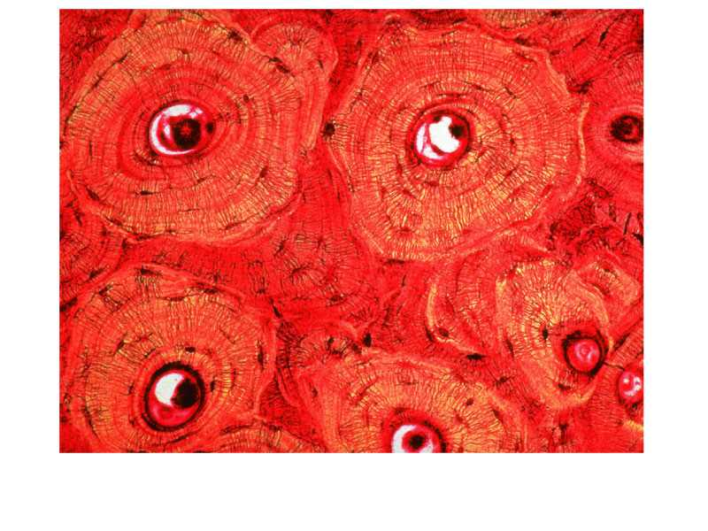
Concentric circles of bone, deposited around a central canal that contains a blood vessel, are clearly visible in this micrograph.
central canal for
blood vessel
bone cells
concentric bone matrix
Notes:
Biology 99
Overview - Tissues & Organ Systems
24
Figure: 19-05
Title:
Bone consists of cells embedded in a hard matrix.
Caption:
Concentric circles of bone, deposited around a central canal that contains a blood vessel, are clearly visible in this micrograph. Bone cells appear as dark spots trapped in small chambers within the hard matrix that the cells themselves deposit.

Slide 25
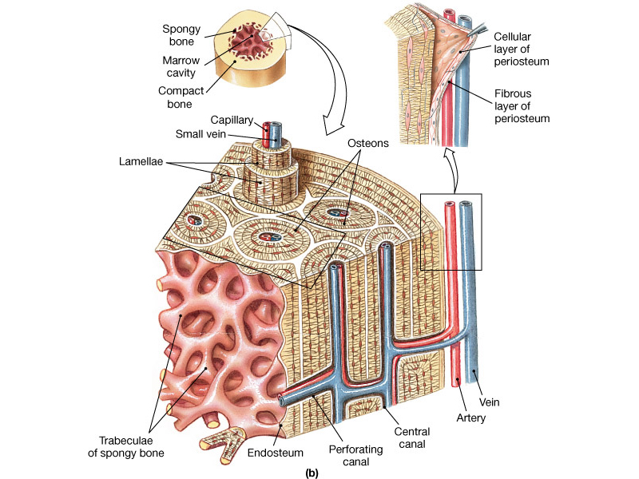
The Human Skeleton
Anatomy of Bone
Notes:
Biology 99
Overview - Tissues & Organ Systems
25

Slide 26
Specialized Connective Tissue: 3bii. Cartilage
  Cartilage cells are called chondrocytes, in
  small cavities (lacunae) .
  These cells are in a rubbery matrix of elastic protein fibers for flexibility.

Slide 27
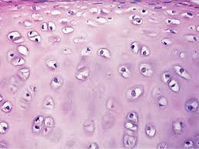
Specialized Connective Tissue: 3bii. Cartilage
* Lab
Fibroblast
Matrix: ground substance
& protein fubers

Slide 28
Specialized Connective Tissue: 3biii. Blood
Blood cells arise from bone marrow, so blood is classified as a connective tissue.
Image: Formed elements of blood, Wiki

Slide 29
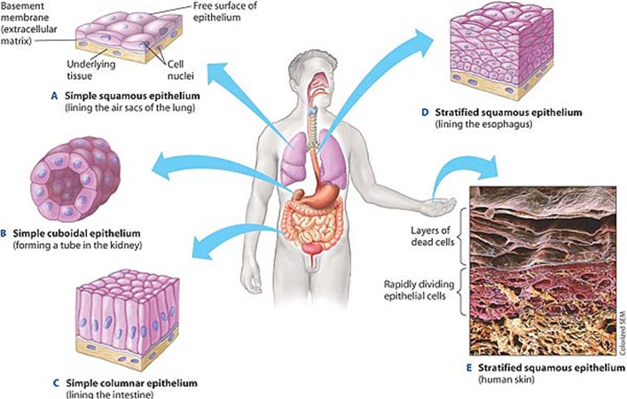
4. Epithelial Tissue
Cells that line or cover all internal and external body surfaces.
Cell structure and function varies depending on where it is in the body.
Image credit: http://www.ck12.org/

Slide 30
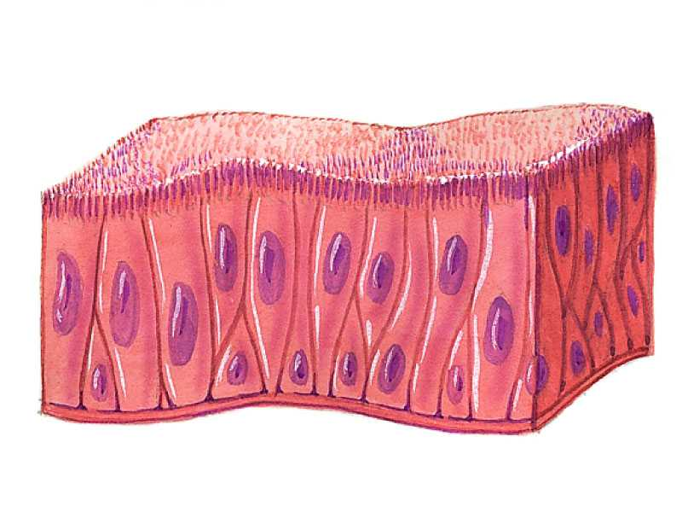
Epithelial Tissue Characteristics
Free surface, Basement membrane, Tightly packed cells
Function: Often form barriers.
Example: Elongated epithelial cells bearing cilia line the passage to the lungs and tubes of the reproductive organs.
Image credit: http://www.ck12.org/

Slide 31
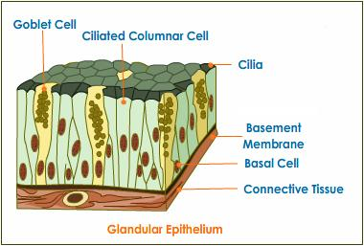
4. Epithelial Tissue Characteristics
Barrier between body tissues
Tightly bound cells
One free surface and one bound surface
Attached to a basement membrane
Classified by Layers
i. Simple - single layer of cells
ii. Stratified - many layers of cells
b. Classified by Cell Shape
i. Squamous – flattened cells
ii. Cuboidal – square cells
iii. Columnar – tall cells

Slide 32
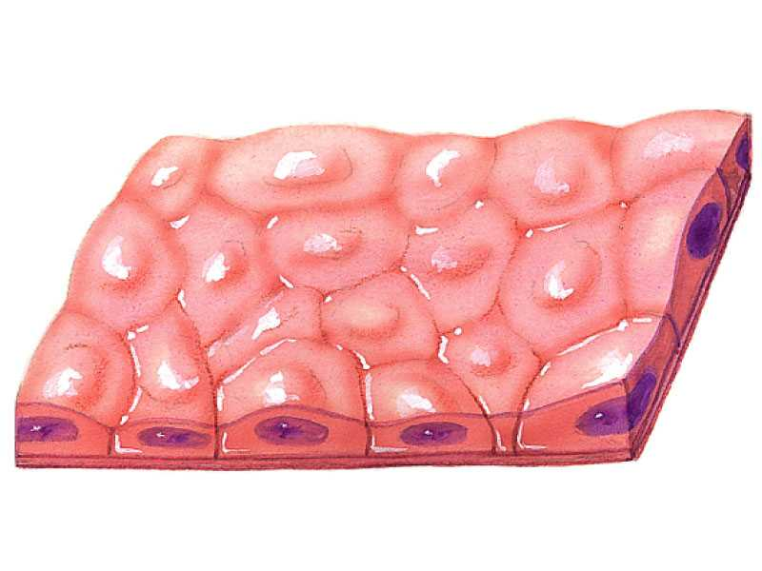
4. Types of Epithelial Tissue by Layer
4ai. Simple Epithelium: Single layer of cells
Example: Lining of lungs and blood vessels

Slide 33
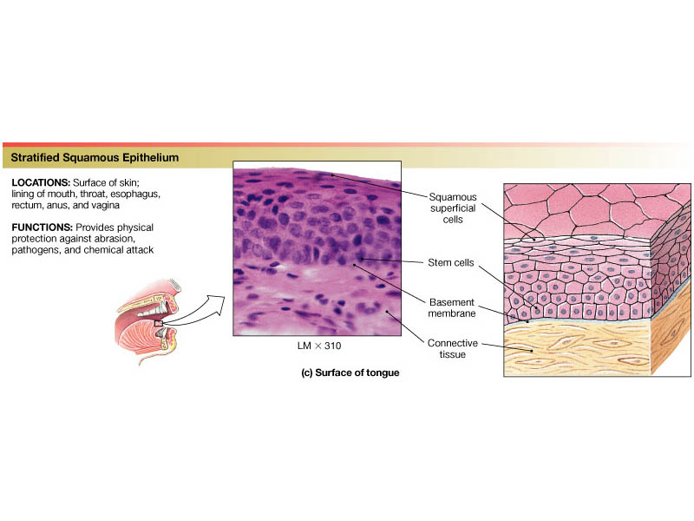
Types of Epithelial Tissue by Layer
4aii. Stratified Epithelium: More than one layer of cells

Slide 34
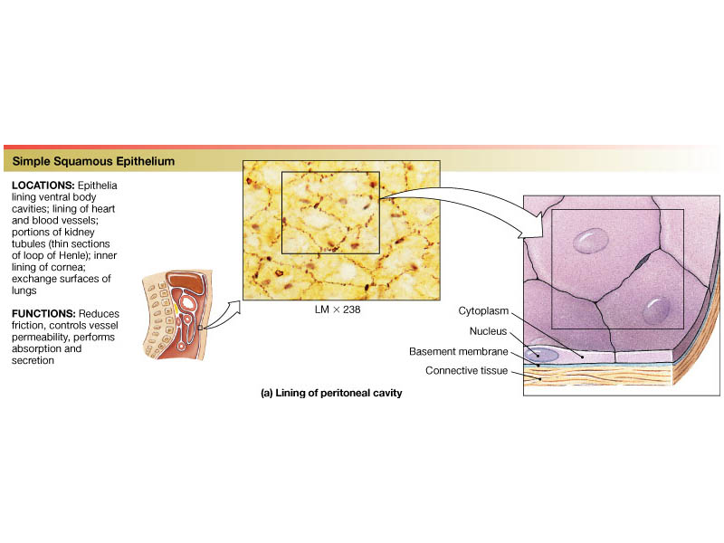
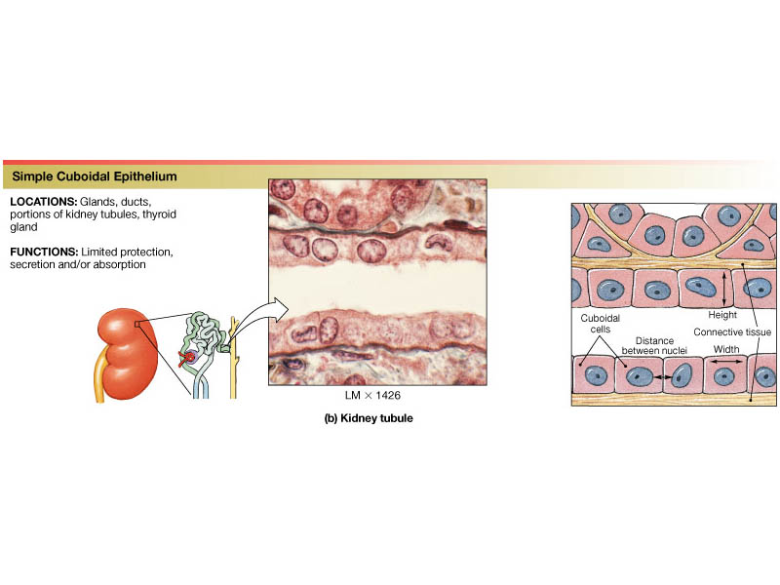
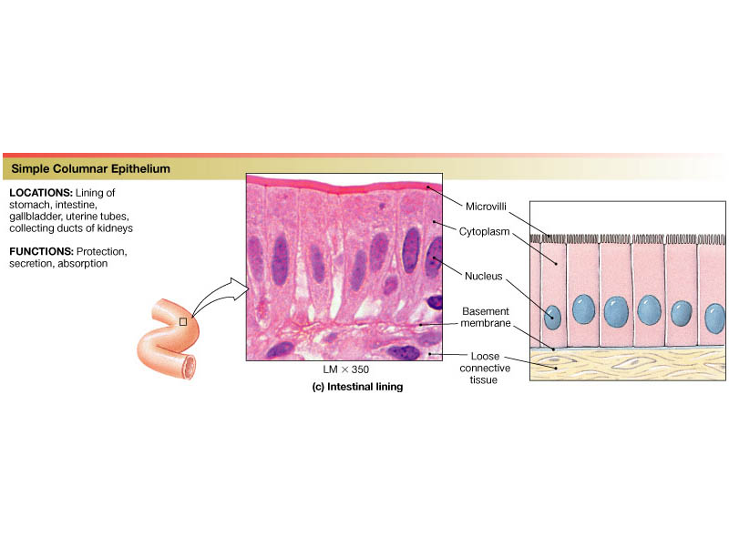
4b. Types of Epithelial Tissue by Cell Shape
i. Squamous-flattened cells
ii. Cuboidal- Square cells
ii. Columnar- Tall cells

Slide 35
4b. Types of Epithelial Tissue by Cell Shape
i. Squamous = flattened cells

Slide 36
4b. Types of Epithelial Tissue by Cell Shape
Basement membrane between cuboidal cells and connective tissue.
ii. Cuboidal = square cells

Slide 37
4b. Types of Epithelial Tissue by Cell Shape
iii. Columnar = tall cells

Slide 38
Epithelial Tissue Terms Combine Layer & Shape
Combining layering and shape terms:
Stratified Squamous Epithelium

Slide 39
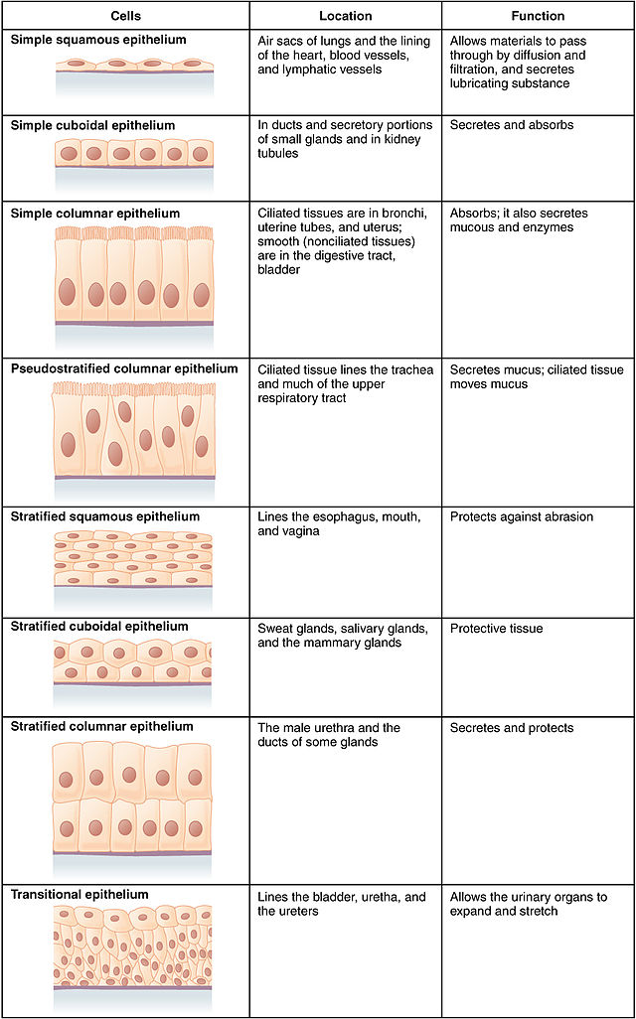
4. Epithelial Tissue
Image: Table of Epithelial Cell Types, Wiki

Slide 40
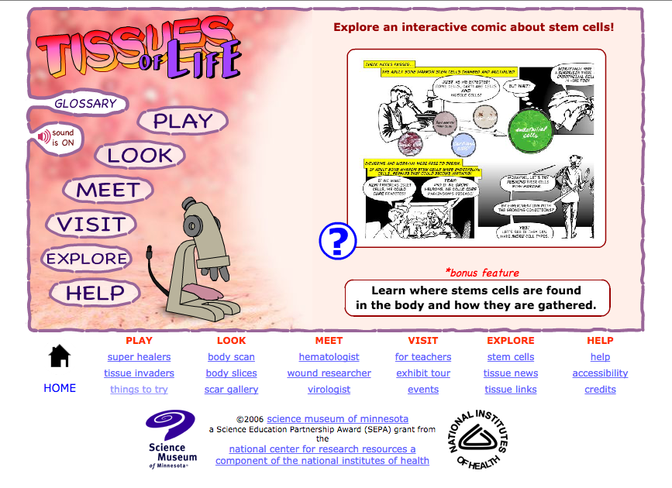
Let’s Check Out the Interactive Tissues of Life Website!

Slide 41
Confused?
Here are some links to fun resources that further explain Human Tissues:
Animation of Different Cell & Tissue Types from Paradise Valley Bio 156.
Tissues (biology) from Wikipedia.
Tissues of Life Animated Tutorial from the Science Museum of Minnesota, with tissues of the body. Includes games (“super healers” and “tissue invaders”), interviews with scientists who work with tissues, read the “Stem Cell Comic” and explore various tissue types.
Al’s Interactive Tutorial for Histology from the University of British Colombia has a written tutorial with links to visuals on the right half of screen. It provides good diagrams of different types of tissues, should you wish to elaborate on that topic.
Human Body 101 video from National Geographic.
(You must be in PPT slideshow view to click on links.)
Smart Links
From the Virtual Cell Biology Classroom on ScienceProfOnline.com

