Slide 1

About Science Prof Online
PowerPoint Resources
Science Prof Online (SPO) is a free science education website that provides fully-developed Virtual Science Classrooms, science-related PowerPoints, articles and images. The site is designed to be a helpful resource for students, educators, and anyone interested in learning about science.
The SPO Virtual Classrooms offer many educational resources, including practice test questions, review questions, lecture PowerPoints, video tutorials, sample assignments and course syllabi. New materials are continually being developed, so check back frequently, or follow us on Facebook (Science Prof Online) or Twitter (ScienceProfSPO) for updates.
Many SPO PowerPoints are available in a variety of formats, such as fully editable PowerPoint files, as well as uneditable versions in smaller file sizes, such as PowerPoint Shows and Portable Document Format (.pdf), for ease of printing.
Images used on this resource, and on the SPO website are, wherever possible, credited and linked to their source. Any words underlined and appearing in blue are links that can be clicked on for more information. PowerPoints must be viewed in slide show mode to use the hyperlinks directly.
Several helpful links to fun and interactive learning tools are included throughout the PPT and on the Smart Links slide, near the end of each presentation. You must be in slide show mode to utilize hyperlinks and animations.
This digital resource is licensed under Creative Commons Attribution-ShareAlike 3.0:
http://creativecommons.org/licenses/by-sa/3.0/
Alicia Cepaitis, MS
Chief Creative Nerd
Science Prof Online
Online Education Resources, LLC
alicia@scienceprofonline.com
Tami Port, MS
Creator of Science Prof Online
Chief Executive Nerd
Science Prof Online
Online Education Resources, LLC
info@scienceprofonline.com
From the Virtual Cell Biology Classroom on ScienceProfOnline.com
Image: Compound microscope objectives, T. Port
Notes:
Welcome to Science Prof Online PowerPoint Resources!
This PowerPoint Presentation comes from the Virtual Cell Biology Classroom of Science Prof Online, and, as such, is licensed under Creative Commons Attribution-ShareAlike 3.0.; meaning you can download, share and alter any of this presentation, but you can’t sell it or repackage and sell any part of it. Please credit Science Prof Online as the source of this presentation. Please abide by credited image copyrights. Thank you for using this resource.

Slide 2
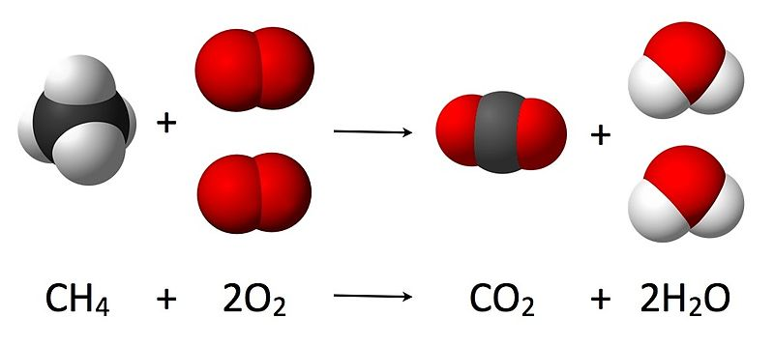
Chemical Bonds, Reactions & Notation
Making Molecules
& Compounds
From the Virtual Cell Biology Classroom on ScienceProfOnline.com
Image: Combustion Reaction of Methane, Wiki

Slide 3
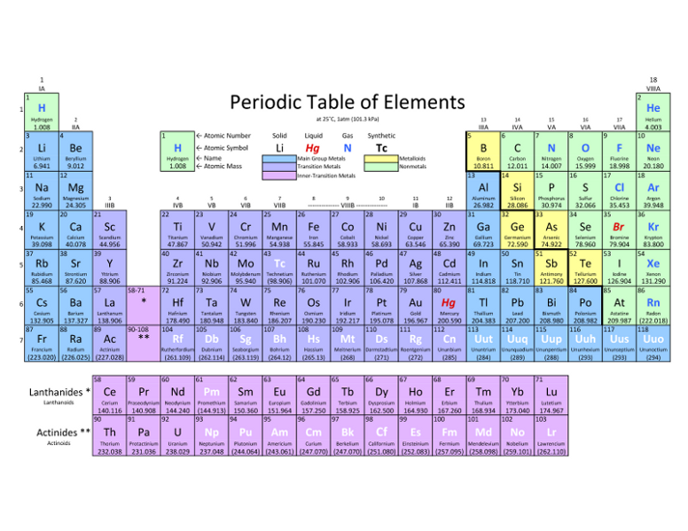
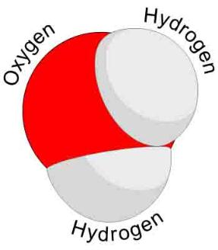
Elements, Atoms, Molecules & Compounds
Elements → Substances that can’t be broken
down any further.
Atom → The smallest unit of an element.
Two or more atoms joined together chemically:
Molecule
Molecule containing at least two different
Elements: Compound
Examples of molecules: Carbon dioxide (CO₂) and methane (CH₄) , molecular hydrogen (H₂), molecular oxygen (O₂) and molecular nitrogen (N₂).
Examples of compounds: Only molecules containing two or more elements, such as carbon dioxide (CO₂) and methane (CH₄).
Q: Explain why all compounds are molecules but not all molecules are compounds.
Image: Periodic Table of Elements; Water Molecule, Wiki
From the Virtual Biology Classroom on ScienceProfOnline.com

Slide 4

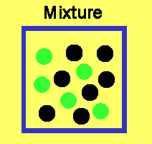

Mixtures & Compounds
mixture = Physical combination of two or more pure substances.
compound = Chemical combination of two or more pure substances in a fixed, definite proportion.
Example:
Mixture - Iron & Sulfur
Iron filings may be mixed with powdered sulfur in any proportion.
The two components are easily separated by means of a magnet,
The magnet will draw out the iron from the mixture.
The components of a mixture usually can be separated by physical means such as distillation, evaporation, etc.
Compound – Iron sulfide (Pyrite or Fools Gold)
However, if:
a. seven parts iron filings or powder are mixed with four parts powdered sulfur
mixture is heated to a red glow
iron and sulfur form a compound - iron sulfide; chemically combined, not readily separated.
Watch Video:
Mixture vs Compound
From the Virtual Cell Biology Classroom on ScienceProfOnline.com
Notes:
Mixture
Compound

Slide 5
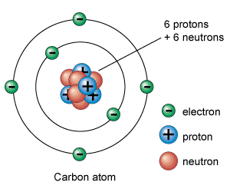
Remind me why we care about these valence electrons…
The electrons in an atom are located in shells at different energy levels.
Electrons in the highest energy level are called valence electrons.
Number of valence electrons governs an atom’s bonding behavior.
Q: What is the max number of valence electrons for a full valence shell?
Atoms are much more stable, or less reactive, with a full valence shell.
By moving electrons, the two atoms become linked. This is known as chemical bonding.
This stability can be achieved one of two ways:
- Ionic bond
- Covalent bond
Images: Carbon, Universe Today Website
From the Virtual Cell Biology Classroom on ScienceProfOnline.com
Notes:
A: 8

Slide 6
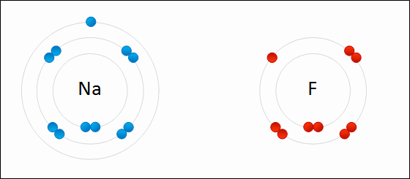
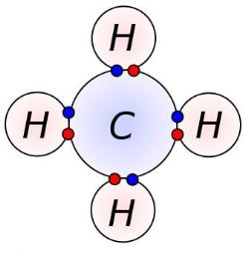
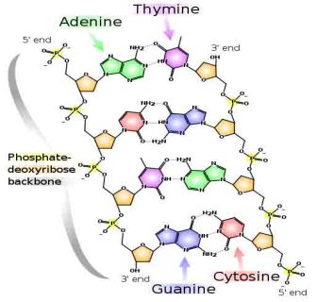
Three Main Types of Chemical Bonds:
1. Ionic
2. Covalent
3. Hydrogen
Image: Formation of ionic sodium fluoride, Wdcf; Methane Covalent Bonds, Dynablast, Wiki; DNA Chemical Structure, Madprime, Wiki
From the Virtual Cell Biology Classroom on ScienceProfOnline.com

Slide 7
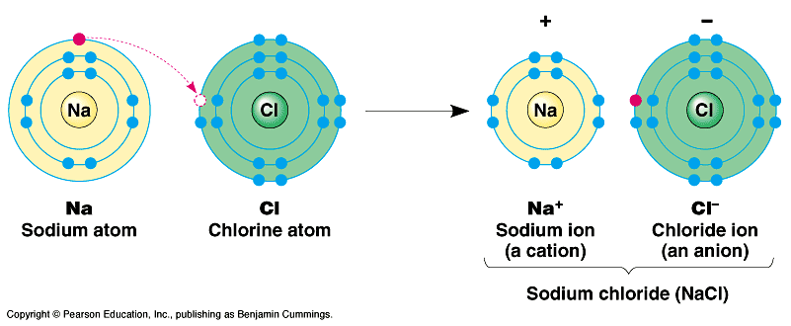
Ionic Bonds
Involves transfer of electrons between two atoms.
Found mainly … inorganic compounds.
Ion = an atom or group of atoms which have lost or gained one or more electrons, making them negatively or positively charged.
Q: What are positively charged ions (+) called?
Q: What are negatively charged ions (-) called?
Images: Sodium Chloride, University of Winnepeg
From the Virtual Cell Biology Classroom on ScienceProfOnline.com

Slide 8
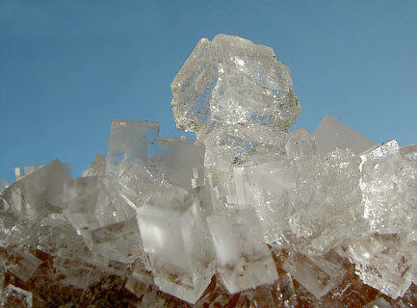
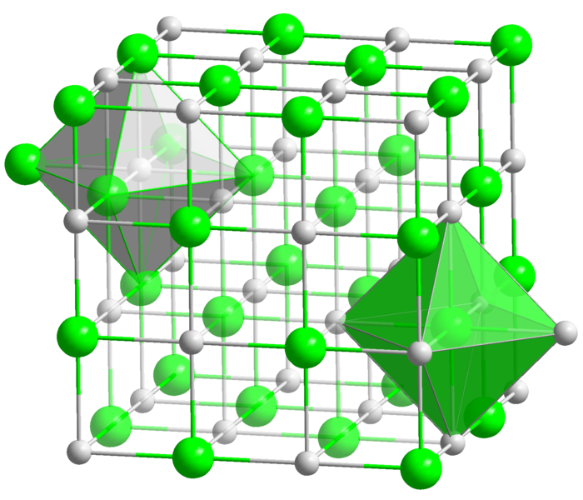
Ionic compounds are made of oppositely charged ions
Ionic Bonds are atoms held together by attraction between
a (+) and a (–) ion
Compound is neutral overall, but still charged on the inside.
Makes solid crystals (salts).
Images: Halit crystal, Crystal structure of NaCl, Wiki
From the Virtual Cell Biology Classroom on ScienceProfOnline.com

Slide 9
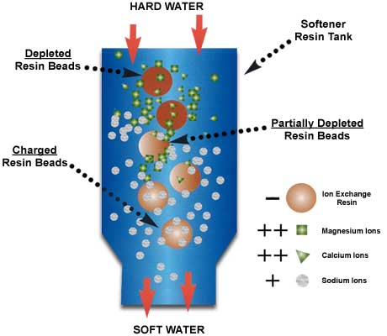
Reactions Involving Ions
Remember… ion = an atom which has lost or gained one or more electrons, so it’s negatively or positively charged.
The Principle of
ion exchange
is a common water softening method.
From the Virtual Cell Biology Classroom on ScienceProfOnline.com

Slide 10




Lets use a Branganalogy to help us Understand the Concept of Ion Exchange…
From the Virtual Cell Biology Classroom on ScienceProfOnline.com
1. Brad Pitt is a negatively charged resin bead
2. Jennifer Anniston is a positively charged Sodium Ion
3. Angelina Jolie is a positively charged Calcium Ion
-
-
Na+
Now lets say that ‘positiveness’ equates with ‘drop-dead gorgeousness’
-
-
-
Ca++
-
-
Na+
-
Ca++
-
-
-
-
-
Negatively charged Brad is attracted to reasonably positive Jennifer.
-
Na+
-
Negatively charged Brad lets go of reasonably positive Jennifer in the presence of insanely positive Angelina.
-

Slide 11
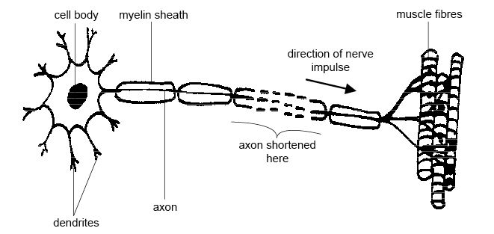
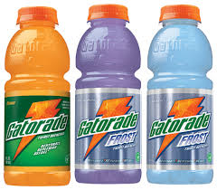
Importance of Ions/Electrolytes in the Body:
K⁺ ,Na⁺, Cl⁻
Carry electrical impulses in the nervous system
Maintain cellular function with the correct concentrations electrolytes
Watch This! “Brawndo” Video Clip
from movie Idiocracy.
Image: Motor neuron, Wiki
From the Virtual Biology Classroom on ScienceProfOnline.com

Slide 12
Three Main Types of Chemical Bonds:
1. Ionic
2. Covalent
3. Hydrogen
Image: Formation of ionic sodium fluoride, Wdcf; Methane Covalent Bonds, Dynablast, Wiki; DNA Chemical Structure, Madprime, Wiki
From the Virtual Cell Biology Classroom on ScienceProfOnline.com

Slide 13
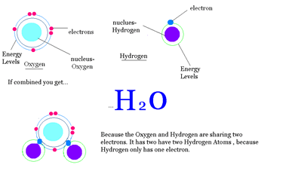
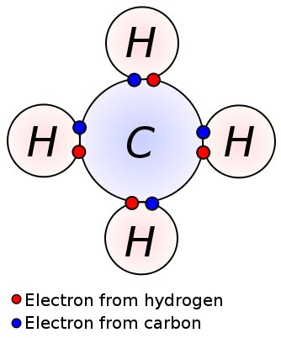
Covalent Bonds
Involves the sharing of a pair of electrons between atoms.
One covalent bond = 1 pair of shared electrons
Covalent Compounds can make single (2 electrons), double (4 electrons) or even triple bonds
(6 electrons) depending on the number of electrons they share.
Found mainly … organic compounds
Image: Methane Covalent Bonds, Dynablast, Wiki
From the Virtual Cell Biology Classroom on ScienceProfOnline.com

Slide 14
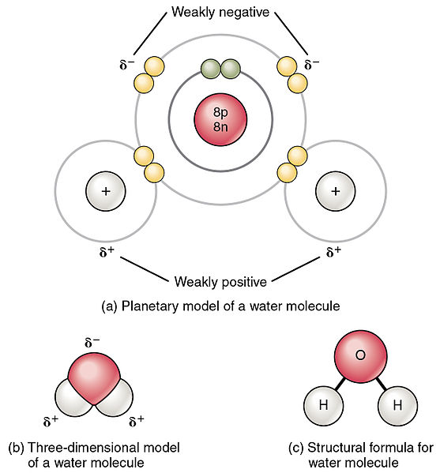
Polar vs. Non-Polar Covalent Bonds
Polar molecules unequally share electrons between atoms, so have a slight positive charge at one end and a slight negative charge at the other.
Non-polar molecules have electrons equally shared between their atoms.
Image: Polar water molecule, Non-polar methane molecule, Wiki
From the Virtual Biology Classroom on ScienceProfOnline.com

Slide 15
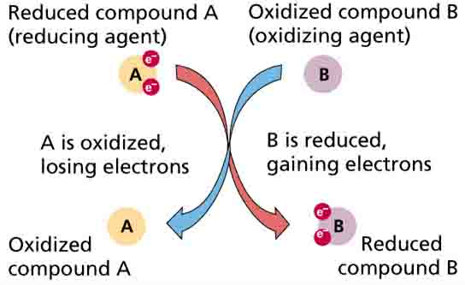
Oxidation - Reduction Reactions
Or Redox reaction = chemical reactions in which electrons are gained, lost (Q: What kind of bond?) or shared (Q: What kind of bond?) in a chemical reaction.
• oxidation: loss of electrons by a molecule, atom or ion.
• reduction: gain of electrons by a molecule, atom or ion.
From the Virtual Cell Biology Classroom on ScienceProfOnline.com

Slide 16
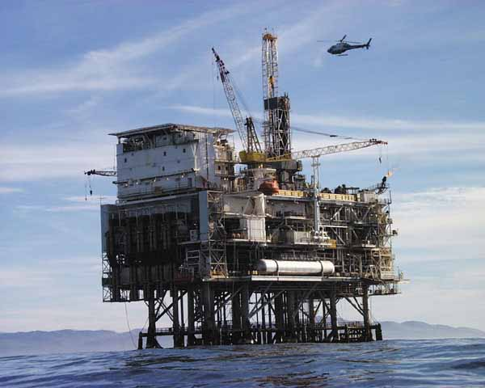
Oil Rig
Image: Oil Rig Platform, Nasa
From the Virtual Cell Biology Classroom on ScienceProfOnline.com
Notes:
Oxidation Is Loss = OIL
Reduction Is Gain = RIG

Slide 17
Three Main Types of Chemical Bonds:
1. Ionic
2. Covalent
3. Hydrogen
Image: Formation of ionic sodium fluoride, Wdcf; Methane Covalent Bonds, Dynablast, Wiki; DNA Chemical Structure, Madprime, Wiki
From the Virtual Cell Biology Classroom on ScienceProfOnline.com

Slide 18
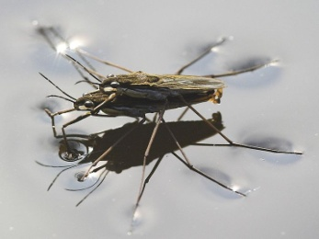
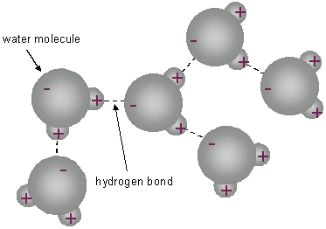
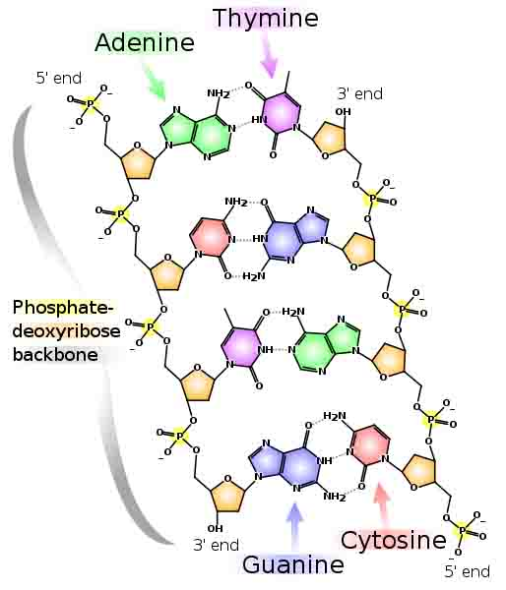
Hydrogen Bonds
Hydrogen Bonds: When an atom of hydrogen is attracted to another electronegative
atom in addition to the one it is covalently bonded to.
In some covalent bonds electrons are shared unequally by the hydrogen and the atom that the hydrogen is bound to. When the electrons in a covalent bond are not equally shared, the molecule is polar.
See the polar, covalent bonds of each individual water molecule below.
See the hydrogen bond attractions between the hydrogens and the oxygens of nearby, but separate water molecule below.
Found in water, proteins & DNA
Image: DNA Chemical Structure, Madprime, Wiki; Water Striders, Markus Gayda, Wiki
From the Virtual Cell Biology Classroom on ScienceProfOnline.com

Slide 19
REVIEW!
Animated lessons on
Chemical Bonding
Image: Methane Covalent Bonds, Dynablast; Formation of ionic sodium fluoride,
From the Virtual Cell Biology Classroom on ScienceProfOnline.com

Slide 20
Chemical Bonds hold molecules together, but can be broken during a chemical reaction
Reactants are the starting materials
Products are the end materials
From the Virtual Cell Biology Classroom on ScienceProfOnline.com
Image: Combustion Reaction of Methane, Wiki

Slide 21
Formats for writing a chemical reaction.
_______ + ________ -----------> _________
__________ -----------> ________ ________
From the Virtual Cell Biology Classroom on ScienceProfOnline.com
Notes:
Reactant, reactant, (enzyme) > product
Reactant, (enzyme) > product, product
One or more of the reactants in an enzymatic reaction is the substrate, the reactant(s) that specifically interacts with the enzyme.

Slide 22
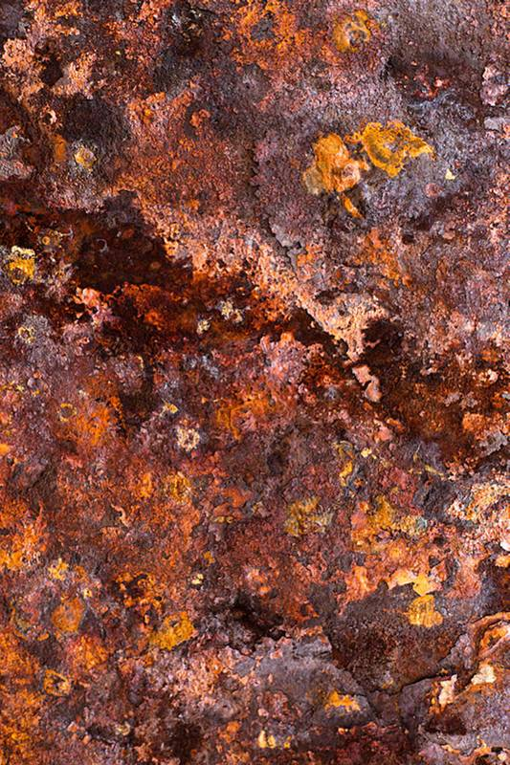

Synthesis, Decomposition & Exchange Reactions
Synthesis Reaction (a.k.a. Combination or Anabolic Reaction)
When two or more substances combine to form a single compound.
Requires energy in order to take place
The general form of a direct combination reaction is:
A + B → AB where A and B are elements or compounds, and AB is a compound consisting of A and B.
Examples of combination reactions include:
2Na + Cl₂ → 2 NaCl (formation of table salt)
4 Fe + 3 O₂ → 2 Fe₂O₃ (iron rusting)
Decomposition Reaction (a.k.a. Catabolic Reaction)
The opposite of a composition reaction. A compound is broken down.
The generalized reaction formula for chemical decomposition is:
AB → A + B
Exchange Reaction (a.k.a. Transfer or Replacement Reaction)
Atoms are moved from one molecule to another.
A + BC → AB + C
Images: Animation decomposition reaction, Armando-Martin; Rust, Later Keiwos
From the Virtual Cell Biology Classroom on ScienceProfOnline.com
Notes:
Synthesis
Decomposition
Exchange

Slide 23
What type of reaction is each of the following?
NiCl₂ → Ni + Cl₂
MgBr₂ + 2K → Mg + 2KBr
4C + 6H₂ + O₂ → 2C₂H₆O
From the Virtual Cell Biology Classroom on ScienceProfOnline.com

Slide 24
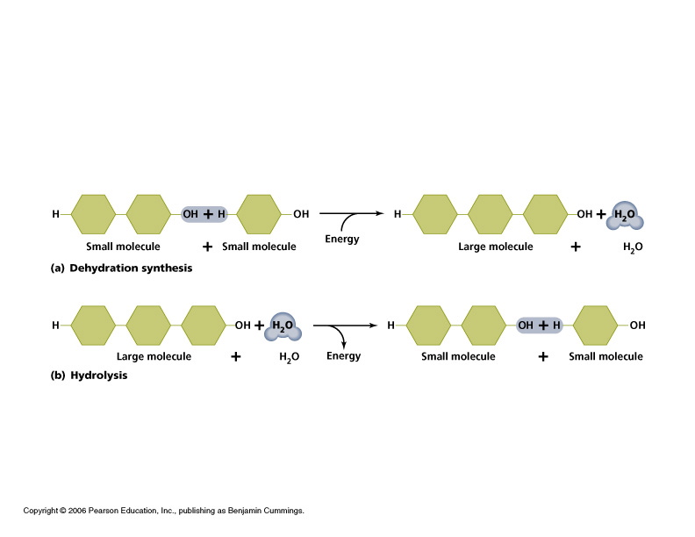
Q: Based on the reaction types we just discussed, how would you categorize the reactions below?
What type is the top reaction?
What type is the bottom reaction?
From the Virtual Cell Biology Classroom on ScienceProfOnline.com
Notes:
Dehydration Synthesis
Hydrolysis Decomposition

Slide 25
Chemical reactions must be balanced, meaning they have the same number of each type of atom on both the reactant side and the product side of the reaction.
Is the following chemical reaction balanced?
Ca +2H₂O → Ca(OH)₂+ H₂
From the Virtual Cell Biology Classroom on ScienceProfOnline.com

Slide 26
Confused?
Here are some links to fun resources that further explain Chemistry:
Inorganic Chemistry Main Page on the Virtual Cell Biology Classroom of Science Prof Online.
“What Kind of Bonds Are These?” song and slide show by Mark Rosengarten.
Chemical Bond Formation animated science tutorial.
“Meet the Elements” music video by They Might Be Giants.
Redox Reactions video lecture by Kahnacademy.
Chem4Kids website by Rader.
Neutron Dance …a so-bad-its-good ’80s music video by The Pointer Sisters
(You must be in PPT slideshow view to click on links.)
Smart Links
Image: Daniel Radcliff by Joella Marano
From the Virtual Cell Biology Classroom on ScienceProfOnline.com

Slide 27
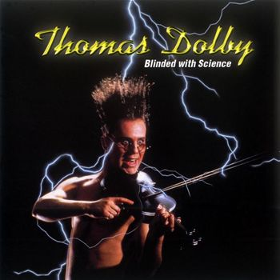
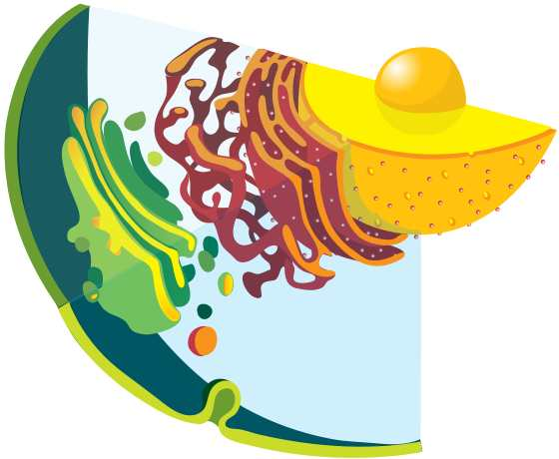
Are you feeling blinded by science?
Do yourself a favor. Use the…
Virtual Cell Biology Classroom (VCBC) !
The VCBC is full of resources to help you succeed, including:
practice test questions
review questions
study guides and learning objectives
PowerPoints on other topics
You can access the VCBC by going to the Science Prof Online website www.ScienceProfOnline.com
Images: Blinded With Science album, Thomas Dolby; Endomembrane system, Mariana Ruiz, Wiki

