Slide 1

About Science Prof Online
PowerPoint Resources
Science Prof Online (SPO) is a free science education website that provides fully-developed Virtual Science Classrooms, science-related PowerPoints, articles and images. The site is designed to be a helpful resource for students, educators, and anyone interested in learning about science.
The SPO Virtual Classrooms offer many educational resources, including practice test questions, review questions, lecture PowerPoints, video tutorials, sample assignments and course syllabi. New materials are continually being developed, so check back frequently, or follow us on Facebook (Science Prof Online) or Twitter (ScienceProfSPO) for updates.
Many SPO PowerPoints are available in a variety of formats, such as fully editable PowerPoint files, as well as uneditable versions in smaller file sizes, such as PowerPoint Shows and Portable Document Format (.pdf), for ease of printing.
Images used on this resource, and on the SPO website are, wherever possible, credited and linked to their source. Any words underlined and appearing in blue are links that can be clicked on for more information. PowerPoints must be viewed in slide show mode to use the hyperlinks directly.
Several helpful links to fun and interactive learning tools are included throughout the PPT and on the Smart Links slide, near the end of each presentation. You must be in slide show mode to utilize hyperlinks and animations.
This digital resource is licensed under Creative Commons Attribution-ShareAlike 3.0:
http://creativecommons.org/licenses/by-sa/3.0/
Alicia Cepaitis, MS
Chief Creative Nerd
Science Prof Online
Online Education Resources, LLC
alicia@scienceprofonline.com
Tami Port, MS
Creator of Science Prof Online
Chief Executive Nerd
Science Prof Online
Online Education Resources, LLC
info@scienceprofonline.com
From the Virtual Cell Biology Classroom on ScienceProfOnline.com
Image: Compound microscope objectives, T. Port
Notes:
Welcome to Science Prof Online PowerPoint Resources!
This PowerPoint Presentation comes from the Virtual Cell Biology Classroom of Science Prof Online, and, as such, is licensed under Creative Commons Attribution-ShareAlike 3.0.; meaning you can download, share and alter any of this presentation, but you can’t sell it or repackage and sell any part of it. Please credit Science Prof Online as the source of this presentation. Please abide by credited image copyrights. Thank you for using this resource.

Slide 2
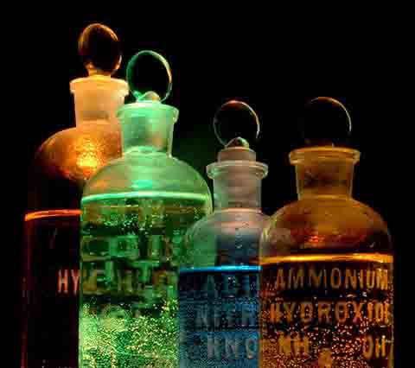
Atomic Theory & the Periodic Table
For additional resources on this lecture topic, see the Inorganic Chemistry Main Page on SPO.
Image: Chemicals in Flasks, J. Sullivan, Wiki

Slide 3
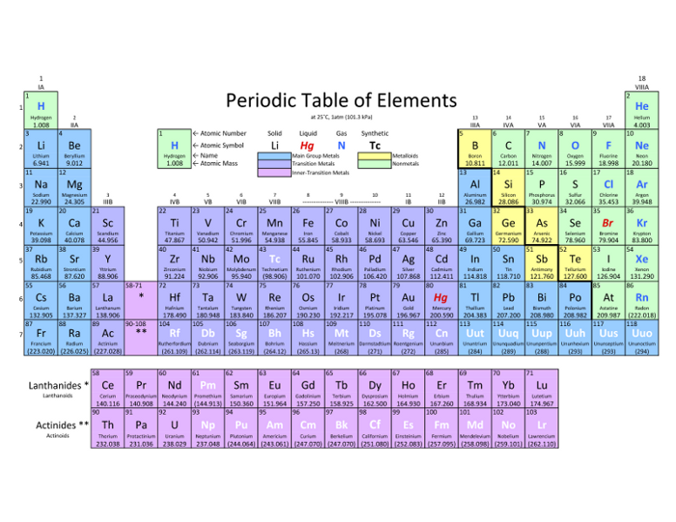

Elements, Atoms & Chemical Symbols
Elements: Substances that can’t be broken down any further.
Atom: The smallest unit of an element.
Chemical Symbol
Begins with one or two letters based on elements name.
Q: What if there is more than one element that starts with the same letter?
Example: Carbon (C), Calcium (Ca), Chlorine (Cl)
Follow this link to see Daniel Radcliff (Harry Potter) sing “The Element Song”.
Image: Periodic Table of Elements
From the Virtual Biology Classroom on ScienceProfOnline.com
Image: Periodic Table of Elements

Slide 4
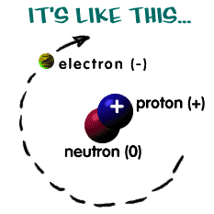
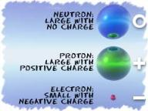
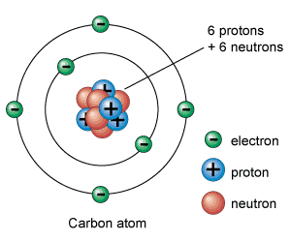
The Structure of an Atom
Here are some examples:
Atoms are the basis for everything in the universe.
Q: What are the three basic parts of an atom?
• ? = "-" negative charge
• ? = "+" positive charge
• ? = neutral (a charge of zero)
The thing that makes each element unique is the number of protons, since the number of neutrons and electrons can vary.
Protons and neutrons always in the center of atom (the nucleus).
Electrons are found orbiting around nucleus in areas called shells.
Q: If there is an equal number of electrons and protons in an atom, what is it’s charge?
NERDY SCIENCE JOKE: A neutron walks into a bar and asks “How much for a drink?”
Q: What does the bartender tell him?
Images: Structure of Atom, Chem4Kids Website; Carbon, Universe Today Website
From the Virtual Cell Biology Classroom on ScienceProfOnline.com

Slide 5
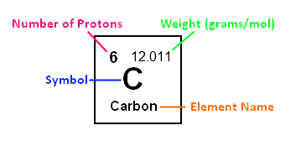
Protons & Neutrons:
Atomic Number, Mass Number & Atomic Mass
Atomic Number: The number of protons in the nucleus of an atom.
Q: What is the atomic number of carbon?
Atomic Mass: (aka atomic weight): The atomic mass of an element is rarely an even number. This happens because of the isotopes.
Many elements occur as isotopes. They vary in the # of neutrons they have.
When an atom has a different number of protons and neutrons, its nucleus becomes unstable.
Q: What is the atomic mass of carbon?
Mass Number: The number of protons, plus the number of neutrons.
Q: How do we know the mass number, if the number of neutrons in an element may vary? Lets look at out Lab Exercise
Atomic mass is calculated by figuring out the amounts of each type of atoms isotopes there are in the Universe.
Example: For carbon, there is a lot of C-12, some C-13, and some C-14 atoms.
When you average out all of the masses, you get a number that is a little bit higher than 12 (the weight of a C-12 atom). The average atomic mass for Carbon is actually 12.011.
Let’s listen to part of the Radiolab podcast episode “Elements” (starting at time 35:00) to learn more about the interesting new use of C-14.
From the Virtual Cell Biology Classroom on ScienceProfOnline.com

Slide 6
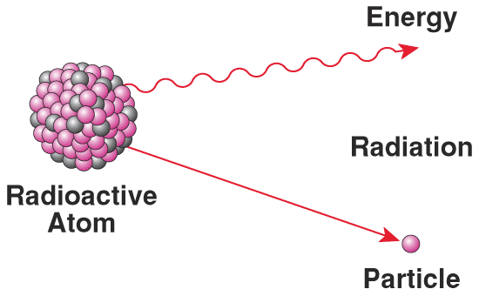
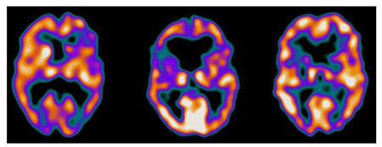
Isotopes & Radioactivity
• Isotope is radioactive if nucleus is unstable.
Most isotopes disintegrate spontaneously with the release
of energy by processes of nuclear or radioactive decay.
When the nucleus changes in structure, energy and/or subatomic particles are given off.
Other than radioactivity, isotopes of an element behave similarly: They can participate in molecule / chemical reactions that involve that element.
• When controlled, radioactive isotopes can be valuable medical tools. (Ex. Gamma camera can produce images of soft tissue when radiopharmaceuticals are injected into or ingested by patient.)
Schizophrenic female
Female with depression
Healthy female
From the Virtual Cell Biology Classroom on ScienceProfOnline.com

Slide 7
What about electrons?
In a neutral atom, there are the same number of protons (+) and electrons (-).
Electrons orbit around the atomic nucleus in shells.
The inner shell (lowest energy level) of an atom, closest to the nucleus, can have a maximum of two electrons.
The outermost, highest energy shell, is called the valence shell.
Eight (8) is the max number of valence electrons for a full valence shell.
Number of valence electrons governs an atom’s bonding behavior.
Atoms are much more stable, or less reactive, with a full valence shell.
By moving electrons, the two atoms become linked. This is known as chemical bonding.
See Rader’s Chem4Kids web page on the Periodic Table. Their explanations are extremely helpful!
Images: Carbon, Universe Today Website
From the Virtual Cell Biology Classroom on ScienceProfOnline.com
Notes:
A: 8

Slide 8
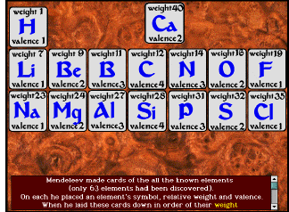
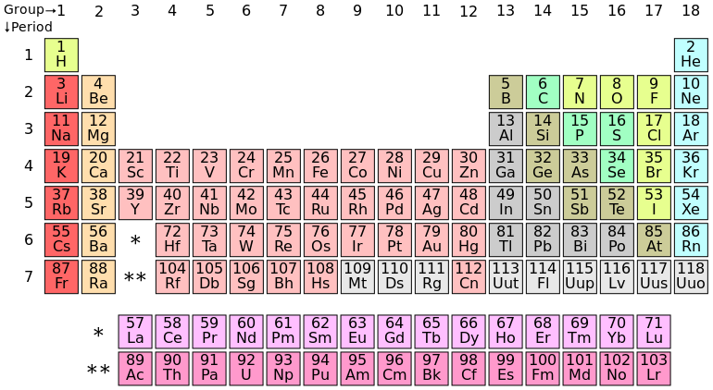
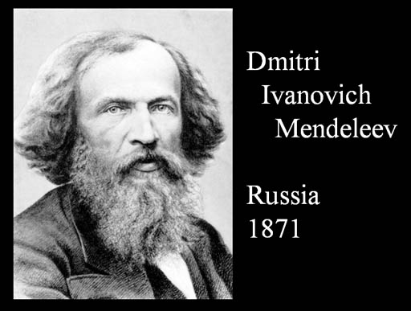
The Periodic Table
Dmitri Ivanovich Mendeleev
(1834 –1907)
Russian chemist and inventor.
Formulated Periodic Law.
Created his own version of the periodic table of elements, and used it to correct the properties of some already discovered elements and to predict the properties of eight elements that had not been discovered yet!
Listen to Radiolab podcast segment on Mendeleev and the periodic table from the episode
“Yellow Fluff and Other Curious Encounters”
(starting at 4:30 into the podcast).
Go to the Chemistry Basics & the Periodic Table Main Page to find a homework assignment based on this podcast.
Image: Periodic Table of Elements
From the Virtual Biology Classroom on ScienceProfOnline.com

Slide 9
Electrons:
How can I determine the number of electron shells? Period !
Electrons in an atom are located in different shells or energy levels.
Each ROW of the periodic table is called a Period.
Period Rule 1: All of the elements in a Period have the same number of electron shells.
For example, every element in the top row (the first period) has one shell for its electrons. All elements in the second row (the second period) have two shells for their electrons.
Period Rule 2: As you move down the table, every row adds a shell, up to seven.
Period Rule 3: The innermost (closest to the nucleus) shell of all atoms (other than hydrogen) has two electrons.
Period Rule 4: The electrons in the outermost shell are called valence electrons.
Image: Periodic Table of Elements
From the Virtual Biology Classroom on ScienceProfOnline.com

Slide 10
Electrons:
How can I determine the number of outer shell electrons? Group!
Electrons in the outermost shell are called valence electrons.
Each COLUMN of the periodic table is called a Group.
Group Rule 1: All elements in the same Group (vertical column) have the same number of valence electrons.
Group Rule 2: As you move across the table, (ignoring columns 3 – 12, the transition elements) every row adds a valence electron, up to 8.
Key! If you know the number of shells and valence electrons, you can draw an electron shell diagram for any of the non-transitional elements.
From the Virtual Biology Classroom on ScienceProfOnline.com
Image: Periodic Table of Elements

Slide 11
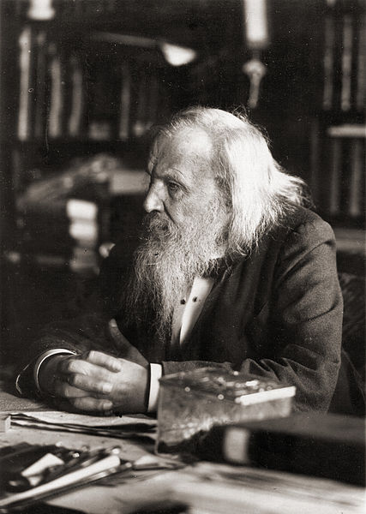
Let’s listen to “The Periodic Table: Rapping the Elements”
From the Virtual Cell Biology Classroom on ScienceProfOnline.com
Images: Periodic Table of Elements; Mendeleev, Wiki

Slide 12
Confused?
Here are some links to fun resources that further explain Chemistry:
Inorganic Chemistry Main Page on the Virtual Cell Biology Classroom of Science Prof Online.
“What Kind of Bonds Are These?” song and slide show by Mark Rosengarten.
Chemical Bond Formation animated science tutorial.
“Meet the Elements” music video by They Might Be Giants.
Redox Reactions video lecture by Kahnacademy.
Chem4Kids website by Rader.
Neutron Dance …a so-bad-its-good ’80s music video by The Pointer Sisters
(You must be in PPT slideshow view to click on links.)
Smart Links
Want to see me sing the Element Song?
Image: Daniel Radcliff by Joella Marano
From the Virtual Cell Biology Classroom on ScienceProfOnline.com

Slide 13

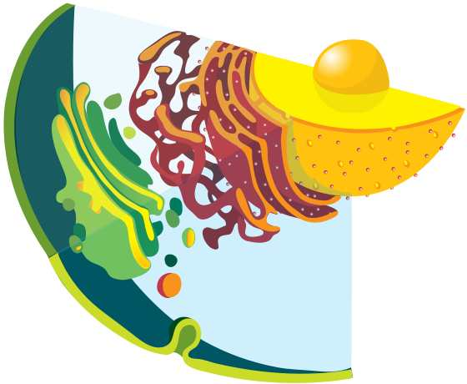
Are you feeling blinded by science?
Do yourself a favor. Use the…
Virtual Cell Biology Classroom (VCBC) !
The VCBC is full of resources to help you succeed, including:
practice test questions
review questions
study guides and learning objectives
PowerPoints on other topics
You can access the VCBC by going to the Science Prof Online website www.ScienceProfOnline.com
Images: Blinded With Science album, Thomas Dolby; Endomembrane system, Mariana Ruiz, Wiki

