Slide 1

About Science Prof Online
PowerPoint Resources
Science Prof Online (SPO) is a free science education website that provides fully-developed Virtual Science Classrooms, science-related PowerPoints, articles and images. The site is designed to be a helpful resource for students, educators, and anyone interested in learning about science.
The SPO Virtual Classrooms offer many educational resources, including practice test questions, review questions, lecture PowerPoints, video tutorials, sample assignments and course syllabi. New materials are continually being developed, so check back frequently, or follow us on Facebook (Science Prof Online) or Twitter (ScienceProfSPO) for updates.
Many SPO PowerPoints are available in a variety of formats, such as fully editable PowerPoint files, as well as uneditable versions in smaller file sizes, such as PowerPoint Shows and Portable Document Format (.pdf), for ease of printing.
Images used on this resource, and on the SPO website are, wherever possible, credited and linked to their source. Any words underlined and appearing in blue are links that can be clicked on for more information. PowerPoints must be viewed in slide show mode to use the hyperlinks directly.
Several helpful links to fun and interactive learning tools are included throughout the PPT and on the Smart Links slide, near the end of each presentation. You must be in slide show mode to utilize hyperlinks and animations.
This digital resource is licensed under Creative Commons Attribution-ShareAlike 3.0:
http://creativecommons.org/licenses/by-sa/3.0/
Alicia Cepaitis, MS
Chief Creative Nerd
Science Prof Online
Online Education Resources, LLC
alicia@scienceprofonline.com
Tami Port, MS
Creator of Science Prof Online
Chief Executive Nerd
Science Prof Online
Online Education Resources, LLC
info@scienceprofonline.com
From the Virtual Cell Biology Classroom on ScienceProfOnline.com
Image: Compound microscope objectives, T. Port
Notes:
Welcome to Science Prof Online PowerPoint Resources!
This PowerPoint Presentation comes from the Virtual Cell Biology Classroom of Science Prof Online, and, as such, is licensed under Creative Commons Attribution-ShareAlike 3.0.; meaning you can download, share and alter any of this presentation, but you can’t sell it or repackage and sell any part of it. Please credit Science Prof Online as the source of this presentation. Please abide by credited image copyrights. Thank you for using this resource.

Slide 2
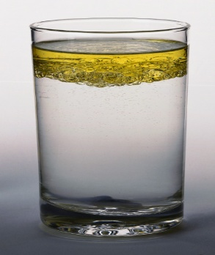
Chemical Solutes, Solvents & Solubility
For additional resources on this lecture topic, see the Inorganic Chemistry Main Page on SPO.

Slide 3
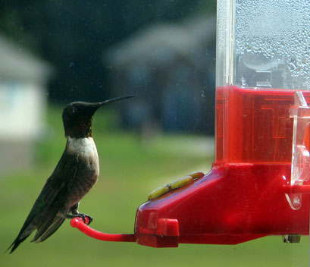
Solutions
Solutions are homogeneous mixtures in which one substance is dissolved in another.
Solutions have two parts:
solute & solvent
Q: Which is the substance that is dissolved?
So the substance that does the dissolving is called the… ?
Homogeneous means that the the solute and the solvent are evenly distributed.
A heterogeneous mixture is made of different substances that remain physically separate.
Image: Hummingbird at feeder, Wiki
From the Virtual Cell Biology Classroom on ScienceProfOnline.com
Notes:
A: solute
A: solvent

Slide 4
Solubility
(mixability)
A measure of how much of a given substance will dissolve in a liquid.
Relates to whether the molecules involved are polar or non-polar.
A substance that does not dissolve is insoluble. Example: Oil is insoluble in water.
A substance that does dissolve is called soluble. Example: Sugar is soluble in water.
From the Virtual Cell Biology Classroom on ScienceProfOnline.com

Slide 5
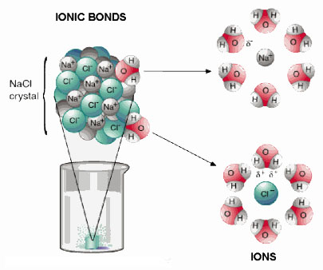
What determines solubility?
Like Dissolves
Like Rule
Substances with charges (full or partial) like to mix with one another.
From the Virtual Cell Biology Classroom on ScienceProfOnline.com

Slide 6
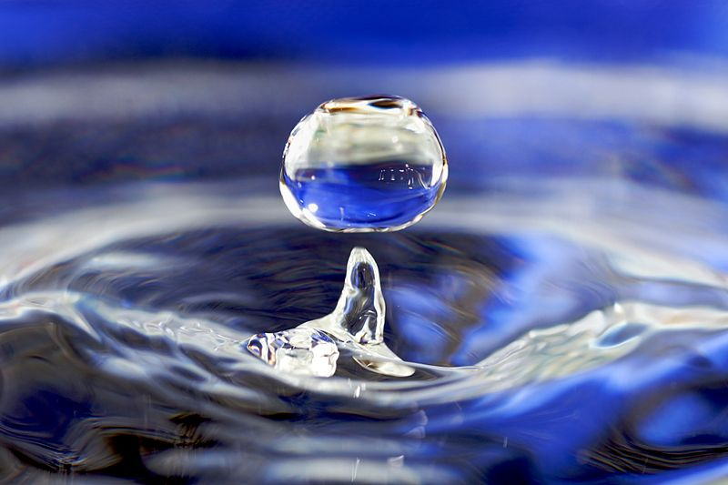
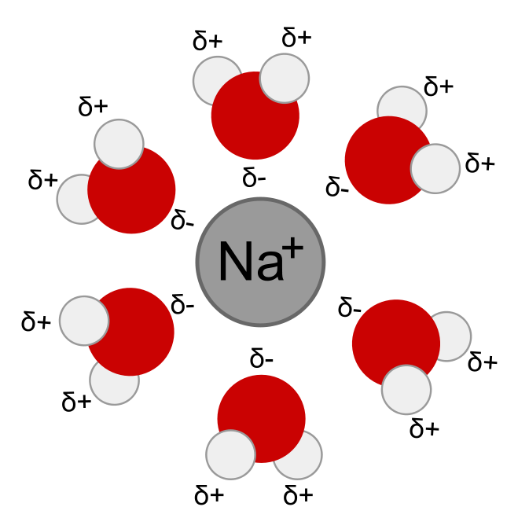
Water is considered the “Universal Solvent”
Water dissolves more substances than any other liquid.
The water molecule’s polarity makes it such an excellent solvent.
The polarity allows water to become attracted to many other charged (ions) or partially charged (polar) molecules.
Images: A water drop , Wiki; Solvation of Na+ in water, Wiki
From the Virtual Cell Biology Classroom on ScienceProfOnline.com

Slide 7
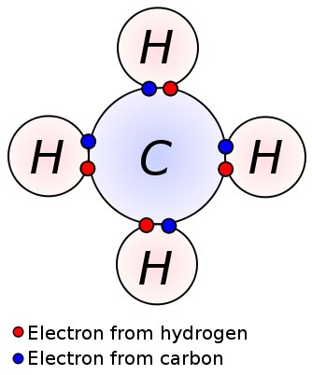
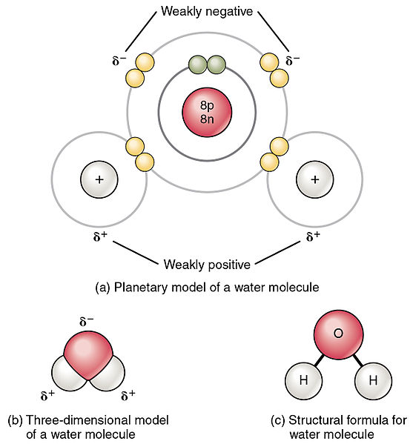
Polar vs. Non-Polar Covalent Bonds
Polar molecules unequally share electrons between atoms, so have a slight positive charge at one end and a slight negative charge at the other.
Non-polar molecules have electrons equally shared between their atoms.
Video:
Polar & Non-Polar Molecules
from Crash Course Biology
Image: Polar water molecule, Non-polar methane molecule, Wiki
From the Virtual Cell Biology Classroom on ScienceProfOnline.com

Slide 8
Water is a good solvent for many other polar solutes.
Polar Covalent Molecules include:
Ammonia NH₃
Glucose C₆H₁₂O₆
Urea (NH₂)₂CO
*High ratio of O’s and N’s tend to make a molecule polar.
For example, blood is a water based solution.
Image: Polar water molecule, Wiki
From the Virtual Cell Biology Classroom on ScienceProfOnline.com

Slide 9
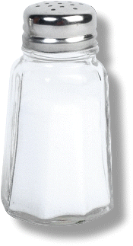
Water is also a good solvent for ionic compounds.
(a.k.a. salts & electrolytes)
The partial and full charges attract each other.
Salts dissociate into their ions in water.
Video of dissociation of NaCl into water.
Video clip from movie Idiocracy:
“Brawndo Has What Plants Crave!”
From the Virtual Cell Biology Classroom on ScienceProfOnline.com

Slide 10
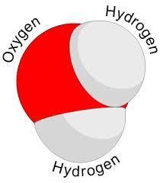
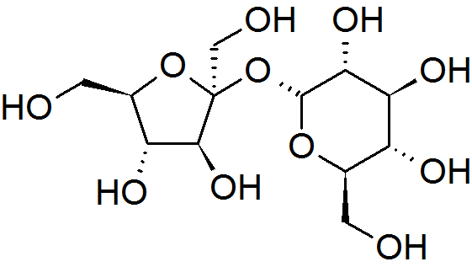
Charged molecules are Hydrophilic
  from the Greek (hydros) "water" and (philia) "friendship”
  Water loving
  Water soluble
  Example: Water & sugar
Image: Hummingbird at feeder, Water molecule, Sucrose molecule, Wiki
From the Virtual Cell Biology Classroom on ScienceProfOnline.com

Slide 11
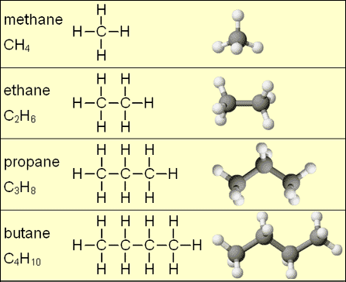
Non-polar substances
DO NOT carry any kind of charge
Mainly molecules made of C’s and H’s.
Example: Oily or gasoline based substances
From the Virtual Cell Biology Classroom on ScienceProfOnline.com

Slide 12
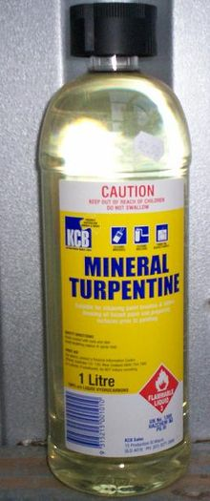
What determines solubility?
Like Dissolves
Like Rule
Non-polar solvents dissolve non-polar solutes.
Image: Mineral turpentine, Wiki
From the Virtual Cell Biology Classroom on ScienceProfOnline.com

Slide 13
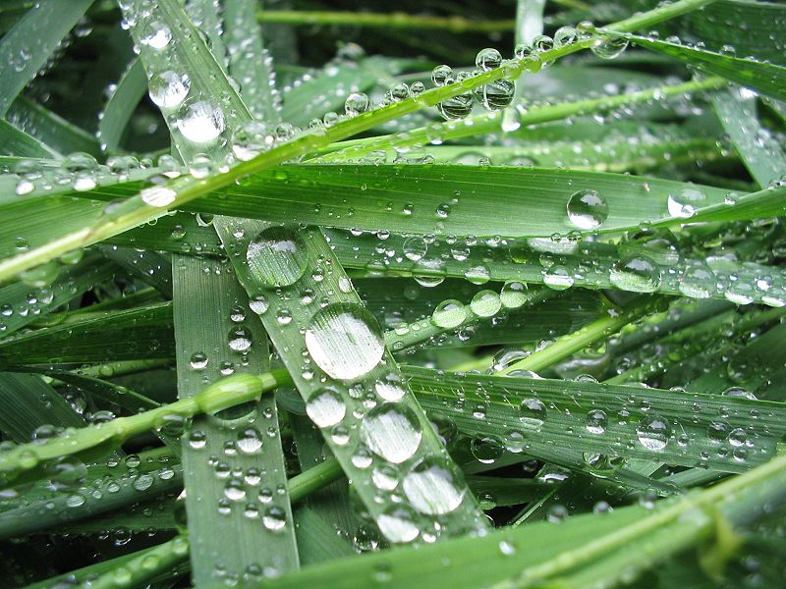
Non-polar, uncharged molecules are Hydrophobic
from the Greek (hydros) “water” and (phobia) “fearing” or “hating”
Water-fearing
Not water soluble
Example: Cholesterol is not water soluble
Non-polar solvents dissolve non-polar solutes.
Examples:
Turpentine dissolves oil-based paints.
Cholesterol is important component of greasy cell membranes.
Image: Water droplets on hydrophobic surface of plant, Wiki
From the Virtual Cell Biology Classroom on ScienceProfOnline.com

Slide 14
Oil and Water Don’t Mix
Hydrophobic
&
Hydrophilic
substances
DO NOT MIX
Examples: Salad dressing, grease fire and water
Insoluble: Substances that
do NOT mix in each other.
Solute does not dissolve.
Line of separation.
From the Virtual Cell Biology Classroom on ScienceProfOnline.com

Slide 15
Solubility
MOLECULE | Hydro - | Solvent examples | What elements to look for
Polar, charged | philic (likes) | water, alcohols | Hydrogen bound to elements that are electronegative in relation such as oxygens & nitrogens)
Non-polar, not charged | phobic (doesn’t like) | oil-based | Carbon-hydrogen bonds
From the Virtual Cell Biology Classroom on ScienceProfOnline.com

Slide 16
Confused?
Here are some links to fun resources that further explain Inorganic and Covalent Compounds & Solutions:
Video of dissociation of NaCl into water.
Factors Affecting Solubility, animation from Tutor Vista.
Video clip from movie Idiocracy: “Brawndo Has What Plants Crave!”
Polar & Non-polar Molecules from Crash Course Chemistry #23.
(You must be in PPT slideshow view to click on links.)
Smart Links
From the Virtual Cell Biology Classroom on ScienceProfOnline.com

Slide 17
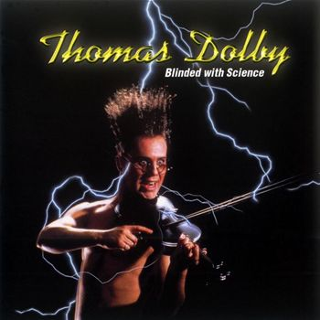
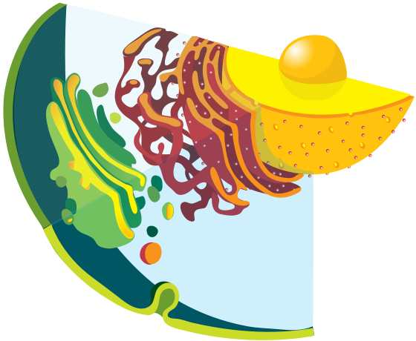
Are you feeling blinded by science?
Do yourself a favor. Use the…
Virtual Cell Biology Classroom (VCBC) !
The VCBC is full of resources to help you succeed, including:
practice test questions
review questions
study guides and learning objectives
PowerPoints on other topics
You can access the VCBC by going to the Science Prof Online website www.ScienceProfOnline.com
Images: Blinded With Science album, Thomas Dolby; Endomembrane system, Mariana Ruiz, Wiki

