Slide 1

About Science Prof Online
PowerPoint Resources
Science Prof Online (SPO) is a free science education website that provides fully-developed Virtual Science Classrooms, science-related PowerPoints, articles and images. The site is designed to be a helpful resource for students, educators, and anyone interested in learning about science.
The SPO Virtual Classrooms offer many educational resources, including practice test questions, review questions, lecture PowerPoints, video tutorials, sample assignments and course syllabi. New materials are continually being developed, so check back frequently, or follow us on Facebook (Science Prof Online) or Twitter (ScienceProfSPO) for updates.
Many SPO PowerPoints are available in a variety of formats, such as fully editable PowerPoint files, as well as uneditable versions in smaller file sizes, such as PowerPoint Shows and Portable Document Format (.pdf), for ease of printing.
Images used on this resource, and on the SPO website are, wherever possible, credited and linked to their source. Any words underlined and appearing in blue are links that can be clicked on for more information. PowerPoints must be viewed in slide show mode to use the hyperlinks directly.
Several helpful links to fun and interactive learning tools are included throughout the PPT and on the Smart Links slide, near the end of each presentation. You must be in slide show mode to utilize hyperlinks and animations.
This digital resource is licensed under Creative Commons Attribution-ShareAlike 3.0:
http://creativecommons.org/licenses/by-sa/3.0/
Alicia Cepaitis, MS
Chief Creative Nerd
Science Prof Online
Online Education Resources, LLC
alicia@scienceprofonline.com
Tami Port, MS
Creator of Science Prof Online
Chief Executive Nerd
Science Prof Online
Online Education Resources, LLC
info@scienceprofonline.com
From the Virtual Cell Biology Classroom on ScienceProfOnline.com
Image: Compound microscope objectives, T. Port
Notes:
Welcome to Science Prof Online PowerPoint Resources!
This PowerPoint Presentation comes from the Virtual Cell Biology Classroom of Science Prof Online, and, as such, is licensed under Creative Commons Attribution-ShareAlike 3.0.; meaning you can download, share and alter any of this presentation, but you can’t sell it or repackage and sell any part of it. Please credit Science Prof Online as the source of this presentation. Please abide by credited image copyrights. Thank you for using this resource.

Slide 2
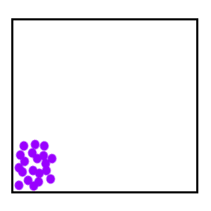
The Movement
of Molecules:
Diffusion,
Osmosis &
Active Transport
For additional resources on this lecture topic, see the Diffusion, Osmosis & Active Transport main page on SPO.
Images: Diffusion Animation, Biology Corner; Diffusion, J Krieger

Slide 3
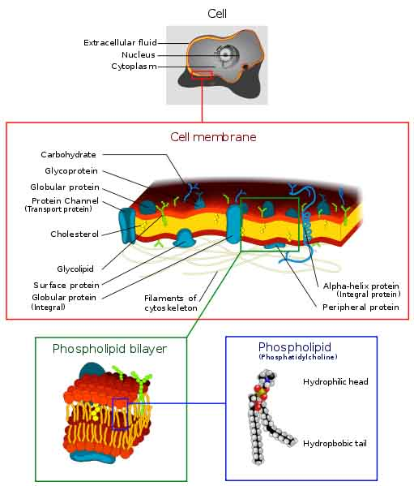
Prokaryotes
Plasma Membrane
Separates the cell from its environment.
Phospholipid molecules oriented so that hydrophilic water-loving heads directed outward and hydrophobic water-hating tails directed inward.
Proteins embedded in two layers of lipids (lipid bilayer).
Membrane is semi-permeable. Q: What does that mean?
From the Virtual Cell Biology Classroom on ScienceProfOnline.com
Image: Cell Membrane diagram, Dhatfield
Notes:
Some materials can move across the membrane, others cannot.

Slide 4
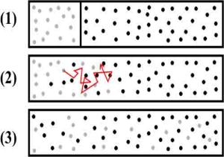
Passive Transport
Primary function of plasma membrane → regulate movement of molecules entering or leaving cell.
Movement of molecules across plasma membrane requires energy.
Movement of molecules is passive if no energy sources of the cell are expended.
Diffusion = when molecules move down a concentration gradient, from a higher to a lower concentration.
Q: What type of things might affect the rate of diffusion?
From the Virtual Cell Biology Classroom on ScienceProfOnline.com
Images: Diffusion Animation, Biology Corner; Diffusion, J Krieger
Notes:
Temperature: molecules are always moving, and move faster at higher temperatures.
Size: small molecules move faster than large molecules.
Concentration Gradient: difference in concentration of a substance between two areas

Slide 5
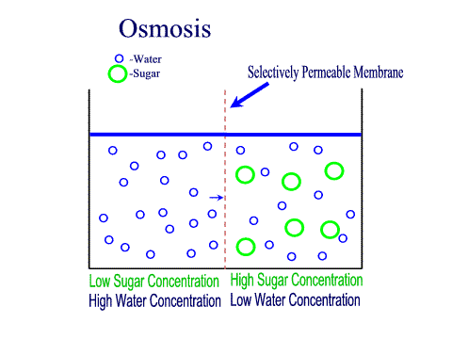
Passive Transport - Osmosis
Q: Diffusion of what across the plasma membrane?
Environment surrounding cells may contain amounts of dissolved substances (solutes) that are…
- equal to
- less than
- greater than
…those found within the cell.
Plasma membrane
CELL
Liquid environment outside the cell.
Liquid environment inside the cell.
From the Virtual Cell Biology Classroom on ScienceProfOnline.com
Images: Osmosis animation
Notes:
A: Water

Slide 6
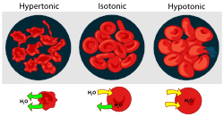
Passive Transport - Osmosis
Tonicity and Osmosis
isotonic: equal concentration of a solute
inside and outside of cell.
hypertonic: a higher concentration of solute.
hypotonic: a lower concentration of solute.
REVIEW!
How Osmosis Works animation
Diffusion, Osmosis & Active Transport Lecture Main Page of the
Virtual Cell Biology Classroom on the
Science Prof Online website
Water will always move toward a hypertonic environment!!
From the Virtual Cell Biology Classroom on ScienceProfOnline.com
Images: Osmosis animation; Osmosis with RBCs, M. Ruiz

Slide 7
Let’s do some osmosis problems, to practice our knowledge.
Passive Transport - Osmosis
Second clamp to seal “cell”.
A solution to put inside the “cell”.
+
CLAMP #2
+
A solution to put the “cell” into.
Plasma membrane
Dialysis Tubing
CELL
Liquid environment outside the cell.
Liquid environment inside the cell.
CLAMP #1
From the Virtual Cell Biology Classroom on ScienceProfOnline.com
Notes:
Experiment using dialysis tubing (semi-permeable membrane) and clamps to make a pretend cell.
What happens when different dilutions of sugar (a big molecule that cannot pass through semi-permeable membrane) are used inside versus outside of cell.
Will the artificial cell lose weight, gain weight or stay the same in the following scenarios?
1. Fill cell with 20% sugar solution, submerge in container of 60% sugar solution
2. Fill cell with 35% sugar solution, submerge in container of pure water.
3. Fill cell with pure water, submerge in a container of 2% sugar solution.

Slide 8
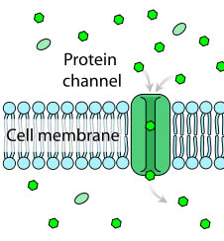
Passive Transport
Facilitated Diffusion
Proteins assist in diffusion of molecules across plasma membrane.
Movement only occurs in the presence of a concentration gradient.
Some molecules move across the membrane more quickly if diffusion is facilitated by a carrier molecule.
From the Virtual Cell Biology Classroom on ScienceProfOnline.com
Image: Facilitated Diffusion, M. Ruiz
Notes:
Facilitated

Slide 9
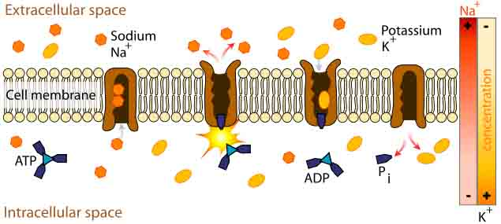
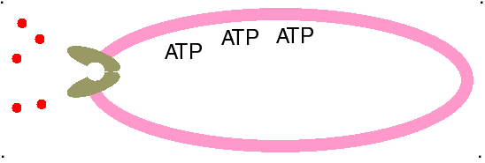
Active Transport
How most molecules move across the plasma membrane.
Analogous to a pump moving water uphill.
Types of active transport are classified by type of energy used to drive molecules across membranes.
ATP Driven Active Transport
Energy from adenosine triphosphate (ATP) drives substances across the plasma membrane with aid of carrier molecules.
From the Virtual Cell Biology Classroom on ScienceProfOnline.com
Image: Sodium-potassium pump, M. Ruiz

Slide 10
Confused?
Here are some links to fun resources that further explain Cell Biology:
Diffusion, Osmosis & Active Transport Main Page, Virtual Cell Biology Classroom of Science Prof Online website.
“The Osmosis Song” music video by Duanie Films.
Osmosis Demonstration with raw egg by thsharpe.
“Osmosis Jones” movie trailer. If you haven’t seen this yet, you must watch it immediately! It’s awesome!
Osmosis Animation and Quiz by McGraw-Hill.
Active Transport Animation and Quiz Sodium Potassium Pump, by McGraw-Hill.
Diffusion Animation and Quiz by McGraw-Hill.
Facilitated Diffusion Animation and Quiz by McGraw-Hill.
(You must be in PPT slideshow view to click on links.)
Smart Links
From the Virtual Cell Biology Classroom on ScienceProfOnline.com

Slide 11

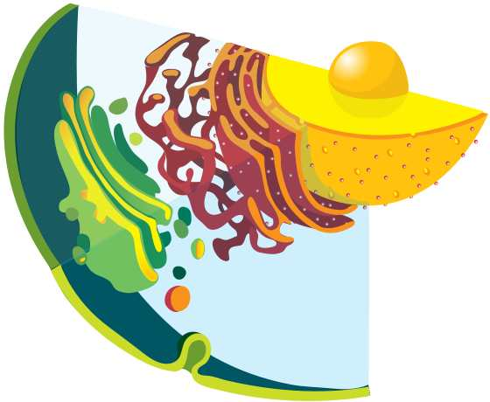
Are you feeling blinded by science?
Do yourself a favor. Use the…
Virtual Cell Biology Classroom (VCBC) !
The VCBC is full of resources to help you succeed, including:
practice test questions
review questions
study guides and learning objectives
PowerPoints on other topics
You can access the VCBC by going to the Science Prof Online website www.ScienceProfOnline.com
Images: Blinded With Science album, Thomas Dolby; Endomembrane system, Mariana Ruiz, Wiki

