Slide 1

About Science Prof Online
PowerPoint Resources
Science Prof Online (SPO) is a free science education website that provides fully-developed Virtual Science Classrooms, science-related PowerPoints, articles and images. The site is designed to be a helpful resource for students, educators, and anyone interested in learning about science.
The SPO Virtual Classrooms offer many educational resources, including practice test questions, review questions, lecture PowerPoints, video tutorials, sample assignments and course syllabi. New materials are continually being developed, so check back frequently, or follow us on Facebook (Science Prof Online) or Twitter (ScienceProfSPO) for updates.
Many SPO PowerPoints are available in a variety of formats, such as fully editable PowerPoint files, as well as uneditable versions in smaller file sizes, such as PowerPoint Shows and Portable Document Format (.pdf), for ease of printing.
Images used on this resource, and on the SPO website are, wherever possible, credited and linked to their source. Any words underlined and appearing in blue are links that can be clicked on for more information. PowerPoints must be viewed in slide show mode to use the hyperlinks directly.
Several helpful links to fun and interactive learning tools are included throughout the PPT and on the Smart Links slide, near the end of each presentation. You must be in slide show mode to utilize hyperlinks and animations.
This digital resource is licensed under Creative Commons Attribution-ShareAlike 3.0 : http://creativecommons.org/licenses/by-sa/3.0/
Alicia Cepaitis, MS
Chief Creative Nerd
Science Prof Online
Online Education Resources, LLC
alicia@scienceprofonline.com
Tami Port, MS
Creator of Science Prof Online
Chief Executive Nerd
Science Prof Online
Online Education Resources, LLC
info@scienceprofonline.com
From the Virtual Cell Biology Classroom on ScienceProfOnline.com
Image: Compound microscope objectives, T. Port
Notes:
Welcome to Science Prof Online PowerPoint Resources!
This PowerPoint Presentation comes from the Virtual Cell Biology Classroom of Science Prof Online, and, as such, is licensed under Creative Commons Attribution-ShareAlike 3.0.; meaning you can download, share and alter any of this presentation, but you can’t sell it or repackage and sell any part of it. Please credit Science Prof Online as the source of this presentation. Please abide by credited image copyrights. Thank you for using this resource.

Slide 2
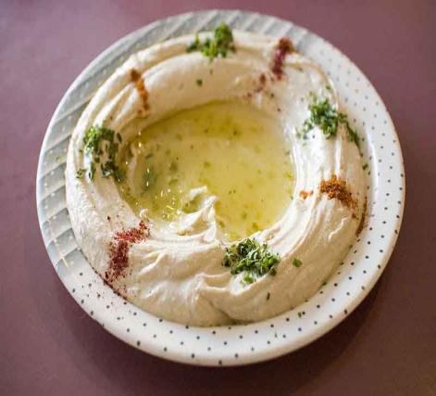
Metabolism
Catabolism
of Proteins
& Fats
From the Virtual Cell Biology Classroom on ScienceProfOnline.com
Image: Hummus by Paul Goyette

Slide 3
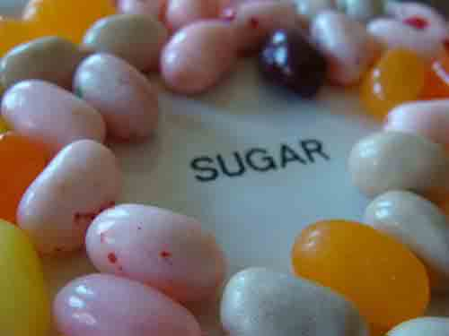
Catabolism of Proteins & Fats
Q: So far in
our study of metabolism, what has provided the energy used to make ATP?
From the Virtual Cell Biology Classroom on ScienceProfOnline.com
Images: Sugar, T. Port
Notes:
A: See next page

Slide 4
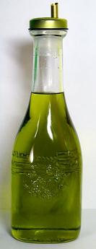
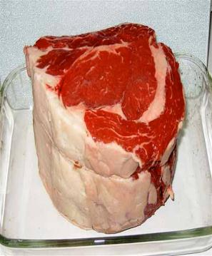
Catabolism of Proteins & Fats
How do we metabolize things that aren’t glucose?
Fats, proteins and carbs can all provide energy for the cell.
Basic pathways used to extract energy from fat & protein are the same as for carbs: glycolysis, Krebs, ETC but there are some extra steps.
From the Virtual Cell Biology Classroom on ScienceProfOnline.com
Images: Olive Oil, Alex Ex; Raw beef, MCB

Slide 5
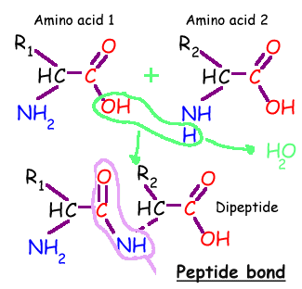
Organic Molecules - Proteins
Dehydration synthesis is the chemical reaction that joins amino acids into polypeptide.
Q: What reaction breaks down polypeptides into amino acids?
From the Virtual Cell Biology Classroom on ScienceProfOnline.com

Slide 6
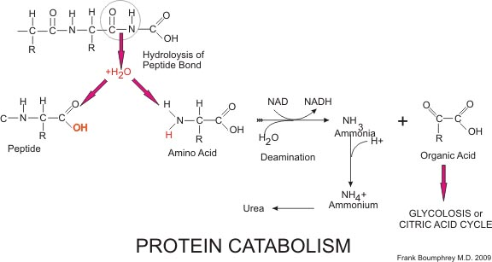
Protein Catabolism
From the Virtual Cell Biology Classroom on ScienceProfOnline.com
Image: Protein catabolism, Boumphreyfr

Slide 7
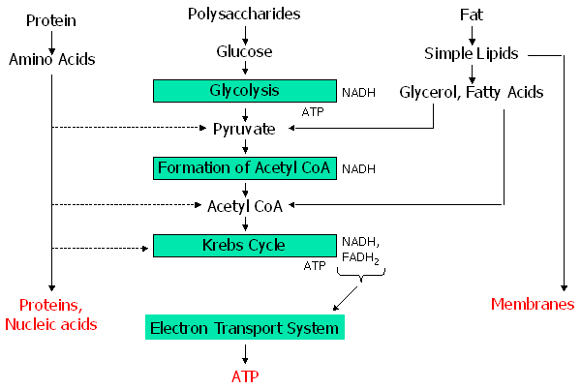
.
How do we metabolize protein?
Excess amino acids can be used to synthesize pyruvate, acetyl CoA, and ketogluterate, which enters the Krebs cycle.
From the Virtual Cell Biology Classroom on ScienceProfOnline.com

Slide 8
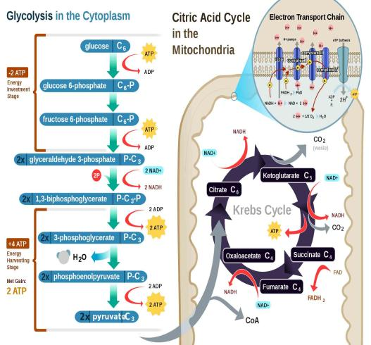
How do we metabolize protein?
Excess amino acids can be used to synthesize pyruvate, acetyl CoA, and ketogluterate, which enters the Krebs cycle.
REVIEW!
Animated
lesson on
Protein Catabolism
Image: Cellular Respiration, Regis Frey
From the Virtual Cell Biology Classroom on ScienceProfOnline.com

Slide 9
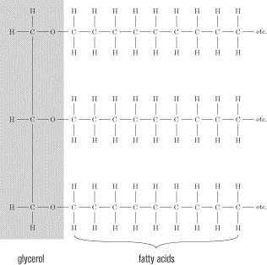
How do we metabolize fats?
• Q: Fats and oils are made from which two kinds of molecules?
Before these fats can be broken down to release energy, they must be converted to smaller units.
The first step is to break the bonds between the glycerol and the fatty acids.
From the Virtual Cell Biology Classroom on ScienceProfOnline.com
Notes:
A: Glycerol & Fatty Acids

Slide 10

How do we metabolize fats?
Glycerol is a 3-carbon molecule that is converted into glyceraldehyde-3-phosphate.
Because glyceraldehyde-3-phosphate is involved in one of the steps in glycolysis, it can enter the glycolysis pathway.
From the Virtual Cell Biology Classroom on ScienceProfOnline.com

Slide 11
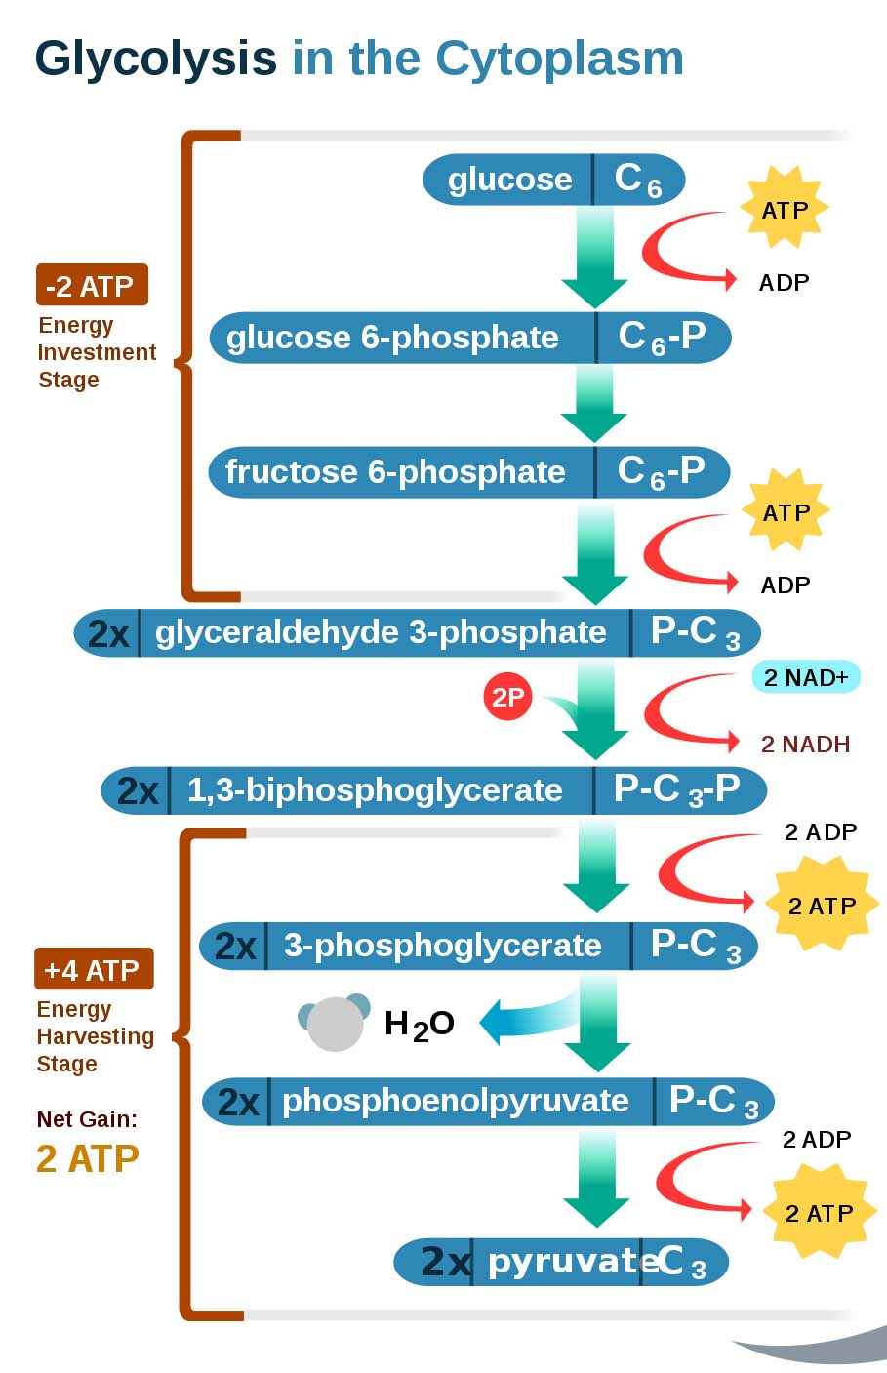
How do we metabolize fats?
From the Virtual Cell Biology Classroom on ScienceProfOnline.com
Image: Glycolysis, Regis Frey

Slide 12
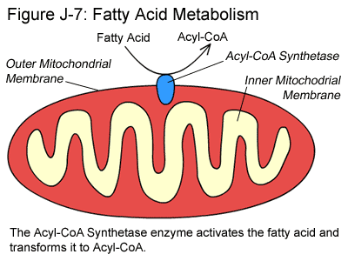
How do we metabolize fatty acid tails?
These long molecules (typically 14 to 20 carbons long) must also be processed before they can be further metabolized.
1. Enter the mitochondrion, where each long chain of carbons that makes up the carbon skeleton is hydrolyzed (split by the addition of a water molecule) into 2-carbon fragments.
2. Each of the 2-carbon fragments is converted into acetyl. Coenzyme A is added to the acetyl, and the ____________ goes into _______ ______.
C
C
From the Virtual Cell Biology Classroom on ScienceProfOnline.com
Notes:
Acetyl-CoA
Kreb’s Cycle

Slide 13
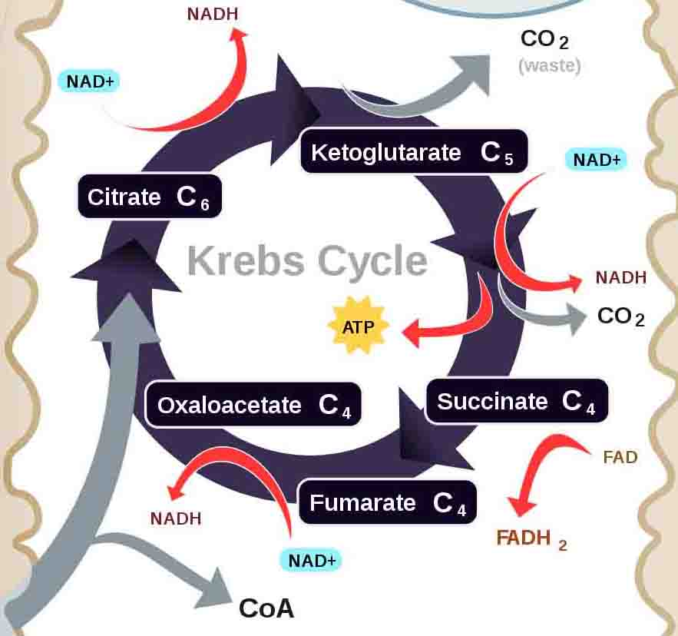
Krebs Cycle
(a.k.a Citric Acid Cycle)
How do we metabolize fatty acid tails?
Acetyl-CoA--→
From the Virtual Cell Biology Classroom on ScienceProfOnline.com
Image: Cellular Respiration, Regis Frey

Slide 14
.
How do we metabolize fats?
REVIEW!
Simple animated
graphic of
Fat Catabolism
and
more in-depth
animated lesson on
Fatty acid Metabolism
From the Virtual Cell Biology Classroom on ScienceProfOnline.com

Slide 15
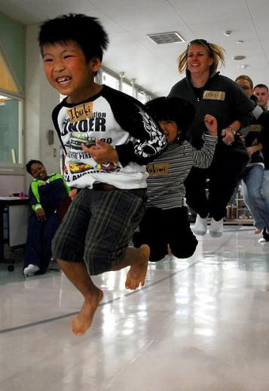
Metabolic Processes … Bottom Line
Metabolism transforms food energy into energy that our cells
can use.
Q: How does the cell turn proteins
into ATP?
Q: How does the cell turn fats
into ATP?
From the Virtual Cell Biology Classroom on ScienceProfOnline.com
Image: Jumping rope, Meagan E. Klein

Slide 16
Confused?
Here are links to fun resources that further explain cellular respiration:
Metabolism of Proteins & Fats Main Page on the Virtual Cell Biology Classroom of Science Prof Online.
Cellular Respiration animation by Jay Phelan, “What is Life? A Guide to Biology”, W. H. Freeman & Co.
“Break It Down Again” music video by Tears for Fears.
How NAD+ Works animation and quiz from McGraw-Hill.
Glycolysis animation and quiz from McGraw-Hill.
Kreb Cycle Animation & Quiz 1 from McGraw-Hill.
Kreb Cycle Animation & Quiz 2 from McGraw-Hill.
Electron Transport Chain animation from Molecular & Cellular Biology Learning Center.
Food Molecules video from HowStuffWorks, a Discovery company.
“The Protein Song” ridiculous but funny song by Ruan0
“Grease (Is the Word)” sung by Frankie Valli.
(You must be in PPT slideshow view to click on links.)
Smart Links
From the Virtual Cell Biology Classroom on ScienceProfOnline.com

Slide 17

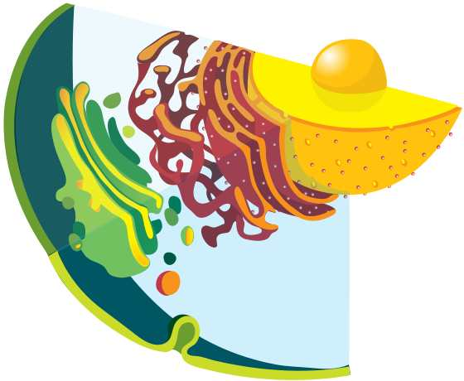
Are you feeling blinded by science?
Do yourself a favor. Use the…
Virtual Cell Biology Classroom (VCBC) !
The VCBC is full of resources to help you succeed, including:
practice test questions
review questions
study guides and learning objectives
PowerPoints on other topics
You can access the VCBC by going to the Science Prof Online website www.ScienceProfOnline.com
Images: Blinded With Science album, Thomas Dolby; Endomembrane system, Mariana Ruiz, Wiki

