Slide 1

About Science Prof Online
PowerPoint Resources
Science Prof Online (SPO) is a free science education website that provides fully-developed Virtual Science Classrooms, science-related PowerPoints, articles and images. The site is designed to be a helpful resource for students, educators, and anyone interested in learning about science.
The SPO Virtual Classrooms offer many educational resources, including practice test questions, review questions, lecture PowerPoints, video tutorials, sample assignments and course syllabi. New materials are continually being developed, so check back frequently, or follow us on Facebook (Science Prof Online) or Twitter (ScienceProfSPO) for updates.
Many SPO PowerPoints are available in a variety of formats, such as fully editable PowerPoint files, as well as uneditable versions in smaller file sizes, such as PowerPoint Shows and Portable Document Format (.pdf), for ease of printing.
Images used on this resource, and on the SPO website are, wherever possible, credited and linked to their source. Any words underlined and appearing in blue are links that can be clicked on for more information. PowerPoints must be viewed in slide show mode to use the hyperlinks directly.
Several helpful links to fun and interactive learning tools are included throughout the PPT and on the Smart Links slide, near the end of each presentation. You must be in slide show mode to utilize hyperlinks and animations.
This digital resource is licensed under Creative Commons Attribution-ShareAlike 3.0:
http://creativecommons.org/licenses/by-sa/3.0/
Alicia Cepaitis, MS
Chief Creative Nerd
Science Prof Online
Online Education Resources, LLC
alicia@scienceprofonline.com
Tami Port, MS
Creator of Science Prof Online
Chief Executive Nerd
Science Prof Online
Online Education Resources, LLC
info@scienceprofonline.com
From the Virtual Cell Biology Classroom on ScienceProfOnline.com
Image: Compound microscope objectives, T. Port
Notes:
Welcome to Science Prof Online PowerPoint Resources!
This PowerPoint Presentation comes from the Virtual Cell Biology Classroom of Science Prof Online, and, as such, is licensed under Creative Commons Attribution-ShareAlike 3.0.; meaning you can download, share and alter any of this presentation, but you can’t sell it or repackage and sell any part of it. Please credit Science Prof Online as the source of this presentation. Please abide by credited image copyrights. Thank you for using this resource.

Slide 2
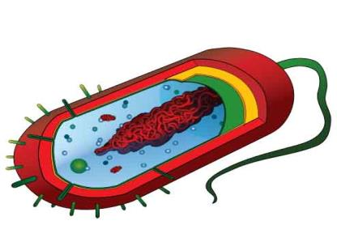
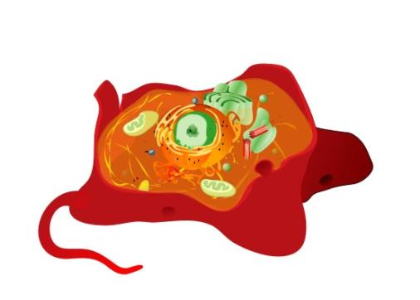
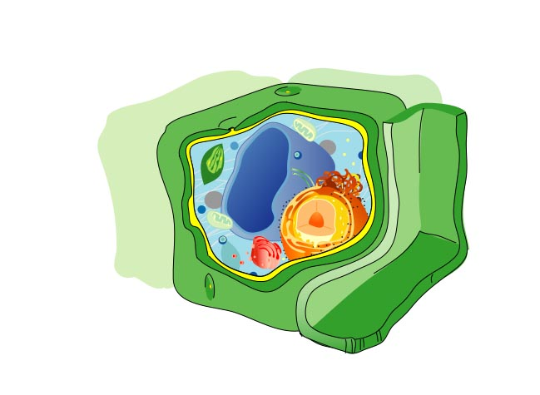
Introduction
to
Cell Biology
For additional resources on this lecture topic, see the Prokaryotic Cell Main Page on SPO.
Images: Prokaryotic Cell Diagram, Eukaryotic Cell Diagram, Plant cell, M. Ruiz

Slide 3
Why else?
Q: Why are you in this class?
“Because it is a requirement to get into
my program of study.”
Because everything alive is made of cells.
(including the patients you will care for and many of
the microbes that cause disease)
From the Virtual Cell Biology Classroom on ScienceProfOnline.com

Slide 4
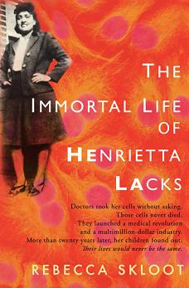
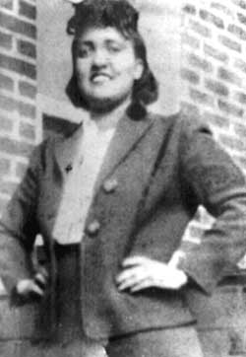
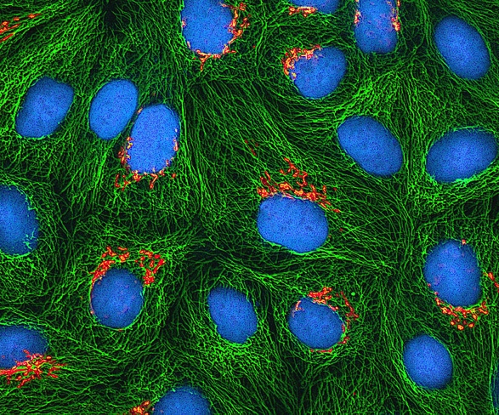
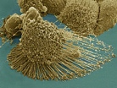
Everyday Cell Biology
Who was Henrietta Lacks and why were her cells
so important to medical science?
Let’s explore the amazing story of Henrietta Lacks
and her immortal cells.
Q: What does the Henrietta Lacks story have to do
with cell biology?
Watch a video of HeLa cells dividing in vitro.
Images: Book, “The Immortal Life of Henrietta Lacks by Rebecca Skloot; Apoptotic HeLa cell, Wiki; Fluorescence image of cultured HeLa cells, Wiki
From the Virtual Cell Biology Classroom on ScienceProfOnline.com
Notes:
HeLa cell filopodia video: https://www.youtube.com/watch?v=-tvFB-eOzJs

Slide 5
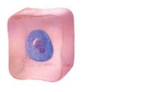
The Cellular Level of Organization
Living things are constructed of cells.
Living things may be unicellular or multicellular.
Cell structure is diverse but all cells share common characteristics.
Cells are small so they can exchange materials with their surroundings.
  - Surface area relative to the volume decreases as size of cell increases.
  - This limits the size of cells.
Cell Theory states:
1. All organisms are composed of one or more cells.
2. Cells are the basic unit of structure and function in organisms.
3. All cells come only from other cells.
From the Virtual Cell Biology Classroom on ScienceProfOnline.com
Notes:
size
Cell Theory

Slide 6
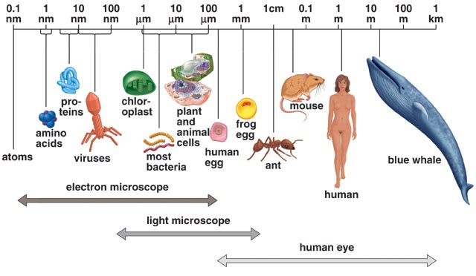
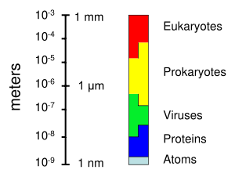
Size of Living Things
1 m = 100 cm = 1,000mm = 1,000,000 µm = 1,000,000,000nm
1mm = 1000 µm = 1000000nm
1 µm = 1000nm
Click link for an interactive
“Size of Microscopic Things”
animation on Cells Alive.
From the Virtual Cell Biology Classroom on ScienceProfOnline.com

Slide 7
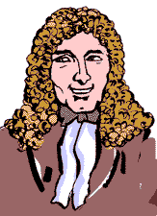
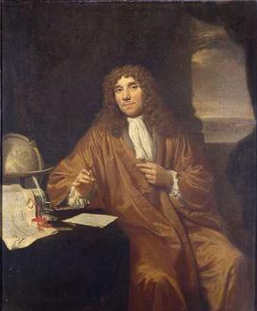
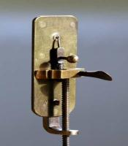
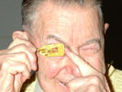
Anton van ___________: “Animalcules”
(Pronounced Lay-when-hook)
As a tailor, used lenses to examine cloth. It was probably this that led to his interest in lens making.
He assembled hundreds of microscopes, some of which magnified objects 270 times.
As he looked at things with his microscopes, he discovered “micro” organisms - organisms so tiny that they were invisible to the naked eye.
He called these tiny living organisms “animalcules”. He first described bacteria and the protozoans.
1632 - 1723
Images: Leeuwenhoek portrait 1680, Jan Verkolje (I);. Replica of Leeuwenhoek microscope, Jacopo Werther; Man with scope, source unknown
From the Virtual Cell Biology Classroom on ScienceProfOnline.com
Notes:
Leuwenhoek

Slide 8

Anton van Leeuwenhoek: “Animalcules”
(Pronounced Lay-when-hook)
Watch Video:
“Pond Life Under the Microscope”
Below is a poem about Van Leeuwenhoek by Maxine Kumin, from the fantastic book of science-related poetry The Tree That Time Built.
The Microscope
Anton Leeuwenhoek was Dutch. He sold pincushions, cloth, and such.
The waiting townsfolk fumed and fussed, as Anton’s dry goods gathered dust.
He worked, instead of tending store,
At grinding special lenses for
A microscope. Some of the things
He looked at were: mosquitoes’ wings,
the hairs of sheep, the legs of lice,
the skin of people, dogs, and mice;
ox eyes, spiders’ spinning gear,
fishes’ scales, a little smear
of his own blood, and best of all,
the unknown, busy, very small
bugs that swim and bump and hop
inside a simple water drop.
Impossible! Most Dutchmen said.
This Anton’s crazy in the head!
We ought to ship him off to Spain!
He says he’s seen a housefly’s brain!
He says the water that we drink
Is full of bugs! He’s mad, we think!
They called him dumkopf, which means dope.
That’s how we got the microscope.
From the Virtual Cell Biology Classroom on ScienceProfOnline.com
Notes:
Leuwenhoek

Slide 9
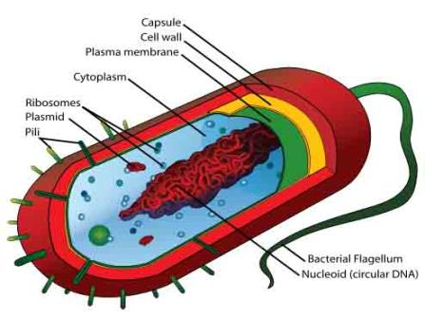
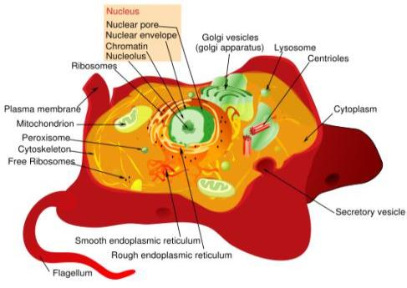
Only TWO Basic Types of Cells
_____________________
_____________________
Cells:
are the building blocks of life!
All living things are made of one or more cells.
only come from other cells.
are , really small. How small are they?
From the Virtual Cell Biology Classroom on ScienceProfOnline.com
Images: Prokaryotic Cell Diagram & Eukaryotic Cell Diagram, M. Ruiz
Notes:
Prokaryotic Cells (Prokaryotes)
Eukaryotic Cells (Eukaryotes)

Slide 10

Prokaryotes…The “studio apartment” of cells.
From the Virtual Cell Biology Classroom on ScienceProfOnline.com
Image: Prokaryotic cell diagram, M. Ruiz,
Notes:
Prokaryotes …
Reproduce by means of binary fission.
Do not have a cell nucleus or any other organelles with membranes. Plasma membrane their only membrane.
DNA travels openly around the cell.
All bacteria are prokaryotes.

Slide 11
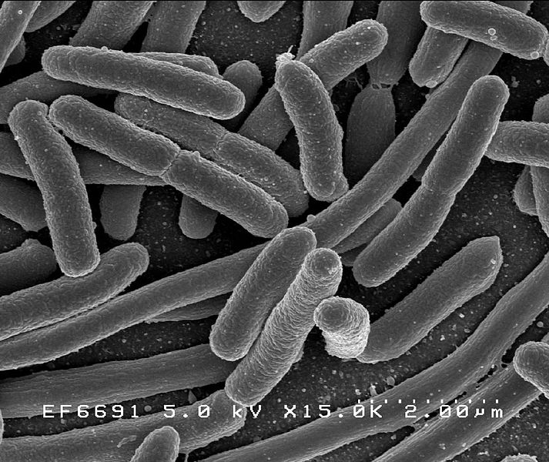
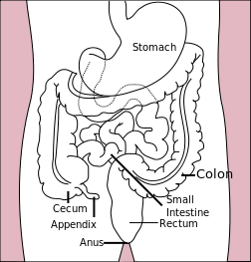
Prokaryotes can be our friends…
Gut Flora
Human body has ~ 100 trillion microbes in intestines (10x more than the total number of human cells in the body).
Bacteria that live on and in us without usually causing harm are called
normal flora.
Bacteria = ~ 60% of the dry mass of poo.
Relationship between gut flora and humans mutualistic … win/win.
Gut microbes perform many useful functions:
  preventing growth of harmful, pathogenic bacteria
  producing vitamins for host (such as biotin and vitamin K)
  producing hormones to direct host to store fats
  keeping our immune system on its toes
Images: E. coli, Rocky Mountain Laboratories, NIAID, NIH; Human Gastrointestinal Tract, Wiki
From the Virtual Cell Biology Classroom on ScienceProfOnline.com

Slide 12
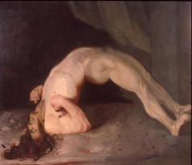
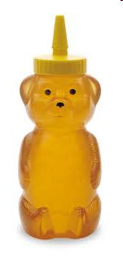
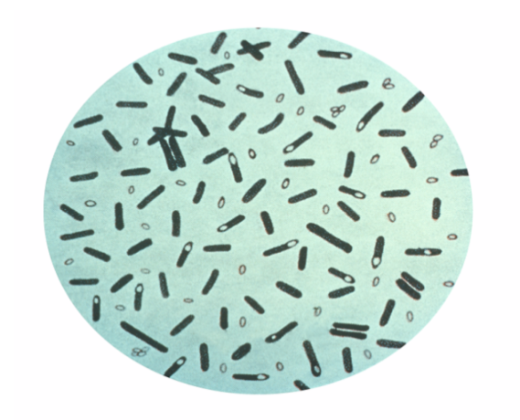
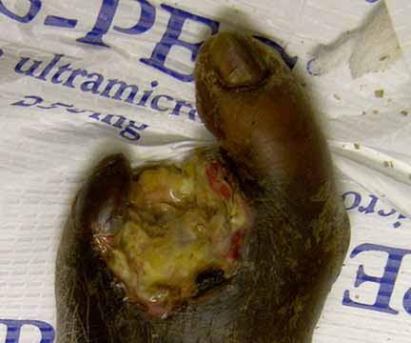
Clostridium
Prokaryotes can be our foes…
Members of this genus have a couple of bacterial weapons that make them particularly tough pathogens.
Vegetative cells are obligate anaerobes killed by exposure to O2, but their endospores are able to survive long periods of exposure to air.
Known to produce a variety of toxins, some of which are fatal.
- Clostridium tetani = agent of tetanus
- C. botulinum = agent of botulism
- C. perfringens = one of the agents of gas gangrene
- C. difficile = part of natural intestinal flora, but resistant strains can proliferate and cause pseudomembranous colitis.
Images: Man with Tetanus, Sir Charles Bell; Clostridium botulinum, PHIL #2107; Wet Gangrene, Wiki
From the Virtual Microbiology Classroom on ScienceProfOnline.com
Notes:
A: Produce endospores & produce toxins
A: Clostridium tetani = agent of tetanus, C. botulinum = agent of botulism, C. perfringens = one of the agents of gas gangrene, C. difficile = part of natural intestinal flora, but resistant strains can proliferate and cause pseudomembranous colitis.

Slide 13
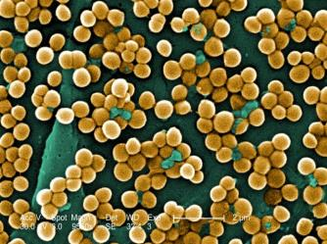
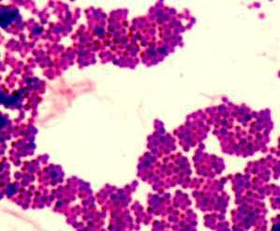
Bacterial “cousins”… one friend, one foe…
Prokaryotes
Staphylococcus
GRAM-POSITIVE
Facultative anaerobe
coccus-shaped
Coccus-shaped bacteria, which divides in a way that results in grape-like clusters.
  Staphylococcus aureus (golden staph), most common cause of staph infections.
  Approximately 20–30% of general population “Staph carriers."
  S. aureus can cause illnesses ranging from minor skin infections to life-threatening diseases, such as meningitis, toxic shock syndrome (TSS) & septicemia.
  MRSA = Methicillin-resistant Staphylococcus aureus
  One of the four most common causes of nosocomial infections, often causing postsurgical wound infections.
  S. epidermidis is normal flora which inhabits the skin of healthy humans.
Staphylococcus aureus,
Golden staph
(One of the reasons
snot gets yellow when
you are sick.)
Gram Stain
Our buddy Stapylococcus epidermidis.
Image: Mannitol salt plates, T. Port; S. aureus, Janice Haney Carr , PHIL #10046; Gram stain Staph, T. Port
From the Virtual Cell Biology Classroom on ScienceProfOnline.com

Slide 14
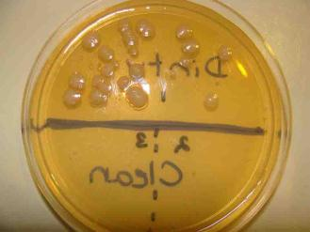
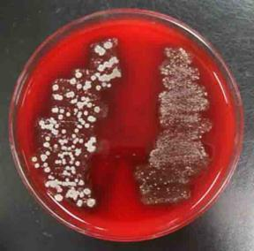
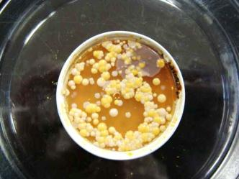
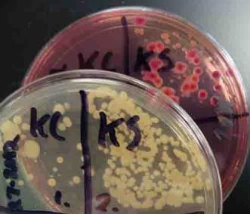
Prokaryotes
Bacteria are
EVERYWHERE!
Images: Various types of bacterial growth media inoculated with different types of samples, T. Port
From the Virtual Cell Biology Classroom on ScienceProfOnline.com
Notes:
Prokaryotes …
Reproduce by means of binary fission.
Do not have a cell nucleus or any other organelles with membranes. Plasma membrane their only membrane.
DNA travels openly around the cell.
All bacteria are prokaryotes.

Slide 15
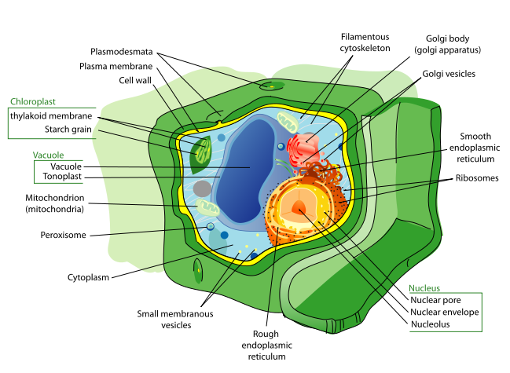

Eukaryotes…The “mansion” of cells.
Images: Animal cell & Plant cell, M. Ruiz
From the Virtual Cell Biology Classroom on ScienceProfOnline.com

Slide 16
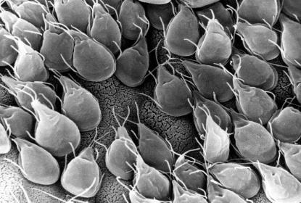
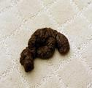
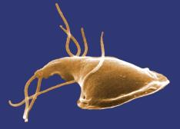
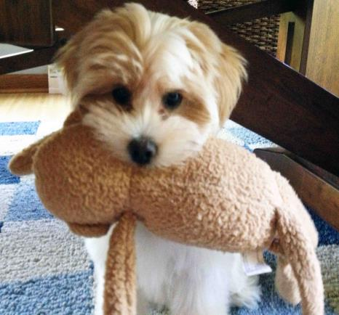
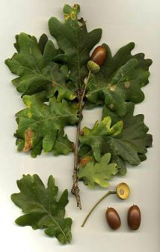
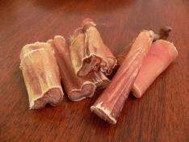
Eukaryotes… are also everywhere.
(but you can see SOME of them)
Lulu’s poo was examined for parasites, and they found the single-celled eukaryotic microbe, Giardia.
Her favorite treat is a bully stick, made from bull penises.
Her sock monkey is cotton, a plant product..
She likes to eat acorns, when playing outside.
Lulu, the puppy, is a multicellular eukaryotic organism.
Images: Giardia, Public Health Image Library, (PHIL) #11649; #11632 & #3394; Dog poo & Lulu with sock monkey, T. Port; Oak leaves and acorns, Wiki, Pizzle sticks, Wiki.
From the Virtual Cell Biology Classroom on ScienceProfOnline.com

Slide 17
Confused?
Here are some links to fun resources that further explain Cell Biology:
Cell Structure: Prokaryotes Main Page on the Virtual Micrboiology Classroom of Science Prof Online.
Cell Structure: Eukaryotes Main Page on the Virtual Cell Biology Classroom of Science Prof Online.
“How big is a…” interactive diagram from Cells Alive website.
“Cells” music video by They Might Be Giants.
Prokaryotic & Eukaryotic: Two Types of Biological Cells, an article from SPO.
Prokaryotic Cell: Structures, Functions & Diagrams, an article from SPO.
Eukaryotic Cell: Structures, Functions & Diagrams article from SPO.
Cell Structure tutorials and quizzes from Interactive Concepts in Biochemistry.
Cells Alive interactive website.
Eukaryotic Cell Tour an Animated Science Tutorial.
“The Cell Song” lyrics by The Cell Squad, Freedom Middle School, Nashville, TN..
Biology4Kids – Cell Biology Main Page by Raders.
(You must be in PPT slideshow view to click on links.)
Smart Links
From the Virtual Cell Biology Classroom on ScienceProfOnline.com

Slide 18
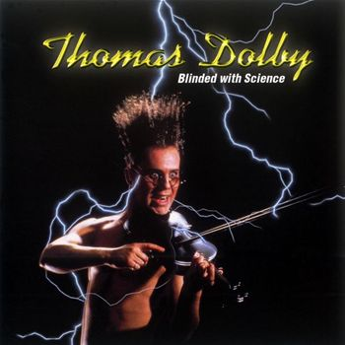
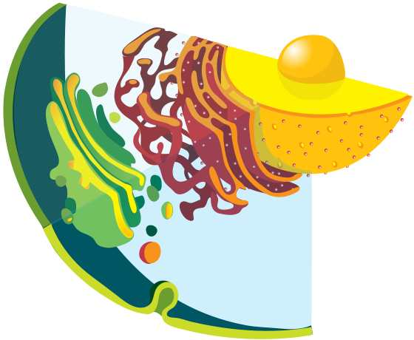
Are you feeling blinded by science?
Do yourself a favor. Use the…
Virtual Cell Biology Classroom (VCBC) !
The VCBC is full of resources to help you succeed, including:
practice test questions
review questions
study guides and learning objectives
PowerPoints on other topics
You can access the VCBC by going to the Science Prof Online website www.ScienceProfOnline.com
Images: Blinded With Science album, Thomas Dolby; Endomembrane system, Mariana Ruiz, Wiki

