Slide 1

About Science Prof Online
PowerPoint Resources
Science Prof Online (SPO) is a free science education website that provides fully-developed Virtual Science Classrooms, science-related PowerPoints, articles and images. The site is designed to be a helpful resource for students, educators, and anyone interested in learning about science.
The SPO Virtual Classrooms offer many educational resources, including practice test questions, review questions, lecture PowerPoints, video tutorials, sample assignments and course syllabi. New materials are continually being developed, so check back frequently, or follow us on Facebook (Science Prof Online) or Twitter (ScienceProfSPO) for updates.
Many SPO PowerPoints are available in a variety of formats, such as fully editable PowerPoint files, as well as uneditable versions in smaller file sizes, such as PowerPoint Shows and Portable Document Format (.pdf), for ease of printing.
Images used on this resource, and on the SPO website are, wherever possible, credited and linked to their source. Any words underlined and appearing in blue are links that can be clicked on for more information. PowerPoints must be viewed in slide show mode to use the hyperlinks directly.
Several helpful links to fun and interactive learning tools are included throughout the PPT and on the Smart Links slide, near the end of each presentation. You must be in slide show mode to utilize hyperlinks and animations.
This digital resource is licensed under Creative Commons Attribution-ShareAlike 3.0:
http://creativecommons.org/licenses/by-sa/3.0/
Alicia Cepaitis, MS
Chief Creative Nerd
Science Prof Online
Online Education Resources, LLC
alicia@scienceprofonline.com
Tami Port, MS
Creator of Science Prof Online
Chief Executive Nerd
Science Prof Online
Online Education Resources, LLC
info@scienceprofonline.com
From the Virtual Biology Classroom on ScienceProfOnline.com
Image: Compound microscope objectives, T. Port
Notes:
Welcome to Science Prof Online PowerPoint Resources!
This PowerPoint Presentation comes from the Virtual Cell Biology Classroom of Science Prof Online, and, as such, is licensed under Creative Commons Attribution-ShareAlike 3.0.; meaning you can download, share and alter any of this presentation, but you can’t sell it or repackage and sell any part of it. Please credit Science Prof Online as the source of this presentation. Please abide by credited image copyrights. Thank you for using this resource.

Slide 2
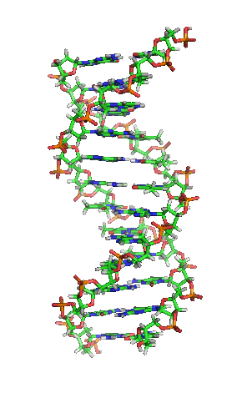
Organic Chemistry
Basics
From the Virtual Biology Classroom on ScienceProfOnline.com
Image: DNA, Richard Wheeler

Slide 3
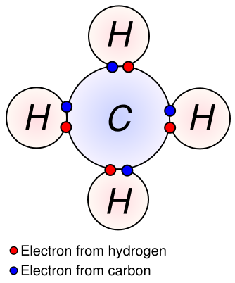
Inorganic vs Organic Molecules
?
?
Inorganic Molecules > Molecules that don’t have Carbon Hydrogen (C-H) bonds.
The major organic macromolecules (big molecules with carbon-hydrogen bonds) found in living things are:
1. carbohydrates
2. proteins
3. nucleic acids
4. lipids
From the Virtual Biology Classroom on ScienceProfOnline.com
Image: Methane Covalent Bonds, Dynablast, Wiki

Slide 4
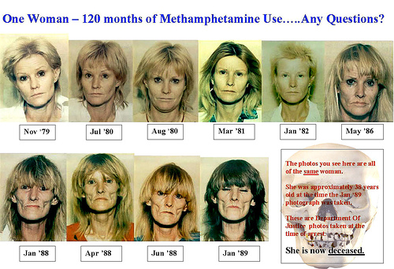
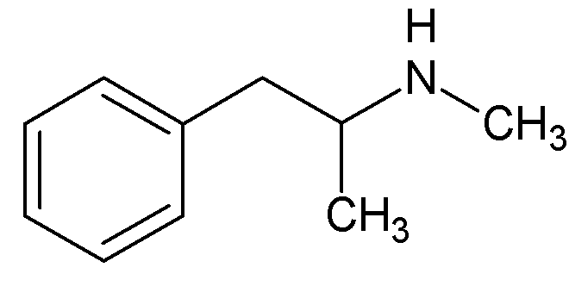
Everyday Science
  In chemistry, organic does NOT mean all natural and healthy.
  For example gasoline, nicotine, many pesticides and drugs, including crystal meth, are all carbon based organic molecules, but definitely NOT good for you!
Image: Chemical structure of meth, Wiki; Woman over course of 10 years of meth use, Don Hankins
From the Virtual Biology Classroom on ScienceProfOnline.com

Slide 5
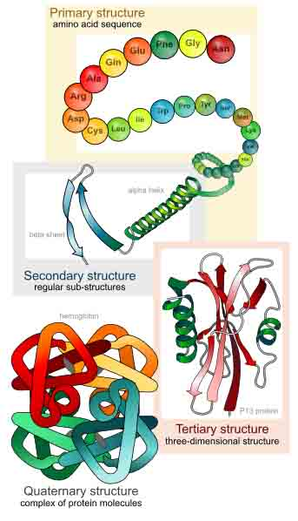
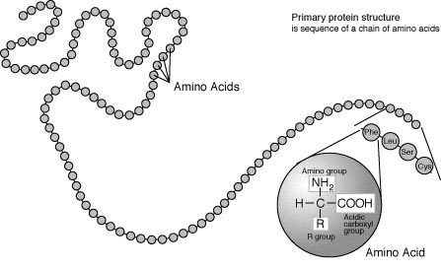
Organic compounds can be extremely large, complex molecules.
Images: Protein Primary Structure, Wiki; Levels of protein structure, M Ruiz
From the Virtual Biology Classroom on ScienceProfOnline.com

Slide 6
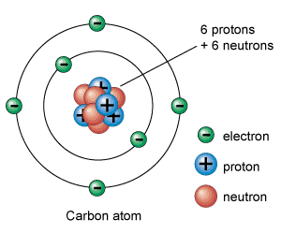
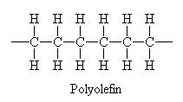
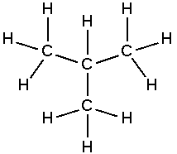
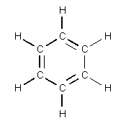
Carbon
Little Atom, Big Deal
The chemical basis of life.
This element is abundant in all known life forms.
Structure of all living things are molecules built on a carbon frame work, such as DNA, sugars, fats and proteins.
Video:
That’s Why Carbon Is a Tramp
from Crash Course Biology
Images: Carbon, Universe Today Website; Isobutane, Wiki
From the Virtual Biology Classroom on ScienceProfOnline.com
Notes:
4

Slide 7
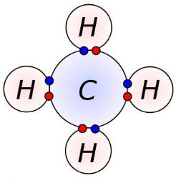
What’s so special about carbon? #1
Carbon has 4 valence electrons.
So each carbon atom can form ___ covalent bonds.
Most commonly forms bonds with hydrogen.
Image: Methane Covalent Bonds, Dynablast, Wiki;
From the Virtual Biology Classroom on ScienceProfOnline.com
Notes:
4

Slide 8
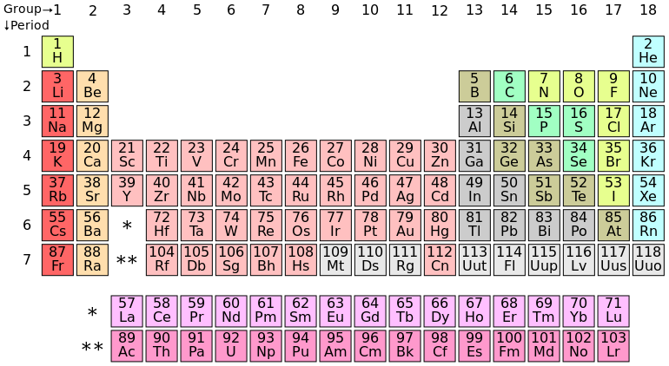
Periodic Table
From the Virtual Biology Classroom on ScienceProfOnline.com
Image: Periodic Table of Elements

Slide 9
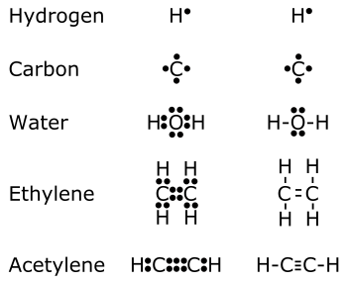
What’s so special about carbon? #2
There can be single, double or even triple bonds between carbon atoms.
A single bond forms when a pair of electrons are shared in a covalent bond.
A double bond forms when two pairs of electrons shared, a triple bond when three pairs of electrons shared.
From the Virtual Biology Classroom on ScienceProfOnline.com
Images: Carbon, Universe Today Website; Chemical bonds, Wiki
Notes:
4

Slide 10
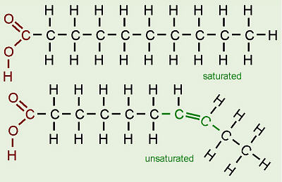
Single vs. Double Bonds
The difference between saturated and unsaturated fatty acids
Saturated fats
• Mostly from animal sources.
• Single bonds between the carbons in their fatty acid tails (all carbons are bonded to max number of hydrogens possible).
• Hydrocarbon chains fairly straight and packed closely together … so ______at room temperature.
Unsaturated fats (oils)
• Mostly from plant sources.
• Have double bonds between some carbons in the hydrocarbon tail, causing bends or “kinks” in shape.
• Kinks in hydrocarbon tails, so unsaturated fats can’t pack closely together … ________ at room temp.
From the Virtual Biology Classroom on ScienceProfOnline.com
Notes:
solid
liquid

Slide 11
What’s so special about carbon? #3
  Carbon backbone of an organic molecule can be arranged many different ways.
  Long straight chains, branched or arranged in closed rings (cyclic compounds).
Images: Carbon, Universe Today Website; Isobutane, Wiki
From the Virtual Biology Classroom on ScienceProfOnline.com
Notes:
4

Slide 12
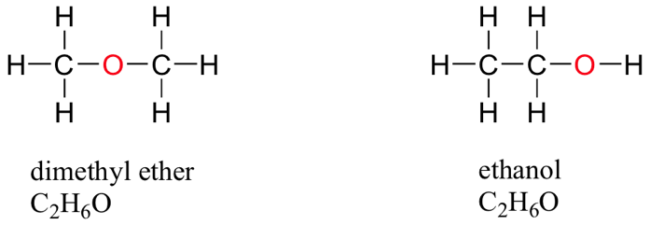
What’s so special about carbon? #4
Isomers: Organic compounds can have isomers.
Same molecular formula but structurally different in some way.
Have different chemical properties.
Functional Groups: Organic compounds very similar structure can have slightly just a few different atoms, called functional groups, that make the molecules have very different chemical properties.
< ISOMERS >
Colorless gas
Booze
From the Virtual Biology Classroom on ScienceProfOnline.com
Images: Carbon, Universe Today Website
Notes:
4

Slide 13
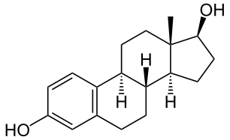
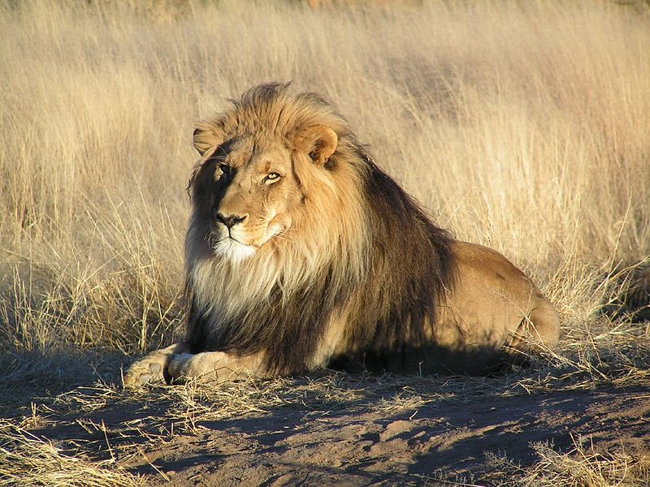
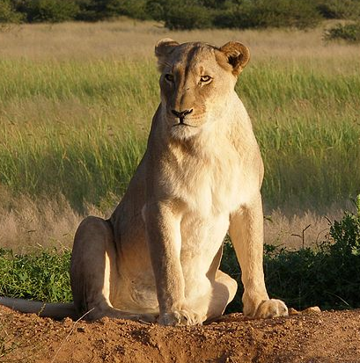
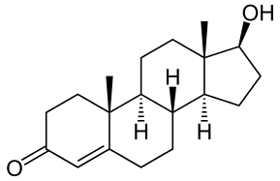
Importance of Functional Groups
Functional groups = specific groups of atoms or bonds within molecules that are responsible for the characteristic chemical reactions of those molecules.
Addition of other elements to carbon skeleton.
Replace H’s on the carbon backbone.
Note how only small differences in molecular structure can give rise to very different biological functions.
estradiol
testosterone
Images: Male lion, Testosterone molecule, Estradiol molecule, Female lion, Wiki
From the Virtual Biology Classroom on ScienceProfOnline.com

Slide 14
Study Table of Organic Macromolecules
(We will fill this in as we go through the rest of the lecture.)
Macromolecule (polymer) | Made of what type of monomer? | Is there another name for this polymer? | What are the main elements in this macromolecule? | Examples
1.
2.
3.
4.
From the Virtual Biology Classroom on ScienceProfOnline.com

Slide 15
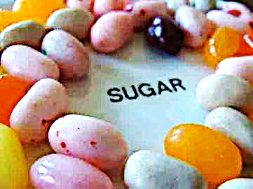
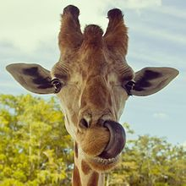
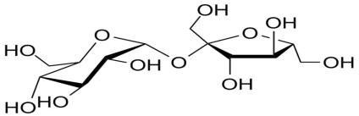
Organic Molecules
Carbohydrates
• “carbon” - hydrates”
• One carbon molecule to one water molecule (CH₂0)n.
• saccharide is a synonym for carbohydrate.
• The prefixes on the word “saccharide” relates to the size of the molecule (mono-, di-, tri- poly-).
BOOGERS!
You probably know that jelly beans are full of refined sugars…carbs. You may not know that boogers contain carbs as well. Boogers are dried-up mucus and dirty nose debris. Mucus is made mostly out of sugars and protein.
Images: Jelly beans, T. Port; Giraffe picking nose with tongue, Sucrose moleculee Wiki
From the Virtual Biology Classroom on ScienceProfOnline.com
Notes:
Saccharide

Slide 16
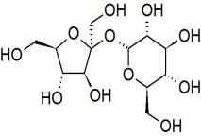
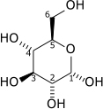
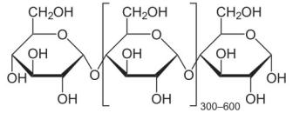
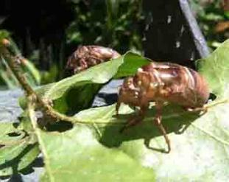
Organic Molecules - Carbohydrates
Monosaccharides
single sugars (one molecule)
simplest
*glucose, fructose
Disaccharides
double sugars
combination of two monosaccharides
* sucrose = glucose + fructose
* lactose = glucose + galactose
Polysaccharides
macromolecules; polymers composed of several sugars
can be same monomer (many of same monosaccharide) or mixture of monomers
food storage carbohydrates: glycogen (animals) starch (plants)
structural carbs: chitin (animals), cellulose (plants)
From the Virtual Biology Classroom on ScienceProfOnline.com

Slide 17
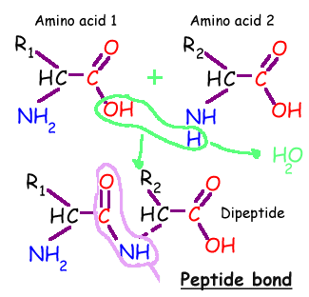
Organic Molecules - Proteins
Proteins are macromolecules, polymers composed of monomers called…
Amino acids contain a:
1. base amino group ( -NH₂)
2. acidic carboxyl group ( -COOH)
3. hydrogen atom
…all attached to same carbon atom (the α –carbon…alpha carbon).
4. Fourth bond attaches α-carbon to a side group (--R) that varies among different amino acids.
Side groups important … affects the way a proteins amino acids interact with one another, and how a protein interacts with other molecules.
Essential amino acids: Cannot be synthesized by the body. They must be ingested in the diet.
Arginine * Histidine * Methionine* Threonine * Valine * Isoleucine * Lysine * Phenylalanine *
Tryptophan * Leucine
From the Virtual Biology Classroom on ScienceProfOnline.com

Slide 18
Organic Molecules – Proteins
Peptide Bonds
Link amino acids together in chains, like the beads on a necklace.
A dipeptide is 2 amino acids linked together.
A polypeptide, more than two.
From the Virtual Biology Classroom on ScienceProfOnline.com
Image: Protein Primary Structure, Wiki

Slide 19
Levels of Protein Structure
From the Virtual Biology Classroom on ScienceProfOnline.com
Image: Levels of protein structure, M Ruiz

Slide 20

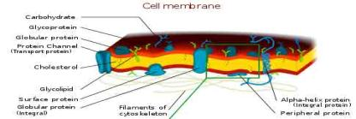
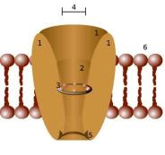
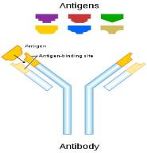
Organic Molecules - Proteins
Complex organic macromolecules fundamental to living cells.
Composed of one or more chains of amino acids.
Proteins perform many functions in cells, including:
1. Structural
• Components in cell walls, membranes,
and within cells themselves.
2. Enzymes
• Chemicals that speed up a chemical reaction.
• The catalysts in cells are called enzymes.
3. Regulation
• Some regulate cell function by stimulating or hindering either the
action of other proteins or the expression of genes.
4. Transportation
• Some act as channels and “pumps” that move substances into or out of
cells.
5. Defense
• Antibodies = proteins that defend your body against microorganisms
• Some bacteria produce proteins (bacteriocins) that kill other bacteria.
Images : Cell Membrane, Wiki; Channel Protein, Wiki; Antibody, Wiki
From the Virtual Biology Classroom on ScienceProfOnline.com

Slide 21
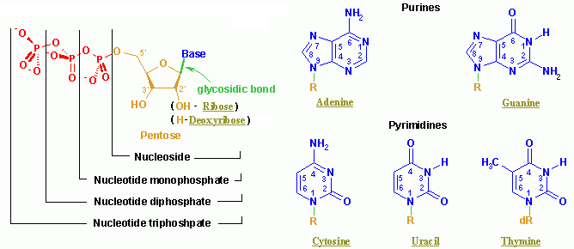
Organic Molecules – Nucleic Acids
Nucleic acids (both RNA and DNA) are macromolecules; polymers made up of monomers called nucleotides.
Nucleic acids deoxyribonucleic acid (DNA) and ribonucleic acid (RNA) = genetic material of cells.
Names derived from type of sugar contained within molecules = ribose
Nucleotides
Each monomer of nucleic acid is a nucleotide and consists of 3 portions:
- a sugar
- one or more phosphate
- one of five cyclic nitrogenous bases
+adenine, guanine (double-ringed purines)
+ cytosine, thiamine or uracil (single-ringed pyrimidines)
From the Virtual Biology Classroom on ScienceProfOnline.com
Image: Nucleotide Structure, Wikipedia

Slide 22
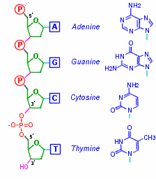
Organic Molecules – Nucleic Acids
Nucleic Acid Structure
Nucleotides linked by covalent bonds between sugar of one nucleotide and phosphate of next (sugar-phosphate backbone).
Nitrogenous bases extend from it like teeth of a comb.
From the Virtual Biology Classroom on ScienceProfOnline.com

Slide 23
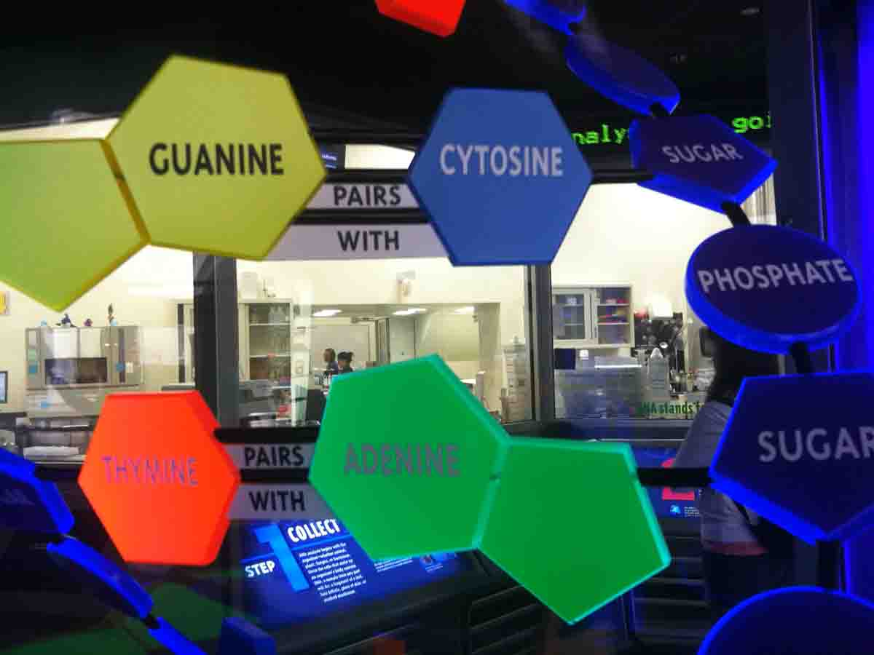
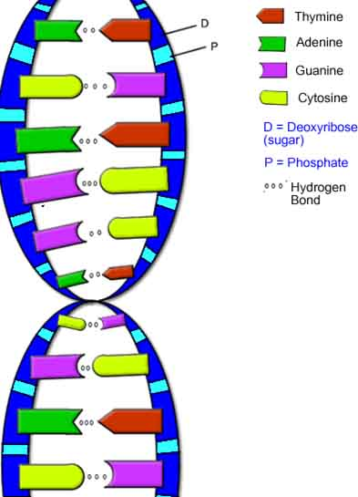
Nucleic Acids - DNA
DNA is a double stranded molecule, analogous to a ladder.
The “ladder” =
• two deoxyribose-phosphate chains form the “side rails”
• base pairs, linked by hydrogen bonds, form the “rungs”.
Purine Bases (double ring)
Adenine & Guanine
Pyrimidine Bases (single ring)
Cytosine & Thymine
Base Pairs (purine always pairs with pyrimidine):
Adenine + Thymine
Cytosine + Guanine
Hydrogen bonds attract the bases from one strand to the bases on the other strand and also twist the phosphate-sugar backbones into a helix.
Q: How do I remember this?
Images: Model of DNA Molecule, Field Museum, Chicago, T. Port DNA, Biology Corner Website
From the Virtual Biology Classroom on ScienceProfOnline.com

Slide 24
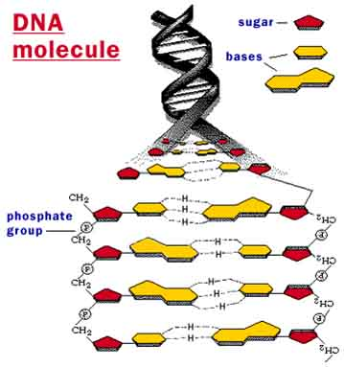
From the Virtual Biology Classroom on ScienceProfOnline.com
Image: DNA Molecule, National Science Foundation

Slide 25
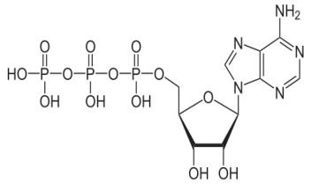
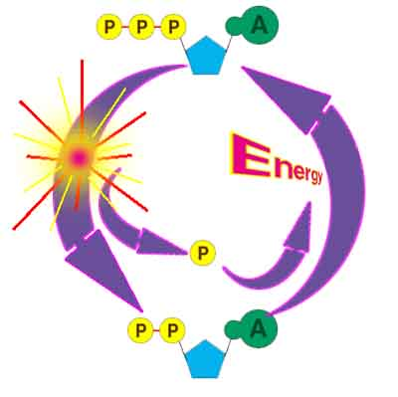
ATP Production and Energy Storage
Q: This molecule has a sugar, a base and three phosphate groups. What kind of monomer is it?
Adenosine 5'-triphosphate
Multifunctional "molecular currency" of intracellular energy transfer.
Organisms release energy from nutrients; can be concentrated and stored in high-energy phosphate bonds of ATP.
Transports chemical energy within cells for metabolism.
Produced as energy source during photosynthesis and cellular respiration.
Consumed by many enzymes and a multitude of cellular processes
From the Virtual Biology Classroom on ScienceProfOnline.com
Image: ATP Molecule, NEUROtiker; ATP-ADP Cycle, CUNY
Notes:
A: Nucleotide

Slide 26
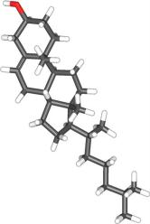
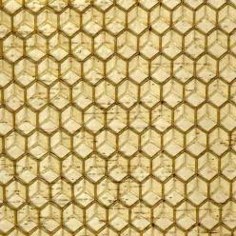
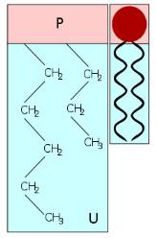
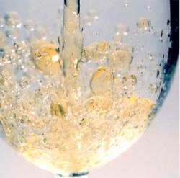
Organic Molecules – Lipids
(Fats, Phospholipids, Waxes & Steroids)
Hydrophobic macromolecules…insoluble in water.
Not attracted to water because …
non-polar covalent bonds linking carbon & hydrogen aren’t attracted to the polar bonds of water.
From the Virtual Biology Classroom on ScienceProfOnline.com
Images: Cholesterol, Wiki; Phospholipid Structure, Bryan Derksen. Wiki Honeycomb, Wikii; Oil & Water, Kidipede

Slide 27
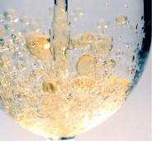
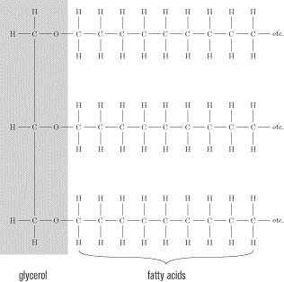
Organic Molecules – Lipids
(Fats, Phospholipids, Waxes & Steroids)
Fats
Fats and oils are made from two kinds of molecules:
• glycerol
(a type of alcohol)
• fatty acids
(triglycerides)
Images: Oil & Water, Kidipede
From the Virtual Biology Classroom on ScienceProfOnline.com

Slide 28
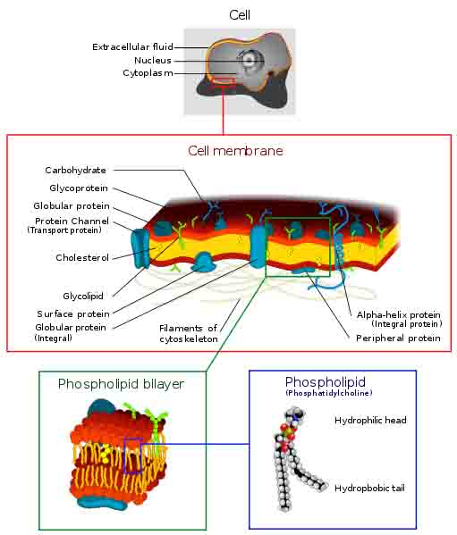
Organic Molecules – Lipids
(Fats, Phospholipids, Waxes & Steroids)
Phospholipids
• Phospholipids are a major component of all cell membranes.
Most phospholipids contain a diglyceride as the tail, and a phosphate group for head.
Hydrocarbon tails are hydrophobic, but phosphate heads are hydrophilic.
• So phospholipids are soluble in both water and oil.
• Tails from both layers facing inward and the heads facing outward = phospholipid bilayer.
From the Virtual Biology Classroom on ScienceProfOnline.com
Image: Cell Membrane, Wiki;

Slide 29
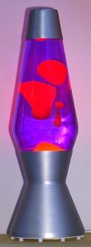

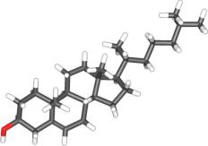
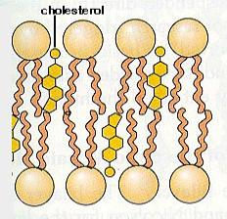
Organic Molecules – Lipids
(Fats, Phospholipids, Waxes & Steroids)
Waxes
• Do not have a hydrophilic head: so completely water insoluble.
Steroids
• The central core of a cholesterol molecule (4 fused rings) is shared by all steroids.
• Cholesterol is precursor to our sex hormones and Vitamin D.
• Our cell membranes contain cholesterol (in between the phospholipids) to help keep membrane “fluid” even when exposed to cooler temperatures.
From the Virtual Biology Classroom on ScienceProfOnline.com
Image: Lava Lamp, Wiki; Cholesterol molecule, Wiki; Phospholipids & Cholesterol, Cytochemistry.net

Slide 30
Confused?
Here are some links to fun resources that further explain Chemistry:
Organic Chemistry Main Page on the Virtual Cell Biology Classroom of Science Prof Online.
“What Kind of Bonds Are These?” song and slide show by Mark Rosengarten
Macromolecules interactive science tutorial.
DNA Structure Cell Biology Animation from John Kyrk.
Build a DNA Molecule from University of Utah.
“Chemistry” a song by Kimya Dawson.
Redox Reactions video lecture by Kahnacademy
“Sugar, Sugar” song by The Archies.
Chem4Kids website by Rader.
“Better Living Through Chemistry” a song by Queens of the Stone Age.
“Chemistry” a song by Rush.
(You must be in PPT slideshow view to click on links.)
Smart Links
From the Virtual Cell Biology Classroom on ScienceProfOnline.com

