Slide 1

About Science Prof Online
PowerPoint Resources
Science Prof Online (SPO) is a free science education website that provides fully-developed Virtual Science Classrooms, science-related PowerPoints, articles and images. The site is designed to be a helpful resource for students, educators, and anyone interested in learning about science.
The SPO Virtual Classrooms offer many educational resources, including practice test questions, review questions, lecture PowerPoints, video tutorials, sample assignments and course syllabi. New materials are continually being developed, so check back frequently, or follow us on Facebook (Science Prof Online) or Twitter (ScienceProfSPO) for updates.
Many SPO PowerPoints are available in a variety of formats, such as fully editable PowerPoint files, as well as uneditable versions in smaller file sizes, such as PowerPoint Shows and Portable Document Format (.pdf), for ease of printing.
Images used on this resource, and on the SPO website are, wherever possible, credited and linked to their source. Any words underlined and appearing in blue are links that can be clicked on for more information. PowerPoints must be viewed in slide show mode to use the hyperlinks directly.
Several helpful links to fun and interactive learning tools are included throughout the PPT and on the Smart Links slide, near the end of each presentation. You must be in slide show mode to utilize hyperlinks and animations.
This digital resource is licensed under Creative Commons Attribution-ShareAlike 3.0:
http://creativecommons.org/licenses/by-sa/3.0/
Alicia Cepaitis, MS
Chief Creative Nerd
Science Prof Online
Online Education Resources, LLC
alicia@scienceprofonline.com
Tami Port, MS
Creator of Science Prof Online
Chief Executive Nerd
Science Prof Online
Online Education Resources, LLC
info@scienceprofonline.com
From the Virtual Cell Biology Classroom on ScienceProfOnline.com
Image: Compound microscope objectives, T. Port
Notes:
Welcome to Science Prof Online PowerPoint Resources!
This PowerPoint Presentation comes from the Virtual Cell Biology Classroom of Science Prof Online, and, as such, is licensed under Creative Commons Attribution-ShareAlike 3.0.; meaning you can download, share and alter any of this presentation, but you can’t sell it or repackage and sell any part of it. Please credit Science Prof Online as the source of this presentation. Please abide by credited image copyrights. Thank you for using this resource.

Slide 2
Scientific
Method
For additional resources on this lecture topic, see the Scientific Method Main Page on SPO.
Image: Compound microscope objectives, T. Port

Slide 3

What is science
?
Science is a tool for answering questions.
What Is Science? from Patuxent Wildlife Research Center, US Gov
Notes:
Tool

Slide 4
What is Science?
or
True
False
Here are a few statements
to test your current understanding of science!
(You are thinking … Wow! This instructor is HARSH! A test the first time we meet.)
What Is Science? from Patuxent Wildlife Research Center, US Gov

Slide 5
Science can prove anything, solve any problem or answer any question.
True or False?
False
Science actually attempts to disprove ideas (hypotheses).
Science is limited strictly to solving problems about the physical and natural world.
Explanations based on supernatural forces, values or ethics can never be disproved and thus do not fall under the realm of science.
What Is Science? from Patuxent Wildlife Research Center, US Gov
Notes:
Science can prove anything.
FALSE.
The process of science, when properly applied, actually attempts to disprove ideas (hypotheses) by testing or challenging the hypothesis with observations (data) gathered from carefully designed experiments. If the idea survives testing, then it is stronger, and more likely an accurate explanation. Science is a process which can only produce “possible” or “highly probable” explanations for natural phenomena; these are never certainties. With new information, tools, or approaches, earlier findings can be replaced by new findings.
Science can solve any problem or answer any question.
FALSE.
The realm of science is limited strictly to solving problems about the physical world, a world that we can observe with our senses. Science is not properly equipped to handle the supernatural realm, nor the realm of values and ethics, realms that cannot be observed with our senses. Scientific explanations must be potentially disprovable. Explanations based on supernatural forces, values or ethics can never be disproved and thus do not fall under the realm of science.

Slide 6
Any study done carefully and based on observation is scientific.
False
  • Science must follow certain rules.
  • The rules of science make the scientific process as objective as is possible.
Objective = Not influenced by feelings, interests and prejudices; UNBIASED
vs.
Subjective = Influenced by feelings, interests and prejudices; BIASED
What Is Science? from Patuxent Wildlife Research Center, US Gov
Notes:
Any study done carefully and based on observation is scientific.
FALSE.
Science must follow certain rules; otherwise, it's not science (just as soccer is not soccer if its rules are not followed). The rules of science are intended to make the process as objective as is humanly possible, and thereby produce a degree of understanding that is as close to reality as possible. Scientific explanations must be based on careful observations and the testing of hypotheses.

Slide 7
Science can be done poorly.
True
What Is Science? from Patuxent Wildlife Research Center, US Gov
Notes:
Science can be done poorly.
TRUE.
Anything done scientifically can be relied upon to be accurate and reliable.
FALSE.
Science can be done poorly, just like any other human endeavor. We are all fallible, some of us make fewer mistakes than others, some observe better than others, but we are still subjective in the end. Self-correction mechanisms in science increase the reliability of its product.

Slide 8
Different scientists may get different solutions to the same problem.
False
True
True
What Is Science? from Patuxent Wildlife Research Center, US Gov
Notes:
Different scientists may get different solutions to the same problem.
Science can be influenced by the race, gender, nationality, religion, politics or economic interests of the scientist.
TRUE.
Intentional or unintentional sources of bias introduced in a study can result in different solutions to the same problem. Scientists are people, and although they follow certain rules and try to be as objective as possible, both in their observations and their interpretations, their biases are still there. Unconscious racial bias, gender bias, social status, source of funding, or political leanings can and do influence one's perceptions and interpretations.
Unfortunately, science is all too frequently misused. Because it works so well, there are those who apply the name of science to their efforts to "prove" their favorite cause, even if the rules of science were not followed. Such causes are properly labeled "pseudosciences". Also, some scientists have been known to do fraudulent work, in order to support their pet ideas. Such work is usually exposed sooner or later, due to the peer review system and the work of other scientists.

Slide 9
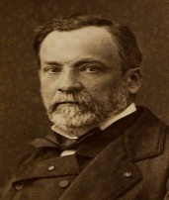

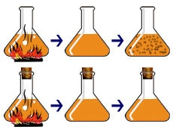
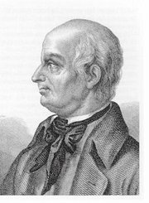
The Controversy Over Spontaneous Generation
John Needham & Lazzaro Spallanzani
The Question:
What causes tiny living things to appear in decaying broth?
Needham’s Hypothesis: Spontaneous generation.
Spallazani’s Hypothesis: Microbes come from the air. Boiling will kill them.
French chemist Louis Pasteur’s design of this experiment settled the argument. Click here for an animation and quiz.
Needham >
Spallazani >
Image: Louis Pasteur, Pierre Lamy Petit, circa 1866; Lazzaro Spallanzani, 1729-1799
From the Virtual Cell Biology Classroom on ScienceProfOnline.com
Notes:
Experiment: Heat broth to kill all life within, then see if, after heat is removed, microbes reappear.
Needham and Spallanzani did almost identical experiments. However, there was one key difference that critically impacted their results. Needham didn’t cover his flasks, so material (including microbes) from the surrounding air could drift into his flasks. Spallanzani’s flasks were sealed. This difference in experimental design accounted for their opposing conclusions:
Needham: Life re-emerged due to spontaneous generation.
Spallanzani: Heat killed the microbes, and, since the flasks were sealed, microbes did not reappear.

Slide 10

What is good science?
Objectivity is the key to good science.
To be objective, experiments must be designed and conducted in a way that does not introduce bias into the study.
Scientists use the
Scientific Method
From the Virtual Cell Biology Classroom on ScienceProfOnline.com

Slide 11
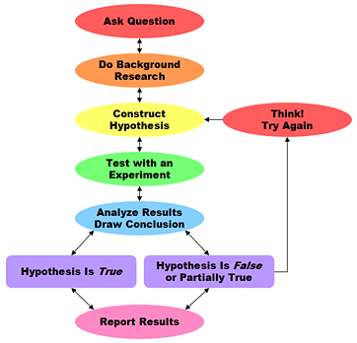
Scientific Method
Data Support Hypothesis
Data DO NOT
Support Hypothesis
From the Virtual Cell Biology Classroom on ScienceProfOnline.com
Image: Scientific Method Flowchart, Science Buddies

Slide 12
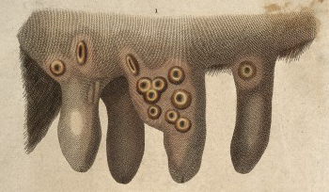
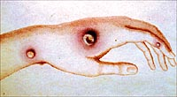
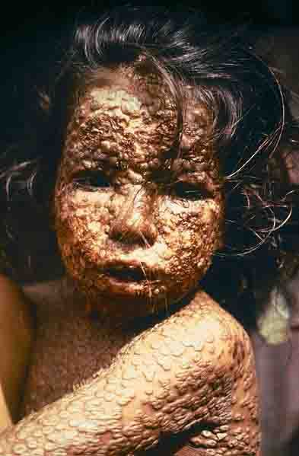
The Beginnings of Immunology
Edward Jenner and the first vaccine
cowpox: Infectious disease that causes mild discomfort, aching, a few pustules, some swelling…symptoms that disappeared in a few days. No biggie.
smallpox: Infectious disease that causes massive disfigurement, sometimes blindness, and often death.
  Caused two airborne virus variants, Variola major and Variola minor.
  Approx 500 million deaths worldwide in the 20th century. And millions more throughout previous history.
  Eradicated in 1979 though widespread vaccination.
From the Virtual Cell Biology Classroom on ScienceProfOnline.com
Images: Cowpox on Udder Wiki; Child with Smallpox, James Hicks, CDC

Slide 13
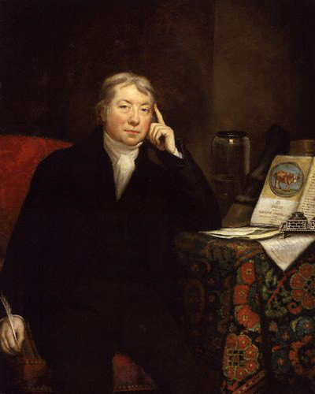
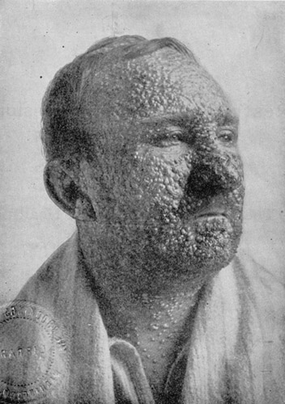
The Beginnings of Immunology
Edward Jenner and the first vaccine
1749 - 1823
=
Dr. Edward Jenner was aware that farm workers believed that if they ever contracted cowpox, they then wouldn’t get smallpox.
Images: Dr. Edward Jenner by James Northcote Cowpox on Udder Wiki; Man with smallpox, 1912, Illinois Department of Health
From the Virtual Cell Biology Classroom on ScienceProfOnline.com

Slide 14
The Beginnings of Immunology
Edward Jenner and the first vaccine
Match each statement with it ’s corresponding step number in the Scientific Method.
_____ Jenner made small incisions or punctures with cowpox material in arms of human subjects in order to prevent smallpox.
_____ If I infect someone with cowpox, they will then be immune to smallpox.
_____ At first his peers doubted the safety and efficacy of his treatment, but eventually the value of the cowpox inoculum was recognized.
_____ He saw that the people that he infected with cow pox, when later exposed to smallpox, would get a little bit sick, but never come down with a full-blown case of smallpox.
_____ Dr. Jenner was aware that farm workers believed that if you had ever contracted cowpox, you wouldn’t get smallpox.
_____ Does having cowpox make a person immune to smallpox?
1.
2.
3.
4.
5.
6.
From the Virtual Cell Biology Classroom on ScienceProfOnline.com
Image: Scientific Method Flowchart, Science Buddies; Dr. Edward Jenner by James Northcote
Notes:
4, 3, 6, 5, 2, 1

Slide 15
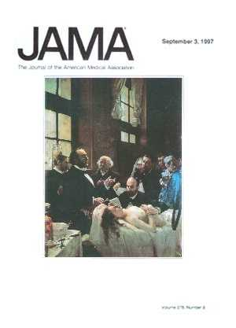
Verification is another quality control measure to eliminate bias.
Results are verified by independent duplication and publication in a peer-reviewed journal.
Independent duplication = Two or more scientists from different institutions investigate the same question separately and get similar results.
Peer-reviewed Journal = A journal that publishes articles only after they have been checked for quality by several expert, objective scientists from different institutions.
From the Virtual Cell Biology Classroom on ScienceProfOnline.com

Slide 16
So that’s Science…
Now, what’s the difference between:
1. Science
2. Non-science
3. Pseudoscience
?
From the Virtual Cell Biology Classroom on ScienceProfOnline.com

Slide 17
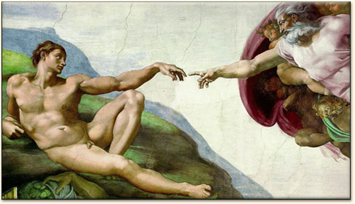
Non-science = Outside the Domain of Science
Non-science is important in human thinking and experience.
  • Values
  • Religious beliefs
  • Art
  • Creativity & Intuition
  Subjects of non-science are usually easily separated from science.
From the Virtual Cell Biology Classroom on ScienceProfOnline.com

Slide 18
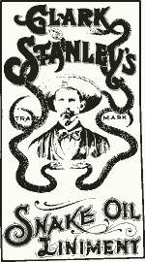
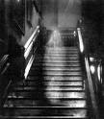
Pseudoscience
When Non-science Claims to Be Science
• Claims that can be tested scientifically, but are not.
• Try to pose as science.
  Religious “science”: constantly upholds hypotheses instead of trying to falsify them.
  Unidentified flying objects: none of the UFO “sightings” stand to careful scrutiny
  Hauntings: none of the ghost “sightings” stand to careful scrutiny
From the Virtual Cell Biology Classroom on ScienceProfOnline.com
Images: Snake Oil Poster, Wiki; Brown Lady Ghost, Wiki

Slide 19
Confused?
Here are some links to fun resources that further explain the Scientific Method:
Scientific Method Main Page from the Virtual Cell Biology Classroom at Science Prof Online.
“Science Is Real” music video by They Might Be Giants.
Scientific Method Cartoon & Quizzes from BrainPop.
“Put It To The Test” music video by They Might Be Giants.
Scene from Monty Python’s Holy Grail used to explain Scientific Method.
Pasteur’s Experiment interactive science tutorial.
“She Blinded Me With Science” music video Thomas Dolby.
(You must be in PPT slideshow view to click on links.)
Smart Links
From the Virtual Cell Biology Classroom on ScienceProfOnline.com

Slide 20
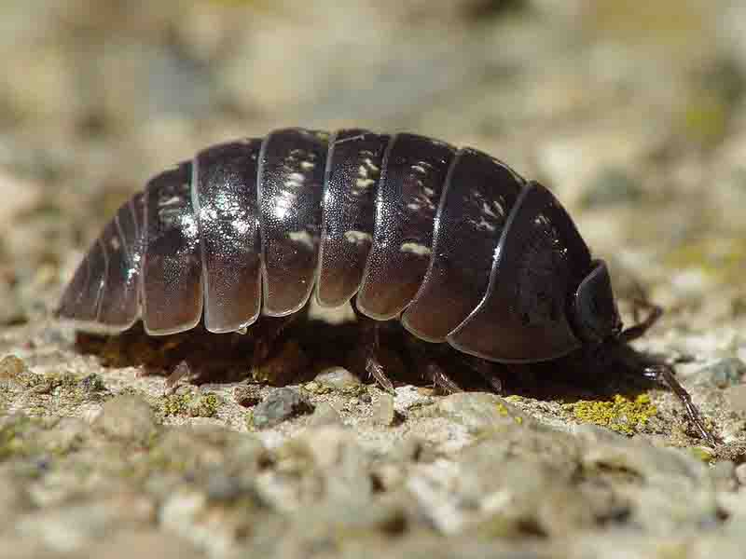
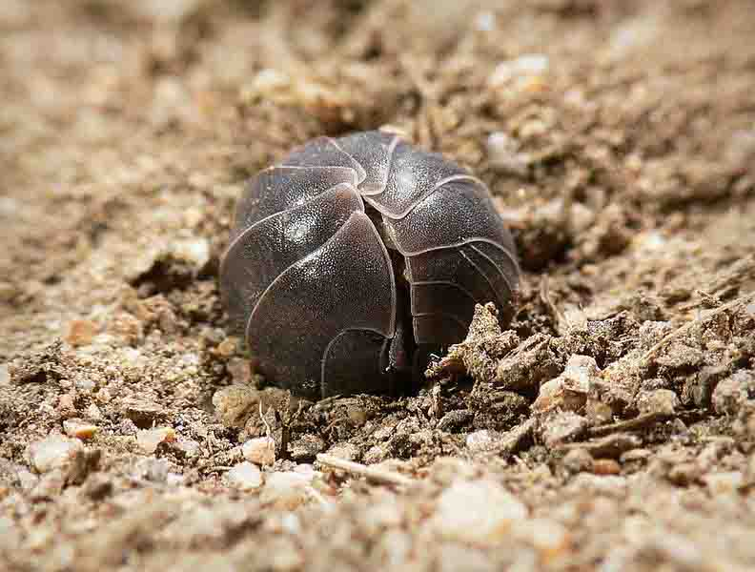
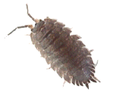
Animal Behavior Experiment with Isopod Commonly Known as the Pillbug
They get their common names (pillbug, wood lice, sowbug, roly-polie) because they often respond to mechanical stimuli by rolling up into a ball.
They are a crustacean. Most crustaceans are aquatic (shrimp, lobster, crab), but pillbugs are terrestrial. Still, much of their behavior is due to their need to avoid desiccation (drying out).
Images: Pillbug, Armadillidium vulgare, Franco Folini,
Wiki; Wood louse, benjamint444, Wiki
From the Virtual Cell Biology Classroom on ScienceProfOnline.com

Slide 21
Pillbug Experiment
See the ScienceProfOnline Virtual Cell Biology Classroom: Scientific Method Lecture for a printable Word .doc of this assignment.
You will be designing an experiment to help you better understand the scientific method.
Break up into groups (of 3 to 5 members) and design an experiment to investigate the pillbugs’ response to light, pH, food hiding place or background color.
Choose only one variable to manipulate.
You will must work through all of the steps of the scientific method:
  ask a question
  develop a hypothesis
  state the objectives of your experiment
  design your experiment (list materials that you will use, and outline your procedure in detail, determine what data you will collect)
  analyze your data
  draw a conclusion (was your hypothesis supported or not?)
I will need to approve your experiment before you begin.
From the Virtual Cell Biology Classroom on ScienceProfOnline.com

Slide 22
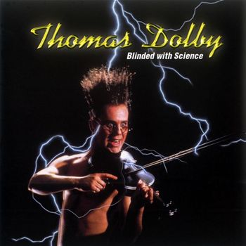
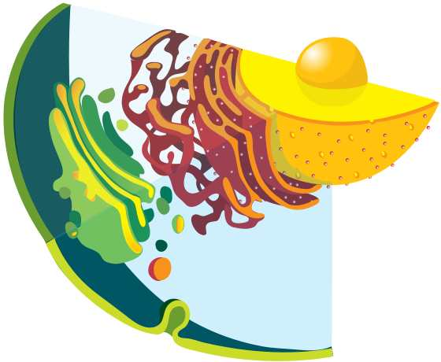
Are you feeling blinded by science?
Do yourself a favor. Use the…
Virtual Cell Biology Classroom (VCBC) !
The VCBC is full of resources to help you succeed, including:
practice test questions
review questions
study guides and learning objectives
PowerPoints on other topics
You can access the VCBC by going to the Science Prof Online website www.ScienceProfOnline.com
Images: Blinded With Science album, Thomas Dolby; Endomembrane system, Mariana Ruiz, Wiki

