Slide 1

About Science Prof Online
PowerPoint Resources
Science Prof Online (SPO) is a free science education website that provides fully-developed Virtual Science Classrooms, science-related PowerPoints, articles and images. The site is designed to be a helpful resource for students, educators, and anyone interested in learning about science.
The SPO Virtual Classrooms offer many educational resources, including practice test questions, review questions, lecture PowerPoints, video tutorials, sample assignments and course syllabi. New materials are continually being developed, so check back frequently, or follow us on Facebook (Science Prof Online) or Twitter (ScienceProfSPO) for updates.
Many SPO PowerPoints are available in a variety of formats, such as fully editable PowerPoint files (.ppt), as well as uneditable versions in smaller file sizes, such as PowerPoint Shows (.pps) and Portable Document Format (.pdf), for ease of printing. The font “Jokerman” is used frequently in titles. It has a microbiology feel to it. If you do not have this font, some titles may appear odd, oversized and off-center. Find free downloads of Jokerman by Googling “download jokerman font microsoft”.
Images used on this resource, and on the SPO website are, wherever possible, credited and linked to their source. Any words underlined and appearing in blue are links that can be clicked on for more information. PPT files must be viewed in slide show mode to use the hyperlinks directly.
Several helpful links to fun and interactive learning tools are included throughout the PPT and on the Smart Links slide, near the end of each presentation. You must be in slide show mode to utilize hyperlinks and animations.
This digital resource is licensed under Creative Commons Attribution-ShareAlike 3.0:
http://creativecommons.org/licenses/by-sa/3.0/
Alicia Cepaitis, MS
Chief Creative Nerd
Science Prof Online
Online Education Resources, LLC
alicia@scienceprofonline.com
Tami Port, MS
Creator of Science Prof Online
Chief Executive Nerd
Science Prof Online
Online Education Resources, LLC
info@scienceprofonline.com
From the Virtual Microbiology Classroom on ScienceProfOnline.com
Image: Compound microscope objectives, T. Port
Notes:
Welcome to Science Prof Online PowerPoint Resources!
This PowerPoint Presentation comes from the Virtual Cell Biology Classroom of Science Prof Online, and, as such, is licensed under Creative Commons Attribution-ShareAlike 3.0.; meaning you can download, share and alter any of this presentation, but you can’t sell it or repackage and sell any part of it. Please credit Science Prof Online as the source of this presentation. Please abide by credited image copyrights. Thank you for using this resource.

Slide 2
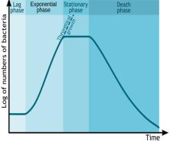
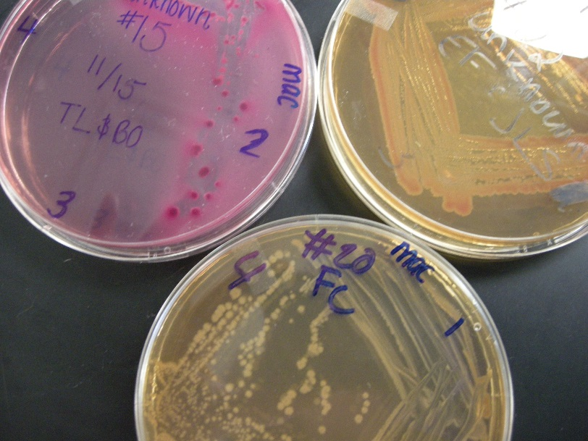
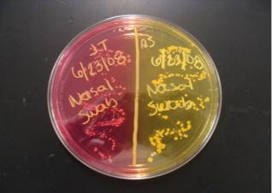
Microbial
Growth &
Metabolism
Image: : MacConkey’s media, clockwise from top left – E. coli, Enterobacter, Salmonella; & Mannitol Salt Agar (MSA), T. Port; Bacterial growth phases, M. Komorniczak
From the Virtual Microbiology Classroom on ScienceProfOnline.com

Slide 3
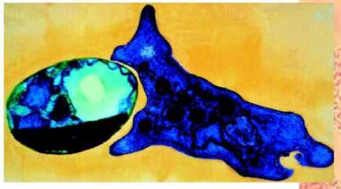
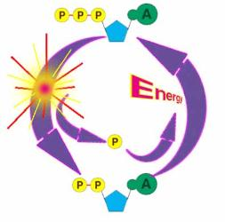
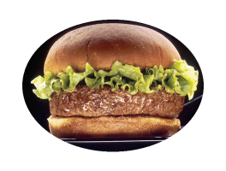
Metabolism
The Transformation of Energy
Cells either get their energy either by
photosynthesis or by eating stuff.
But a cell can’t just use sunlight or nutrients to run cellular reactions.
Q: What type of fuel is needed to run a cell?
.
Cells Can’t Eat Hamburgers
The mother of all rechargeable batteries.
From the Virtual Microbiology Classroom on ScienceProfOnline.com
Images: Hamburger, Wiki; ATP-ADP Cycle, CUNY

Slide 4
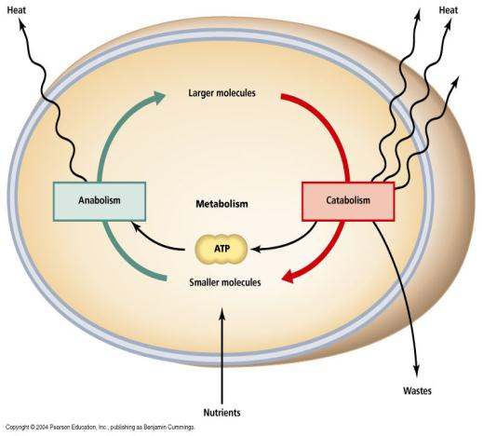
Building and Breaking Down Molecules
Anabolic Reaction
(anabolism)
The phase of metabolism in which simple substances are synthesized into the complex materials of living tissue.
Catabolic Reaction
(catabolism)
The metabolic break down of complex molecules into simpler ones, often resulting in release of energy.
From the Virtual Microbiology Classroom on ScienceProfOnline.com

Slide 5
Cellular Respiration is Catabolism
Organisms catabolize (break down) carbohydrates as the primary energy source for anabolic reactions.
The monosaccharide glucose is used most commonly.
Glucose catabolized by:
  Aerobic cellular respiration → Requires oxygen. Results in complete breakdown of glucose to carbon dioxide, water and a lot of
  Anaerobic cellular respiration → Does not require oxygen, but does require and oxygen “stand in”. Only partially breaks down glucose, so makes less
Q: What is required for respiration to be aerobic?
ATP
ATP
From the Virtual Microbiology Classroom on ScienceProfOnline.com

Slide 6
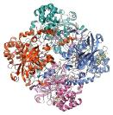
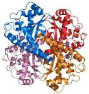
Using oxygen (1/2 O₂) in metabolism creates toxic waste.
Microbes & Oxygen
Microbes that are able to use aerobic respiration produce enzymes to detoxify oxygen:
Catalase: H₂O₂ ---→ H₂0 and 0₂
Superoxide dismutase (SOD): oxygen radical ---→ H₂0 and O₂
Microbes that don’t make these enzymes cannot exist in the presence of oxygen.
Image: Catalase enzyme structure, Vossman; Superoxide dismutase enzyme structure, Fvasconcellos
From the Virtual Microbiology Classroom on ScienceProfOnline.com
Notes:
Do they make catalase and SOD?
Obligate Aerobe ---→ Bacillus
Obligate Anaerobe ---→ Clostridium
Facultative Anaerobe -→ Stapylococcus (lots of bacteria are facultative
anaerobes)
Microaerophile -→Helicobacter, Campylobacter jejuni
Aerotolerant -→ Lactobacillus, Streptococcus (only produce SOD)

Slide 7
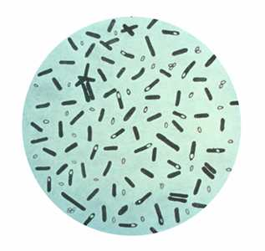
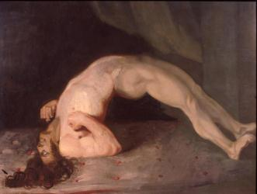
Bacterial Genus: Clostridium
GRAM-POSITIVE
Obligate anaerobe, bacillus-shaped
All species form endospores.
All have a strictly fermentative
mode of metabolism (Don’t’ use oxygen).
Vegetative cells are killed by exposure to O², but their endospores are able to survive long periods of exposure to air.
Known to produce a variety of toxins, some of which are fatal.
Clostridium tetani = agent of tetanus
C. botulinum = agent of botulism
C. perfringens = one of the agents of gas gangrene
C. difficile = part of natural intestinal flora, but resistant strains can overpopulate and cause pseudomembranous colitis.
Clostridium botulinum
Images:Clostridium botulinum: stained with Gentian violet. CDC Public Health Image Library. (PHIL #2107), 1979; Charles Bell 1809 painting.
From the Virtual Microbiology Classroom on ScienceProfOnline.com

Slide 8
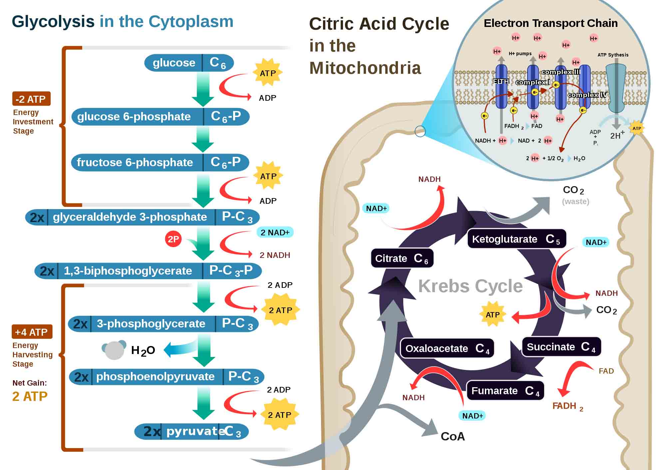
Cellular respiration →
The steps that a cell must go through to turn other forms of energy into ATP.
The 4 subpathways of cellular respiration are …
1. glycolysis
2. synthesis of acetyl-CoA
3. Krebs cycle
4. electron transport chain ETC
…which result in complete breakdown of glucose to carbon dioxide, water and
Q: What is required for respiration to be aerobic?
When food is broken down, electrons from the food are transferred to other molecules that move through cellular respiration pathways. This leaves “left over” electrons that need to be disposed of at the end of the ETC .
ATP
Images: Cellular Respiration, Regis Frey
From the Virtual Microbiology Classroom on ScienceProfOnline.com

Slide 9
Aerobic Cellular Respiration
Subpathway | Molecule In | Molecule Out | Energy Obtained
glycolysis
2. synth acetyl-CoA
3. Krebs cycle
4. ETC
Let’s put the energy extracted from glucose into our energy piggy bank.
Notes:
I draw the table and the pig on the board and fill in as I explain the subpathways of aerobic respiration. All energy obtained is put into (written on) the piggy bank, totals changing as I progress through the lecture.

Slide 10
Images: Cellular Respiration, Regis Frey
From the Virtual Microbiology Classroom on ScienceProfOnline.com

Slide 11
Fermentation
When there is nothing that can “catch” the electrons at the end of the ETC, cellular respiration cannot happen.
Fermentation is an alternative system that allows glycolysis to continue without the other steps of cellular respiration.
Not as energetically efficient as respiration.
Produces only 2 ATP.
ATP
ATP
From the Virtual Microbiology Classroom on ScienceProfOnline.com

Slide 12
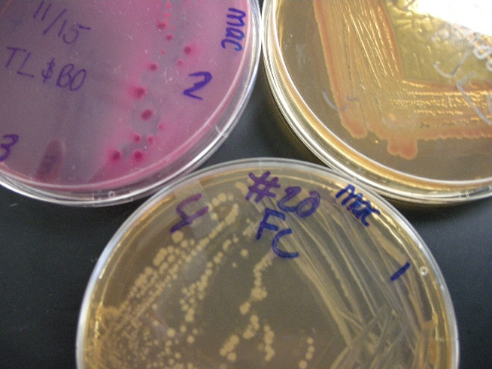

Metabolism & Identification of Microbes
Some of the specialized media that we have worked with in lab is both selective and differential.
The differential properties give us information about bacteria based on its metabolism.
Qs: What is the medium in top picture?
    Is selective …Why? What does it grow?
    Is differential …Why?
    What does the differential property reveal about the bacteria growing there?
Qs: What is the medium in bottom picture?
    Is selective …Why? What does it grow?
    Is differential …Why?
    What does the differential property reveal about the bacteria growing there?
From the Virtual Microbiology Classroom on ScienceProfOnline.com
Images: MacConkey’s Agar (MAC) & Mannitol Salt Agar (MSA), T. Port
Notes:
MacConkey’s
Mannitol Salt

Slide 13
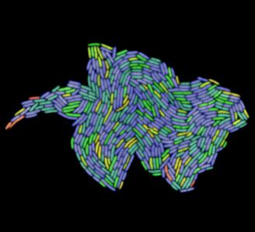
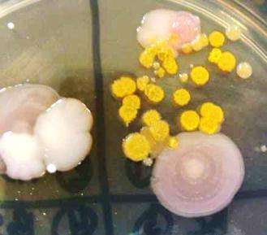
Microbial Growth
Refers to increase in the number of microbes (reproduction) rather than an increase in size of the microbe.
Result of microbial growth is the colony = aggregation of cells arising from single parent cell.
The time required for growth and reproduction is known as the doubling or generation time.
Image: Glowing Colony E. coli from "Aging and Death in E. coli" (2005) PLoS Biol 3(2); Microbes on MacConkeys, T. Port
From the Virtual Microbiology Classroom on ScienceProfOnline.com
Notes:
Number
Size
Colony
Generation time

Slide 14
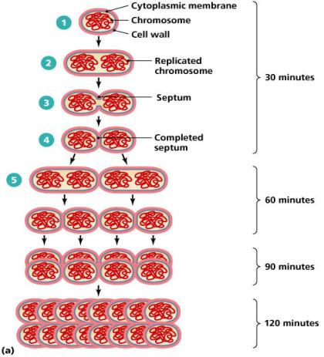
Exponential Growth in Cell Count From Binary Fission
Generation Cell
Number Count
0 1
1 2
2 4
3 8
4 16
5 32
10 1,024
20 1,048,576
Let’s watch a time lapse movie of E. coli population growth.
From the Virtual Microbiology Classroom on ScienceProfOnline.com
Notes:
Logarithmic Growth

Slide 15

Bacterial Population Growth Curve
From the Virtual Microbiology Classroom on ScienceProfOnline.com
Image: Bacterial growth phases, Michal Komorniczak

Slide 16





Generation Time Under Optimal Conditions
(at 37ºC)
Organism Generation Time
Bacillus cereus 28 min
Escherichia coli 12.5 min
Staphylococcus aureus (causes many types of infections) 27-30 min
Mycobacterium tuberculosis (agent of Tuberculosis) 18 – 24 hrs
Treponema pallidum (agent of Syphilis) 30 hrs
Images: B. cereus, E. coli & S. aureus by T. Port; TB culture, Dr. George Kubica PHIL #4428, Treponema pallidum, Dr. Edwin P. Ewing, Jr., PHIL #836
From the Virtual Microbiology Classroom on ScienceProfOnline.com

Slide 17
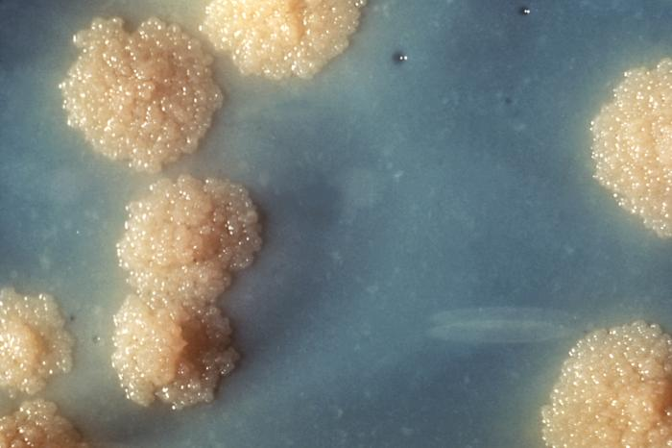
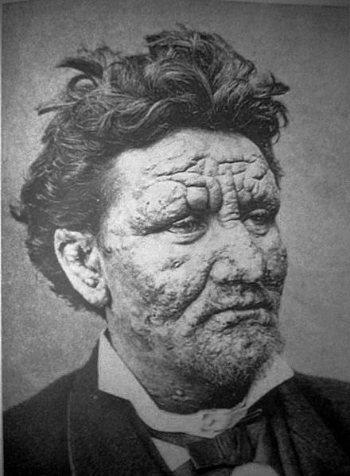
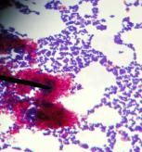
Bacterial Genus: Mycobacterium
GRAM-variable, obligate aerobe, bacillus-shaped
Q: Why Gram variable?
Both leprosy and tuberculosis caused by M. leprae and M. tuberculosis respectively, have plagued mankind for centuries.
Thought that M. tuberculosis and M. leprae evolved from a soil bacterium that infected cows, then made jump to humans about the time of animal domestication, 10,000 years ago.
M. tuberculosis doubles population every 18-24 hours,
M. leprae doubles population about every 14 days.
Q: What might be the impact of generation time on the course of the infectious diseases these microbes cause?
Mycobacteria colonies: Eewwww, looks like ear wax.
Man with Leprosy
Acid-fast stain
The pink is our lab friend Mycobacterium
smegmatis
Images: TB Culture, Public Health Image Library (PHIL) #4428, Dr. George Kubica; 24 yo man from Norway, suffering from leprosy; Pierre Arents; Acid fast stain of Mycobacteria smegmatis & Staph, T. Port
From the Virtual Microbiology Classroom on ScienceProfOnline.com
Notes:
A: Mycobacterium produces mycolic acid as part of its cell wall. This is a wax that protects the bacteria.
Tuberculosis
Leprosy

Slide 18
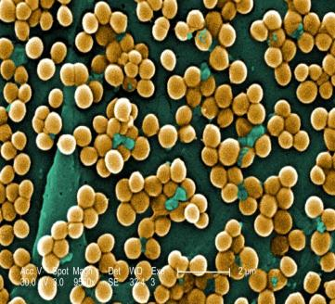
Factors Influencing Microbial Growth
Nutrition
Oxygen
Temperature
pH
Osmotic Pressure
This scanning electron micrograph (SEM) reveals numerous clumps of methicillin-resistant Staphylococcus aureus bacteria, commonly referred to by the acronym, MRSA, by Janice Haney Carr, PHIL #10046
From the Virtual Microbiology Classroom on ScienceProfOnline.com

Slide 19
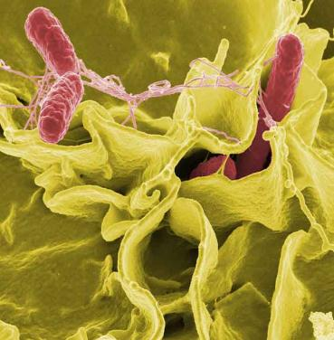
Microbial Nutrition
Organisms use a variety of nutrients for:
  their energy needs
  to build organic molecules & cellular structures.
Most common nutrients contain necessary elements:
  Carbon
  Oxygen
  Nitrogen
  Hydrogen
These 4 elements make up 95% of dry weight of bacterium.
The other 5% is composed of Calcium, Copper, Iron, Magnesium, Manganese, Phosphorus and Iron.
Other elements that are needed are trace elements.
These elements are needed in extremely small amounts, can be obtained through water intake.
From the Virtual Microbiology Classroom on ScienceProfOnline.com
Image: Salmonella, Rocky Mountain Labs NIAID NIH
Notes:
Carbon
trace elements

Slide 20
Microbes & Oxygen
Obligate Aerobes – Need oxygen to stay alive.
Aerobic respiration = Use of O2 to break down food into useable energy.
Obligate Anaerobes – Die in presence of oxygen. It is poisonous to them.
Anaerobic respiration = break down food into useable energy without the use of O2.
Facultative Anaerobes – Not strict aerobes or anaerobes.
Many yeasts and enteric bacteria. Escherichia coli and Staphylococcus aureus.
Microaerophilic bacteria – Require oxygen levels lower that that found under normal atmospheric conditions (Helicobacter pilori – found in stomach).
Aerotolerant Anaerobes – Don’t use oxygen, but are not killed by it.
(Lactobacilli - This genus will make pickles from cucumbers and cheese from milk.)
O₂
From the Virtual Microbiology Classroom on ScienceProfOnline.com
Notes:
Aerobes
Anaerobes
Facultative
Microaerophilic
Aerotolerant

Slide 21
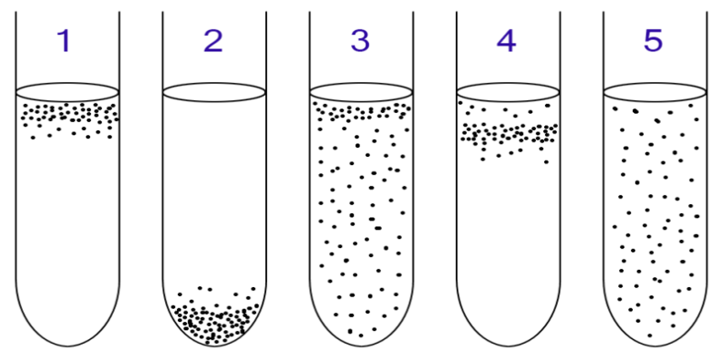
Microbes & Oxygen
Aerobic and anaerobic bacteria can be identified by growing them in liquid culture:
1: Obligate aerobic bacteria gather at top of test tube to absorb maximal amount of oxygen.
2: Obligate anaerobic bacteria gather at bottom to avoid oxygen.
3: Facultative anaerobes gather mostly at the top, since aerobic respiration is most beneficial; but as lack of oxygen does not hurt them, they can be found all along the test tube.
4: Microaerophiles gather at upper part of test tube, not at top. Require O₂, but at low concentration.
5: Aerotolerant bacteria are not affected by oxygen, and they are evenly spread along the test tube.
From the Virtual Microbiology Classroom on ScienceProfOnline.com
Image: Microbial oxygen requirements, Pixie

Slide 22
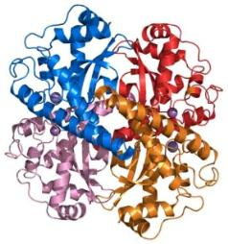
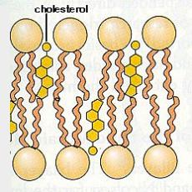
Microbes & Temperature
Proteins
Three-dimensional shape because of the temperature sensitive hydrogen bonds.
These bonds will usually break at higher temperatures, and protein becomes denatured.
Denatured proteins lose function.
Lipids
Also temperature sensitive.
Become brittle if temperature is too low.
If temperature too high, lipids will be more liquid in form.
Outside membrane cannot preserve the integrity of the cell and it will disintegrate.
Images: Superoxide dismutase enzyme structure, Fvasconcellos; Phospholipids & Cholesterol, Cytochemistry.net
From the Virtual Microbiology Classroom on ScienceProfOnline.com
Notes:
Proteins
Denatured
Lipids

Slide 23
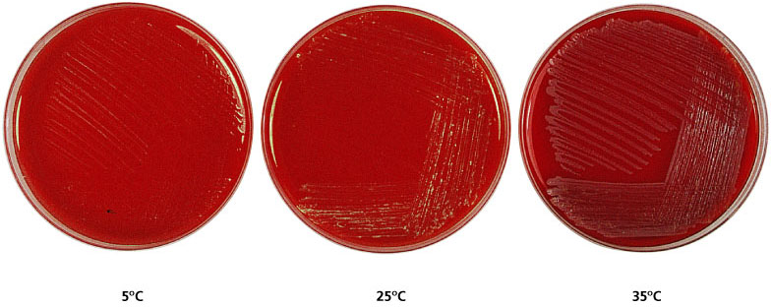
Effects of Temperature on Growth
40ºF
77ºF
95ºF
Most of our plates are incubated at 37ºC (98.6ºF).
Conversion C to F = 1.8 x C + 32
From the Virtual Microbiology Classroom on ScienceProfOnline.com

Slide 24
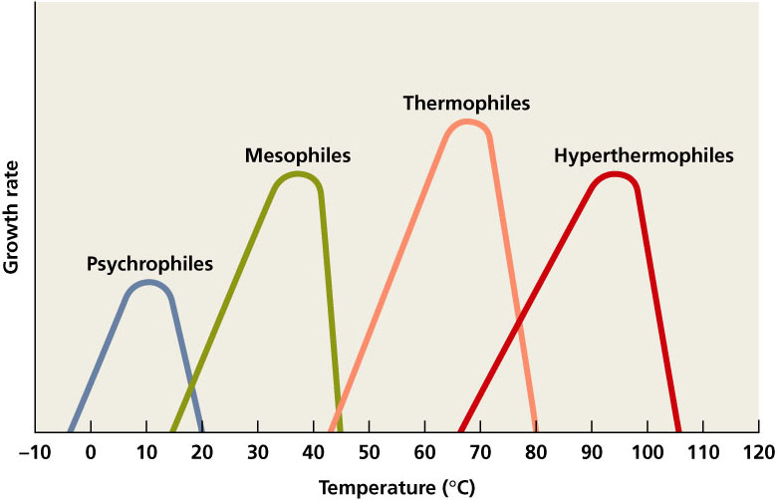
Categories of Microbes Based on Temperature Range

Slide 25

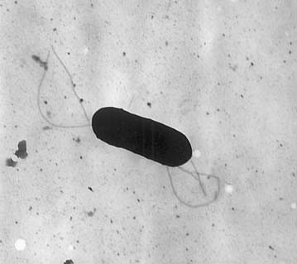

Meet the Microbe! Listeria monocytogenes
Gram positive, rod-shaped psychrophile.
L. monocytogenes is widely distributed; found in soil,
water, animals, birds, insects.
Responsible for disease listeriosis.
Rarely pathogenic in healthy adults (mild flu-like symptoms).
Can be lethal in pregnant women, fetuses, newborns, elderly
and immune compromised, causing meningitis or bacteremia.
Transmitted from environment (contaminated food & water)
to human, except in the case of pregnant woman passing on to
fetus.
In vulnerable populations can have a case fatality rate of 25%.
Facultative intracellular pathogen. Triggers its own phagocytosis.
Listeria are very hardy. Can grow in temperatures ranging from
39°F (refrigerator) to 99°F.
Q: What microbes have we discussed in previous lecture that are
at the other end of the temperature spectrum?
CDC Investigation Announcement:
As of October 6, 2011, a total of 109 persons infected with outbreak-associated strains of Listeria monocytogenes have been reported from 24 states. All illnesses started on or after July 31, 2011.
Twenty-one deaths have been reported: One woman pregnant at the time of illness had a miscarriage.
Image: Listeria monocytogenes, PHIL #2287, Cantaloupe, USDA photo by Scott Bauer. Image Number K7355-11
From the Virtual Microbiology Classroom on ScienceProfOnline.com
Notes:
psychrophile

Slide 26
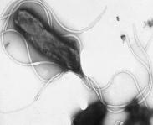
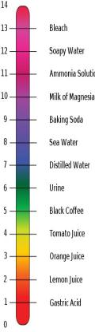
Microbes
& pH
Meet the Microbe!
Helicobacter pylori
As with temperature, bacteria have minimum, optimum and maximum pH ranges.
Neutrophiles
Protozoans and most bacteria have an optimum pH range of 6.5 to 7.5.
pH range of human organs and tissues.
Acidophiles
Most fungi & some bacteria grow best in acid niches.
Obligate acidophiles have to live in an acidic environment.
Acid-tolerant Microbes will survive in an acid environment, but do not prefer that.
• Gram-negative, microaerophilic, and acidophilic bacterium.
• Can thrive in the stomach and upper small intestines and cause ulcers.
• However, many who are infected do not show any symptoms.
• Helicobacter spp. only known microorganisms to thrive in highly acidic environment of stomach.
Images: Helicobacter pylori, Y. Tsutsumi, M.D., Fujita Health University School of Medicine; pH scale, Edward Stevens
From the Virtual Microbiology Classroom on ScienceProfOnline.com
Notes:
Neutrophiles
Acidophiles

Slide 27

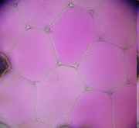
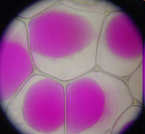

Microbes & Water: Osmotic Pressure
H₂O important reactant in many metabolic reactions.
Most cells die in absence of water.
  Some have cell walls that retain water.
  Q: What genus comes to mind?
  Endospores and cysts can cease most metabolic activity for years.
  Q: What organisms make endospores? Which make cysts?
Cell walls of bacteria prevent them from exploding in a hypotonic environment, but most bacteria are vulnerable in hypertonic environments.
Many bacteria can be plasmolyzed by high concentrations of solutes.
The water moves out of the bacterium and it dies of ‘hyperosmostic shock’ (desiccation).
Q: Why can you keep honey on the cupboard for months, even years, without it spoiling?
Images: Water drop, Fir0002, flagstaffotos.com.au; : Cells, full of water versus plasmolyzed, Mnolf, Wiki
From the Virtual Microbiology Classroom on ScienceProfOnline.com

Slide 28
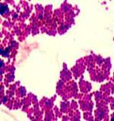

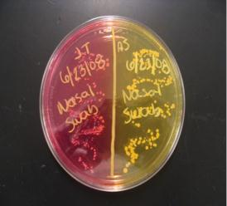
Glycocalyx & Osmotic Pressure
Obligate Halophiles
• Must live in a niche of high salt content.
• Can grow in an environment up to 30% salt.
• If placed within a freshwater environment, they will burst and die.
Facultative Halophiles
• Can survive and tolerate high salt niches, but do not require them to living.
Some bacteria have an additional layer outside of the cell wall called the glycocalyx.
One type of glycocalyx is called a slime layer.
glycoproteins loosely associated with the cell wall.
cause bacteria to adhere to solid surfaces and help prevent the cell from drying out
Meet the Microbe!
The slime layer of Staphylococcus allows it to exist on the salty environment of the skin.
Mannitol Salt
Photo: Sweat on face of runner; Bibikoff; Mannitol salt agar, T. Port
From the Virtual Microbiology Classroom on ScienceProfOnline.com
Notes:
Halophiles
Slime layer

Slide 29
Confused?
Here are links to fun resources that further
explain cellular respiration:
Microbial Growth & Metabolism Main Page on the Virtual Cell Biology
Classroom of Science Prof Online.
Cellular Respiration animation by Jay Phelan, “What is Life? A Guide to Biology”, W. H. Freeman & Co.
Anaerobic Respiration Page by Timothy Paustain, University of Wisconsin, Madison.
Electron Transport Chain animation from Molecular & Cellular Biology Learning Center.
Food Molecules video from HowStuffWorks, a Discovery company.
“The Energy” song by Audiovent.
Diffusion, Osmosis & Active Transport Main Page, Virtual Cell Biology Classroom of Science Prof Online website.
Bacterial growth video and narration, YouTube, Dizzo95..
“The Osmosis Song” music video by Duanie Films.
Smart Links
(You must be in PPT slideshow view to click on links.)
From the Virtual Microbiology Classroom on ScienceProfOnline.com

Slide 30

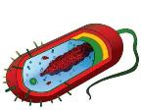
Are microbes intimidating you?
Do yourself a favor. Use the…
Virtual Microbiology Classroom (VMC) !
The VMC is full of resources to help you succeed, including:
practice test questions
review questions
study guides and learning objectives
You can access the VMC by going to the Science Prof Online website www.ScienceProfOnline.com
Images:, Staphylococcus, Giant Microbes; Prokaryotic cell, Mariana Ruiz

