Slide 1

About Science Prof Online
PowerPoint Resources
Science Prof Online (SPO) is a free science education website that provides fully-developed Virtual Science Classrooms, science-related PowerPoints, articles and images. The site is designed to be a helpful resource for students, educators, and anyone interested in learning about science.
The SPO Virtual Classrooms offer many educational resources, including practice test questions, review questions, lecture PowerPoints, video tutorials, sample assignments and course syllabi. New materials are continually being developed, so check back frequently, or follow us on Facebook (Science Prof Online) or Twitter (ScienceProfSPO) for updates.
Many SPO PowerPoints are available in a variety of formats, such as fully editable PowerPoint files, as well as uneditable versions in smaller file sizes, such as PowerPoint Shows and Portable Document Format (.pdf), for ease of printing.
Images used on this resource, and on the SPO website are, wherever possible, credited and linked to their source. Any words underlined and appearing in blue are links that can be clicked on for more information. PowerPoints must be viewed in slide show mode to use the hyperlinks directly.
Several helpful links to fun and interactive learning tools are included throughout the PPT and on the Smart Links slide, near the end of each presentation. You must be in slide show mode to utilize hyperlinks and animations.
This digital resource is licensed under Creative Commons Attribution-ShareAlike 3.0:
http://creativecommons.org/licenses/by-sa/3.0/
Tami Port, MS
Creator of Science Prof Online
Chief Executive Nerd
Science Prof Online
Online Education Resources, LLC
info@scienceprofonline.com
Alicia Cepaitis, MS
Chief Creative Nerd
Science Prof Online
Online Education Resources, LLC
alicia@scienceprofonline.com
From the Virtual Biology Classroom on ScienceProfOnline.com
Image: Compound microscope objectives, T. Port
Notes:
Welcome to Science Prof Online PowerPoint Resources!
This PowerPoint Presentation comes from the Virtual Cell Biology Classroom of Science Prof Online, and, as such, is licensed under Creative Commons Attribution-ShareAlike 3.0.; meaning you can download, share and alter any of this presentation, but you can’t sell it or repackage and sell any part of it. Please credit Science Prof Online as the source of this presentation. Please abide by credited image copyrights. Thank you for using this resource.

Slide 2
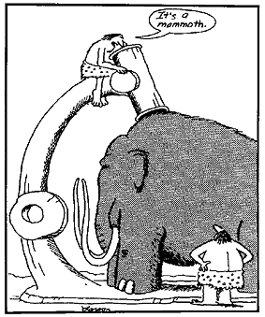
How to Use a Compound Microscope
Basic Microscopy
From the Virtual Biology Classroom on ScienceProfOnline.com
Image: The Far Side by Gary Larson

Slide 3
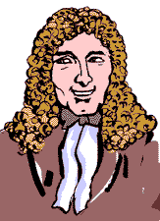
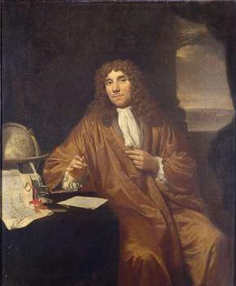
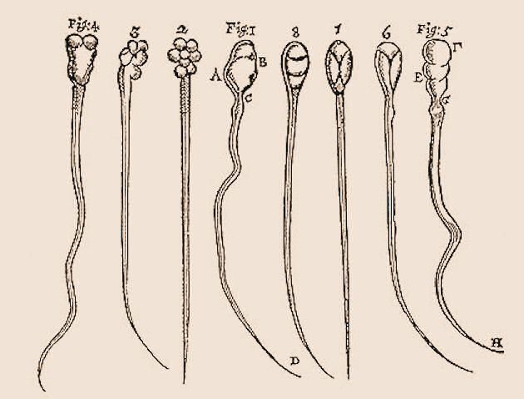
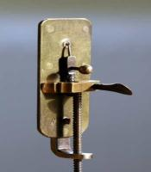
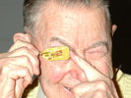
Spontaneous Generation Debate
Anton van Leeuwenhoek’s “Animalcules”
(Pronounced Lay-ven-hook)
1632 - 1723
As a draper (merchant who sells cloth and dry goods), he used lenses to examine cloth. This probably led to his interest in lens making.
He assembled hundreds of microscopes, some of which magnified objects 270 times.
As he looked at things with his microscopes, he discovered “micro” organisms - organisms so tiny that they were invisible to the naked eye.
He called these tiny living organisms “animalcules”. He first described bacteria, protozoans and many cells of the human body.
LISTEN to the Radiolab episode “Sperm” to learn how Anton let his freak flag fly!
♬ Sing It SUPER FREAK!! ♬
Images: Leeuwenhoek portrait 1680, Jan Verkolje (I);Replica of Leeuwenhoek microscope, Jacopo Werther; Man with scope, source unknown; Background image is sperm that van Leeuwenhoek drew.
From the Virtual Biology Classroom on ScienceProfOnline.com

Slide 4

Anton van Leeuwenhoek: “Animalcules”
(Pronounced Lay-when-hook)
WATCH THIS:
“Pond Life Under the Microscope”
Below is a poem about Van Leeuwenhoek by Maxine Kumin, from the fantastic book of science-related poetry The Tree That Time Built.
The Microscope
Anton Leeuwenhoek was Dutch. He sold pincushions, cloth, and such.
The waiting townsfolk fumed and fussed, as Anton’s dry goods gathered dust.
He worked, instead of tending store,
At grinding special lenses for
A microscope. Some of the things
He looked at were: mosquitoes’ wings,
the hairs of sheep, the legs of lice,
the skin of people, dogs, and mice;
ox eyes, spiders’ spinning gear,
fishes’ scales, a little smear
of his own blood, and best of all,
the unknown, busy, very small
bugs that swim and bump and hop
inside a simple water drop.
Impossible! Most Dutchmen said.
This Anton’s crazy in the head!
We ought to ship him off to Spain!
He says he’s seen a housefly’s brain!
He says the water that we drink
Is full of bugs! He’s mad, we think!
They called him dumkopf, which means dope.
That’s how we got the microscope.
From the Virtual Biology Classroom on ScienceProfOnline.com
Notes:
Leuwenhoek

Slide 5
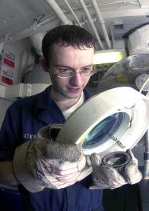
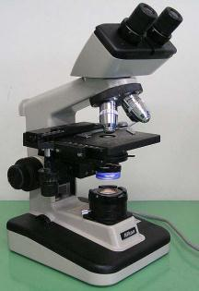
Compound Light Microscope
The “Compound” Part
Simple microscopes have single magnifying lens (like a magnifying glass).
Compound microscopes have two sets of lenses for magnification.
Lens closer to the eye = ocular lens (magnifying power of 10x).
Lenses closer to the object being viewed = objective lens. (Most light microscopes used in biology have three or four objective lenses).
The “Light” Part
Bright-field light microscopes produce a dark image against brighter, backlit background.
Provide a 2-D image.
Commonly used to view stained cells.
Image: Magnifying lamp use to look for part defects, US Navy; Compound light microscope, Moisey
From the Virtual Biology Classroom on ScienceProfOnline.com

Slide 6
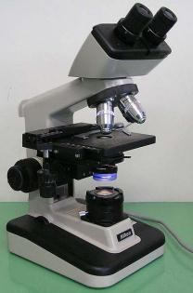
Your Microscope
Take Care of Your Scope:
  It is your responsibility to take care of your scope and learn to use it properly.
  I randomly check scopes to see if they are put away correctly. If yours is not, I may subtract points from your lab grade.
Getting Scope Out:
  When transporting your scope, always hold it with one hand under the base, and one hand around the arm.
Putting Scope Away:
  Clean stage if it is messy, and use lens paper to clean lenses.
  Shortest objective lens (the one with the red band) should be pointing down toward stage.
  Use course focus to position stage as low as it can go.
  ** Now everyone get out their scope **
ARM
BASE
From the Virtual Biology Classroom on ScienceProfOnline.com
Image: Compound light microscope, Moisey

Slide 7

Parts of a Compound Light Microscope
From the Virtual Biology Classroom on ScienceProfOnline.com
Image: Compound light microscope, Moisey

Slide 8
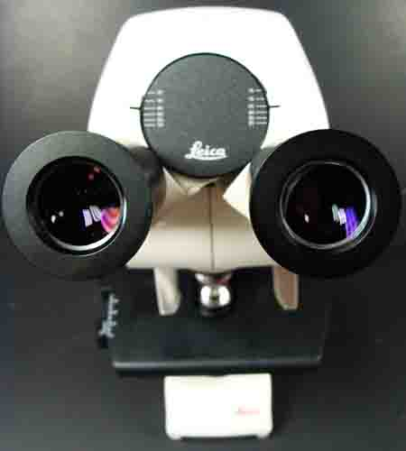
Magnification & The Ocular Lenses
Ocular lens magnifies the specimen 10x.
You will always be looking through the ocular and objective lens simultaneously, so multiply ocular magnification x objective power to calculate the Total Magnification (xTM).
From the Virtual Biology Classroom on ScienceProfOnline.com
Image: Microscope objective lenses, T. Port

Slide 9
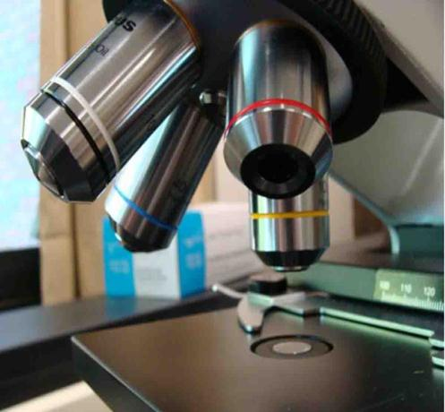
Magnification & The Objective Lenses
Ocular lens magnifies the specimen 10x.
You will always be looking through the ocular and objective lens simultaneously, so multiply ocular magnification x objective power to calculate the Total Magnification (xTM).
Rotary nosepiece of your microscope has four objective lenses attached.
Shortest lens (red band) should have been pointing down when your scopes were last put away.
From the Virtual Biology Classroom on ScienceProfOnline.com
Image: Microscope objective lenses, T. Port

Slide 10
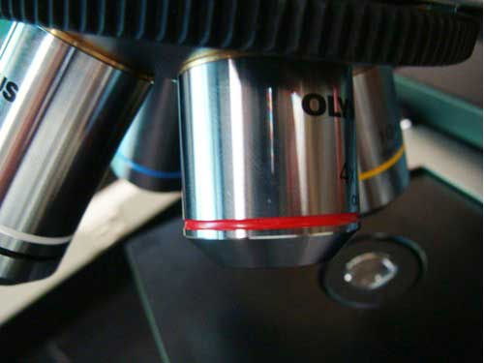
Scanning Power Objective Lens
Red band around it.
Magnifies objects 4x.
Q: What is the Total Magnification? ____ TM
Usually, if you have trouble finding the specimen at this magnification it means that the stage is too low (use coarse focus to adjust), or that the specimen is not centered
From the Virtual Biology Classroom on ScienceProfOnline.com
Image: Microscope objective lenses, T. Port

Slide 11
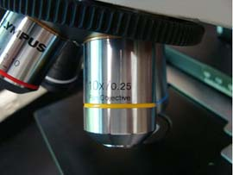
Low Power Objective Lens
Has yellow band around it.
Magnifies objects 10x.
Q: What is the Total Magnification? ____ TM.
Q: What does the term parfocal mean?
From the Virtual Biology Classroom on ScienceProfOnline.com
Image: Microscope objective lenses, T. Port

Slide 12
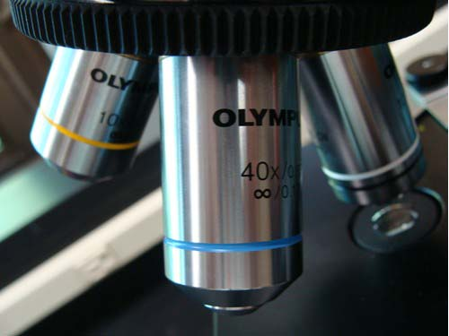
High Dry Objective Lens
Has blue band around it.
Magnifies objects 40x.
Q: What is the Total Magnification? ____ TM
Switch to this lens after getting your specimen in focus at 100xTM.
From the Virtual Biology Classroom on ScienceProfOnline.com
Image: Microscope objective lenses, T. Port

Slide 13
Confused?
Here are links to fun resources that further explain use of the microscope:
Microscopy Laboratory Main Page on the Virtual Microbiology Classroom of Science Prof Online.
Compound Microscope Parts and Use video from Science ProfOnline.
How to Make a Wet Mount of a Cheek Cell video from ScienceProfOnline.
Play Amoeba, a video game where you are an amoeba that eats and grows.
Microscope Mania crossword puzzle.
Microscopic Pond Life, an extremely cool collection of videos of a variety of microscopic pond life to the tune of Radiohead’s “Kid A”.
Smart Links
(You must be in PPT slideshow view to click on links.)
From the Virtual Biology Classroom on ScienceProfOnline.com

